Slide 1
Results of the project till now

Slide 2
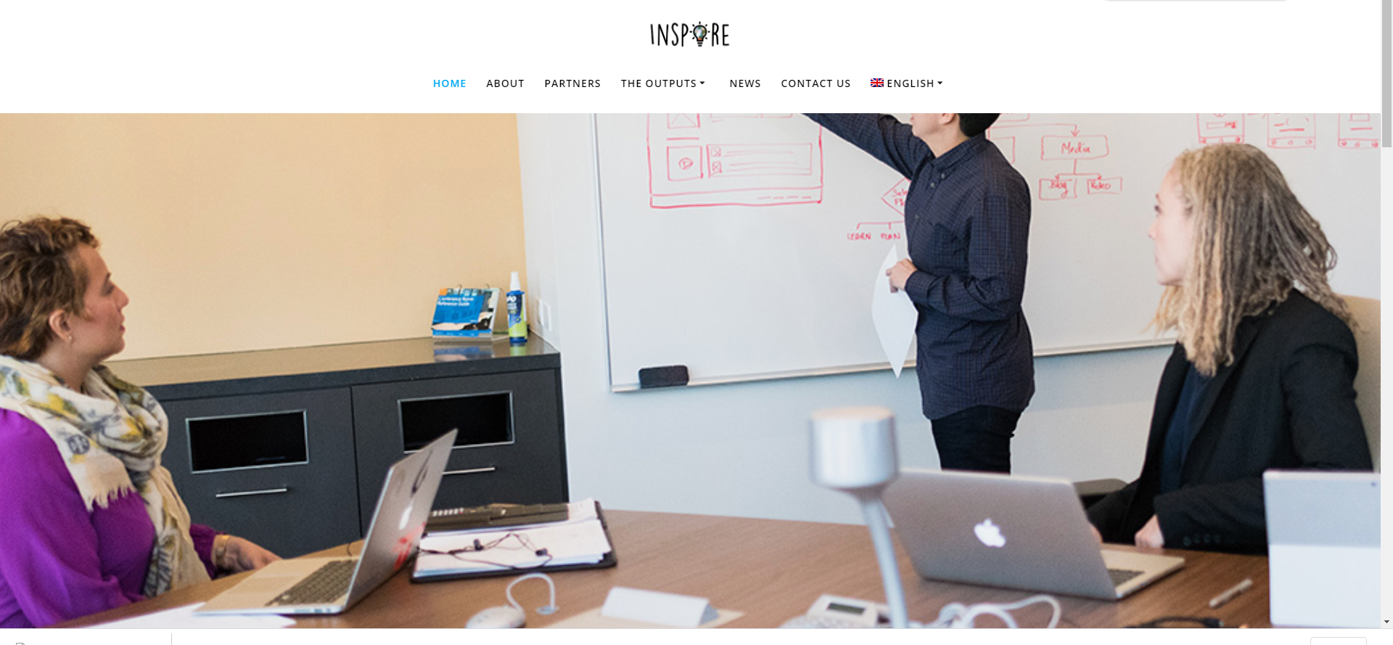
WEBSITE
You can visit our website to find out all details of the project

Slide 3
In the methodological guide you will find:
Youth unemployment rates in Europe
How entrepreneurship can be used as a tool to fight unemployment
Characteristics of Startups in Partners countries
What is Sustainable Development Goals (SDGs) and initiatives for their promotion in Europe
How social-startups can help towards SDGs
Educational projects that promotes Social entrepreneurship
Intellectual Output 1
Methodological guide of INSPIRE
project

Slide 4
The Guide is under development and we need your feedback in today's activities and presentation to make it better!!!!
Main contents:
Career Development and Vocational choices
Skills, competences and personality
Psychometric methods and tools
Roles in a social entrepreneurship
Importance of Teambuilding
Intellectual Output 2
Learning training guide for
career development and psychometric methods.

Slide 5
The Guide is under development and we need your feedback in its activities and presentation to make it better the following days!!!!
Main contents of part 1:
Business models for Social enterprises
SDGs and Social enterprises
Skills and competences of Social entrepreneurs
Activities and tools to develop a strategy for a social enterprise to deal with SDGs
Main contents of part 2:
Social medias in social enterprises
Effective use of social media
Activities and tools to develop a social media strategy for a social enterprise
Intellectual Output 3
Learning training guide for viable Social Enterprises business models addressing challenges based on SDGs (Sustainable Development Goals) and for effective use of Social Medias

Slide 6
First brainstorming on the main concept and mechanics of the game
Intellectual Output 4
Innovative psychometric Serious Game

Slide 7
Newsletters

Slide 8
Newsletters

Slide 9
Newsletters

Slide 10
Press Releases

Slide 11
Kick off
meeting

Slide 12
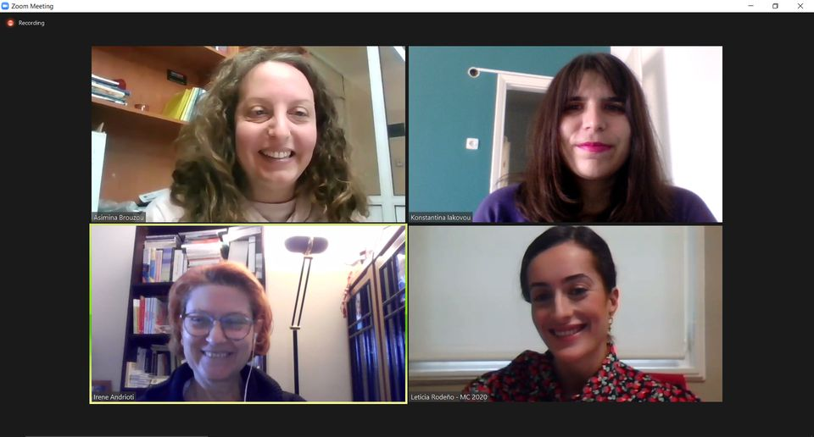
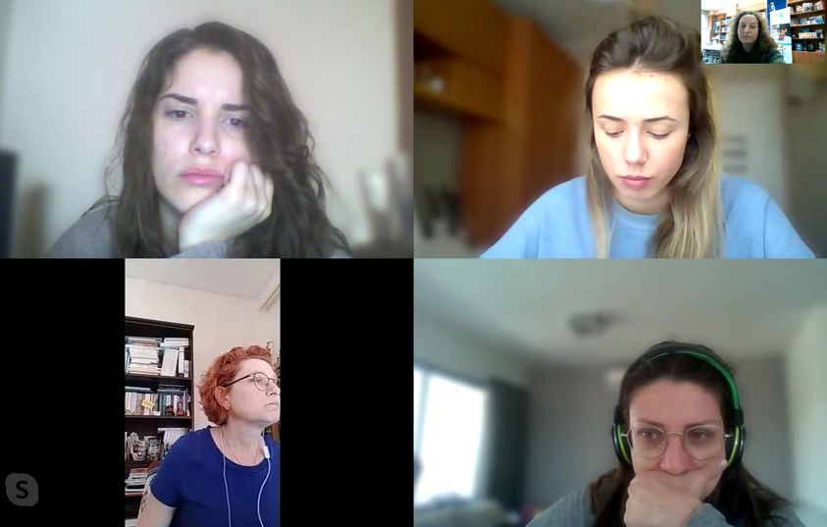
Online
meetings

Slide 13
INSPIRE
2019-3-EL02-KA205-005215
THANK YOU!!
This presentation is related to the Project made by the beneficiaries jointly or individually in any form and using any means shall indicate that it reflects only the authors view and tha the National Agency and the European Commision are not responsible for any use that may be made of the information it contains.

