Slide 1
IO3 – Learning Training Guide for Viable Business Models of Social Enterprises addressing SDG’s and Use of Social Media

Slide 2
OBJECTIVE
To encourage youngsters to create successful Social Enterprises based on Sustainable Development Goals (SDG’s) through:
best practices
examples
keys for the effective use of Social Media
best practices
keys for the effective use of Social Media

Slide 3
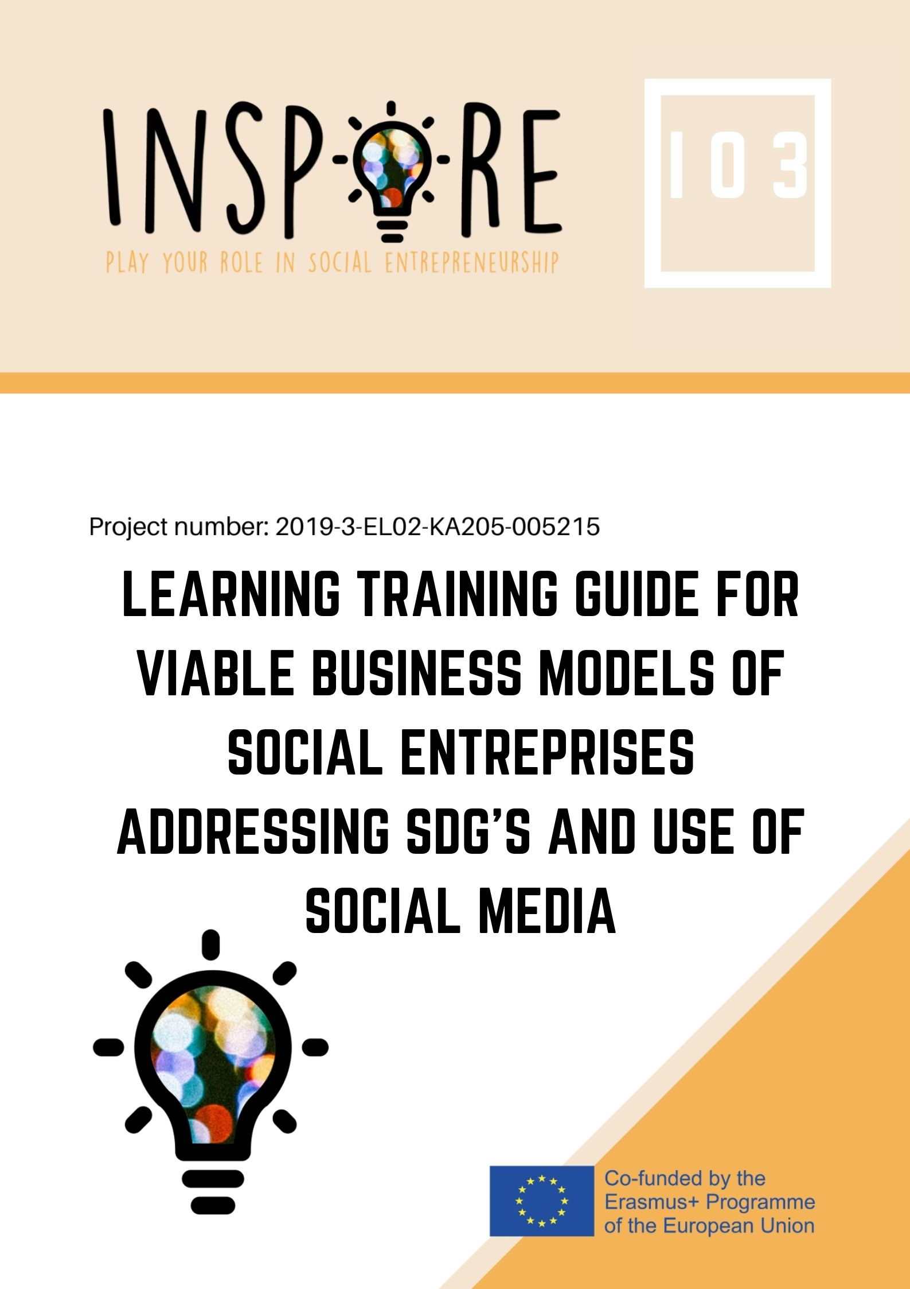
Brief overview on social entrepreneurship and SDGs
Types of business models for social enterprises
Management skills every social entrepreneur should boost
CONTENTS
(PART 1)
Challenges and opportunities for new social entrepreneurs based on SDGs
Successful examples of social enterprises
Activities to promote social entrepreneurship

Slide 4
SOCIAL ENTREPRENEUSHIP AND SDG’s
Clarifying concepts

Slide 5
SOCIAL ENTREPRENEURSHIP
Social enterprises are characterized by generating social impact, by having an entrepreneurial dimension and by its governance structure (workers, customers and stakeholders are involved in the management)
SOME DEFINITIONS

Slide 6
SUSTAINABLE DEVELOPMENT GOALS
Enterprises involved in social economy are, mostly, committed with SDGs
Social economy fosters a business model based on the primacy of the individual over capital, in which business efficiency is combined with solidarity, responsibility and social cohesion
SDG’s are a collection of 17 interlinked goals designed to be a "blueprint to achieve a better and more sustainable future for all".
SOME DEFINITIONS

Slide 7
TYPES OF BUSINESS MODELS FOR SOCIAL ENTREPRENEURS
Our proposal

Slide 8
Type | Description | Example
PROVISION | These kind of enterprises contribute to the achievement of a given SDG through the free provision of goods and services | Greenpeace
SELF-HELP | This model aims at creating value through the productive integration of a target group, for instance: empowering disadvantaged groups | Ocean clean-up
DEPLOYMENT | Characterized by achieving economic sustainability with the combination of social with commercial value. They create goods and services which are marketable | Kruger National Park in South Africa
PROMOTION | Pursues a supportive mission, such as the provision model, but it commercializes a product or service | “By-1-donnate-1” models
SDG – BASED BUSINESS MODEL

Slide 9
Social Enterprise Canvas
SWOT analysis
5 whys technique
USEFUL TOOLS FOR ENTREPRENEURS
Validation Board
Elevator Pitch Builder
Tree Diagrams

Slide 10
MANAGEMENT SKILLS EVERY SOCIAL ENTREPRENEUR SHOULD BOOST
IO2 wrap up

Slide 11
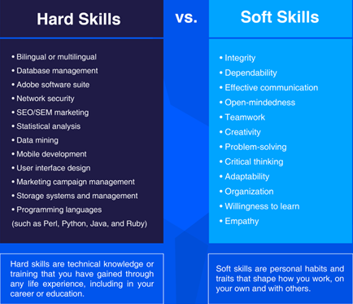
SKILLS FOR A SOCIAL ENTREPRENEUR

Slide 12
ALIGNMENT OF KEY COMPETENCES WITH LABOUR RELATIONS OF THE SOCIAL ENTERPRISE
Organization
Autonomy
People as the core value of the company
Participation in management
Retributive solidarity
Inter-cooperation
Social transformation
Universal character
Education

Slide 13
CHALLENGES AND OPPORTUNITIES FOR NEW SOCIAL ENTREPRENEURS

Slide 14
CHALLENGES
OPPORTUNITIES
Austerity measures and financial pressures
Reduced budget for grants to social enterprises
Difficult access to finance
Lack of awareness on social economy and entrepreneurship
Difficulties in finding appropriate training or mentors
Not strong enough networks of social entrepreneurs
Possibility of playing an important role in crisis scenarios (due to their social mission)
Diversification of funding sources (governments, private sector, awards, crow funding, etc.)
Labour intensive sector rather than capital intensive
ITCs as an ally on business development and management
High probabilities of making strong bonds with the community
Many guidelines and resources that approach SDGs

Slide 15
OPPORTUNITIES BASED ON SDGs
Access to new markets (food, agriculture, sustainable cities, etc.)
Cost saving
Generation of new partnerships and agreements with large companies
Public sector contracts
Improving reputation and increasing brand confidence
Early compliance with laws and regulations
Promotion of more resilient and prosperous communities

Slide 16
ACTIVITIES TO PROMOTE SOCIAL ENTREPRENEURSHIP

Slide 17
1. What is social entrepreneurship?
2. Setting up my own social enterprise
3. What makes a successful businesswoman?
4. The game of 5 “whys”
5.Marmalade game
8. The Life Skills program – Developing Social Entrepreneurs
9. Grassroots U
6. Solve a challenge – support SDGs
7. Find your role
10. Mentorship sessions
11. Theory of Change

Slide 18
SUCCESSFUL SOCIAL ENTREPRISES
Sneak peek of our selection

Slide 19
NAME | 2. Give Med Share
Country of operation | Greece
Legal nature | Non-profit companies
Size (team members) | 4 - micro enterprise
Products/ Services | App and web platform that gives people immediate access to the medicines they need. One can easily and quickly donate the medicines no longer needed to social pharmacies, nursing homes and other charities.
Website/Social Media | https://givmed.org/en/
Addressed SDGs | People: No poverty - Good health and wellbeing
Impact | Since 2016 1 million euro of medicines was donated for helping 50000 people
Supporters | It is supported by numerous companies, foundations from Greece and international such as Roddenberry Foundation, Tima foundation, Latter-day Saint Charities, A G Leventis foundation, Campari, ELPE, The Hellenic Initiative.
Challenges | In Greece there is a lack of an organized system for the collection and management of medicine. GivMed had to invent a whole supply chain.
PROVISION

Slide 20
GIVE MED SHARE – SOCIAL BUSINESS CANVAS
Mission Statement |  |  |  |  | + Externalities
Problem | Key Activities Collecting unused medicine Redistribute them to various channels | Value proposition Access to medicines for all | Beneficiary relationships | Beneficiaries Uninsured people are socially vulnerable groups, and people (usually women) who have medicines that they don’t use anymore
Solution | Key Metrics |  | Channels App Web platform | Key partners Relative NGOs, Health sector companies, Social pharmacies, Nursing houses, Companies, Citizens (Donors) | - Externalities
Cost structure Value-Driven |  | Financial sustainability Lending

Slide 21
NAME | 5. Synthesis Center for Research and Education Ltd
Country of operation | Nicosia, Cyprus
Legal nature | n/d
Size (team members) | Micro entreprise
Products/ Services | Company aiming to develop social entrepreneurship in Cyprus. They implement projects with positive social impacts and acts as training provider. They founded and operate “HUB Nicosia”, a collaborative working space for organisations with a social purpose, as well as an educational centre.
Website/Social Media | https://www.hubnicosia.org/about-us https://www.facebook.com/synthesis.cyprus/
Addressed SDGs | Alliances
Impact | Their beneficiaries are people who are at the risk of social exclusion, including NEET youth, migrants, people with disabilities, or those with fewer opportunities. Their work focuses on developing a combination of knowledge, values and skills which will mobilise youth and adults to engage in civic, political and economic life fully.
Supporters | Member of: EUclid network, Diesis network, European Network of innovation for inclusion
Challenges | n/d
SELF - HELP

Slide 22
NAME | 7. Apadrinaunolivo.org
Country of operation | Oliete, Teruel, Spain
Legal nature | NGO
Size (team members) | Micro-enterprise (10 members)
Products/ Services | Sponsor an olive
Website/Social Media | Website: https://apadrinaunolivo.org/es/quienes-somos Instagram: https://www.instagram.com/adoptaunolivo/
Addressed SDGs | Planet: As well as prosperity and people
Impact | More than 4,000 sponsors and more than 8,300 olive trees recovered, FiturNext 2020 Challenge award, “Young Social Entrepreneurs Award” in 2015, winners of the international tournament EVO-IOCC 2020
Supporters | Fundación Telefónica, Stilh, Bellota, New Holand, Fundación la Caixa, Lush, Fundación Nina Carasso, Zeleris, Provincial Council of Teruel, Oliete’s City Council, Aragon’s Regional Government
Challenges | Production of sufficient oil in order to be a sustainable project.
DEPLOYMENT

Slide 23
APADRINA UN OLIVO – SOCIAL BUSINESS CANVAS
Mission Statement |  |  |  |  | + Externalities Environmental sustainability Economic growth for Oliete’s inhabitants
Problem Depopulation Environmental consequences of the abandonment of olive trees Lack of opportunities | Key Activities Sponsorship of the olives, Production of olive oil, Learning program, Employment workshops, Partnerships with other NGOs/public administration, Participation in summits such as “South Summit” | Value proposition Empower inhabitants from Oliete in the recovery, conservation and enhancement of the century-old abandoned olive grove, generated in those peoples involved a sustainable economy with social inclusion | Beneficiary relationships Personal; establishment of a close bond with the initiative due to its reliance on the project and shared values | Beneficiaries Uninsured people are socially vulnerable groups, and people (usually women) who have medicines that they don’t use anymore
Solution Empower inhabitants in the recovery, conservation and enhancement of the century-old abandoned olive grove, generated in those peoples involved a sustainable economy with social inclusion. | Key Metrics Number of olive trees sponsored Acknowledgements Population growth in the target place Economic revenues from products
 |  |  | Channels Phone, email, social networks and face to face | Key partners Local/National public administration, Foundations, businesses | - Externalities N/D
Cost structure N/D |  | Financial sustainability It is economically sustainable: Revenues from the oil that is sold, Contributions from companies and institutions, Contribution of the olives’ sponsors’

Slide 24
ACTIVITY 2

Slide 25
AIM: To solve a real life problem which is connected with an SDG through the lenses of social entrepreneurship
Try to find an innovative idea of social enterprise for solving a challenge based on a SDG: describe it briefly and try to complete the social business canvas
SOLVE A CHALLENGE – Support SDGs

Slide 26
SOCIAL BUSINESS CANVAS TEMPLATE
Mission Statement |  |  |  |  | + Externalities
Problem | Key Activities | Value proposition | Beneficiary relationships | Beneficiaries
Solution | Key Metrics
 |  |  | Channels | Key partners | - Externalities
Cost structure |  | Financial sustainability

Slide 27
ACTIVITY 3

Slide 28
AIM: To identify what you do well, to address what you're lacking, to minimize risks, and to take the greatest possible advantage of chances for success.
Please complete the SWOT analysis for the idea of social enterprise previously designed
SWOT ANALYSYS
STRENGHTS
WEAKNESSES
OPPORTUNITIES
THREATS

Slide 29
THANK YOU!!
This presentation is related to the Project made by the beneficiaries jointly or individually in any form and using any means shall indicate that it reflects only the authors view and the National Agency and the European Commission are not responsible for any use that may be made of the information it contains.

