Slide 2
CREATE PROMOTE INSPIRE
C.I.P. Citizens In Power (CIP) is a non-profit, educational and research organization. CIP constitutes one of the leading organizations in Cyprus in the fields of global education, social innovation, entrepreneurship, STEM and sustainable growth.

Slide 3
MISSION
Our team designs and implements cross-sectoral, interdisciplinary approaches, as a response to fundamental social, educational and environmental challenges and policy gaps.

Slide 4
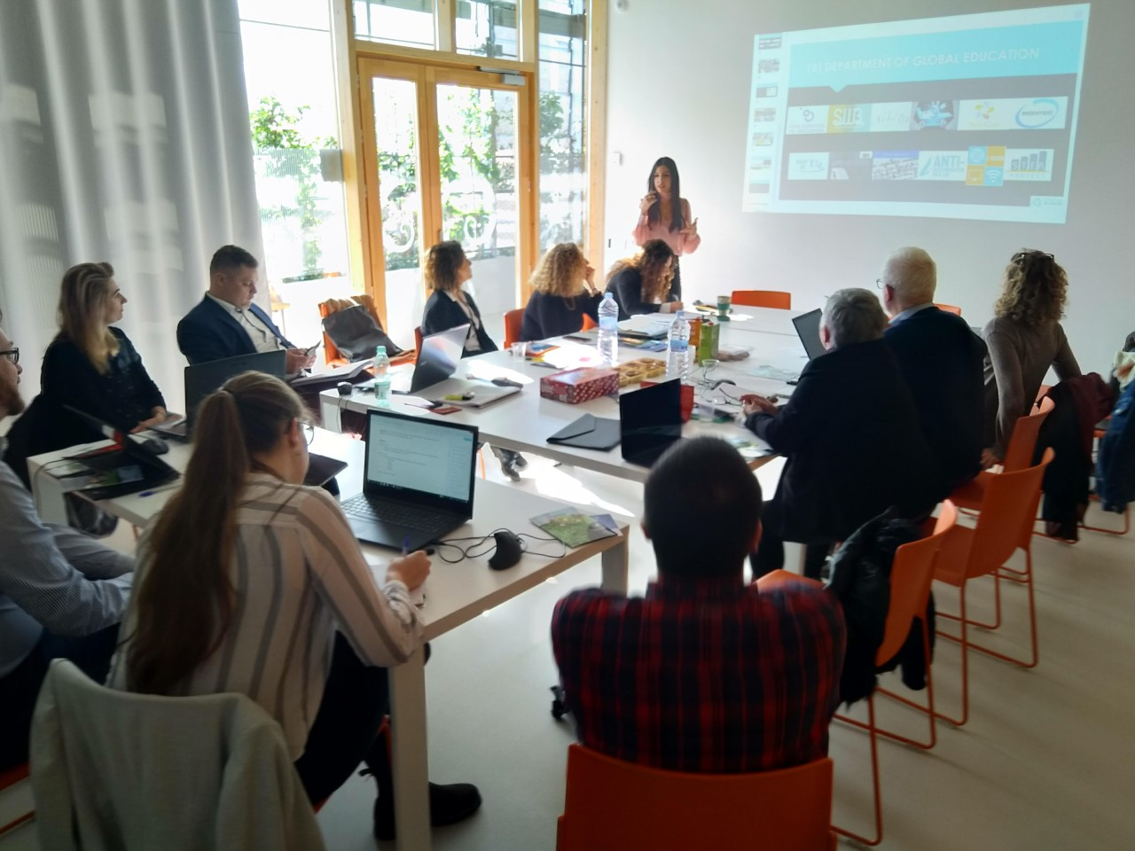
EUROPEAN PROJECTS
100 completed EU-funded projects
Currently running 55 European projects:
- Erasmus+ KA1, KA2, KA3
- Erasmus For Young Entrepreneurs
- COSME
- ENI CBC MED
- REC
- AMIF
Currently coordinating 8 Erasmus+ KA2 and KA3

Slide 5
CIP’s Departments
NEW TECHNOLOGIES
AND INNOVATION
CULTURAL AND
HUMANITARIAN AFFAIRS
STEM EDUCATION
AND RESEARCH
ENTREPRENEURSHIP

Slide 6
CULTURAL AND
HUMANITARIAN AFFAIRS

Slide 7
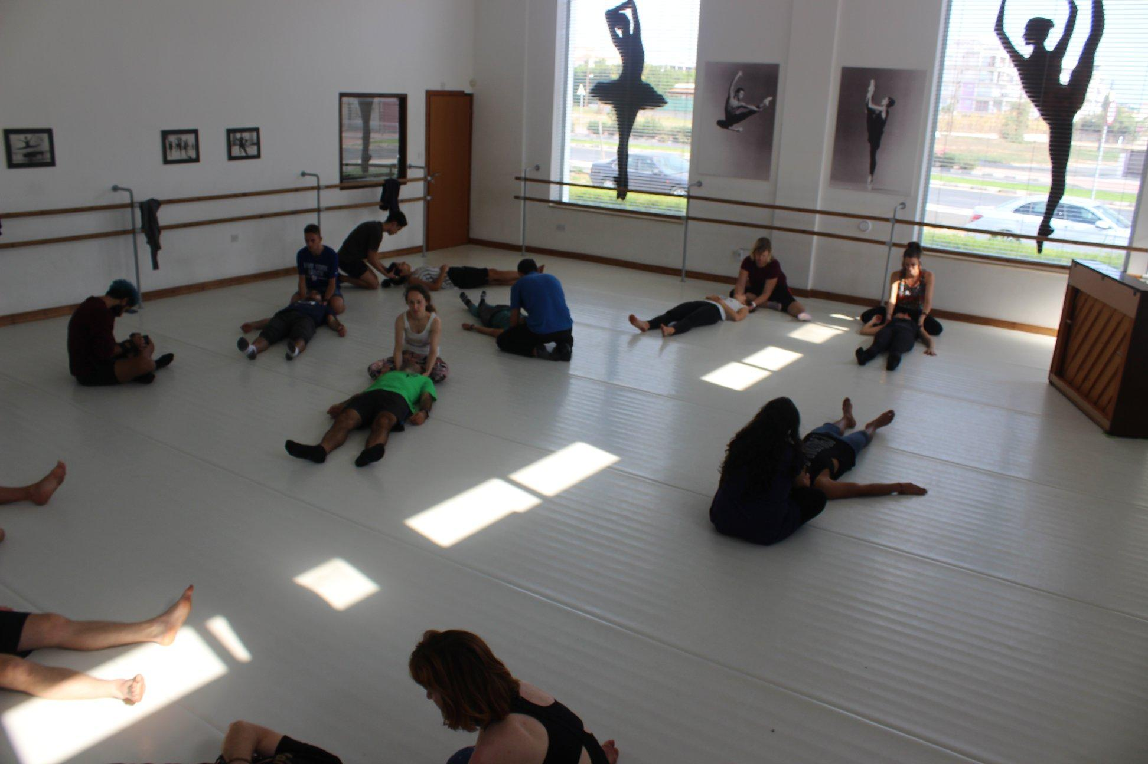
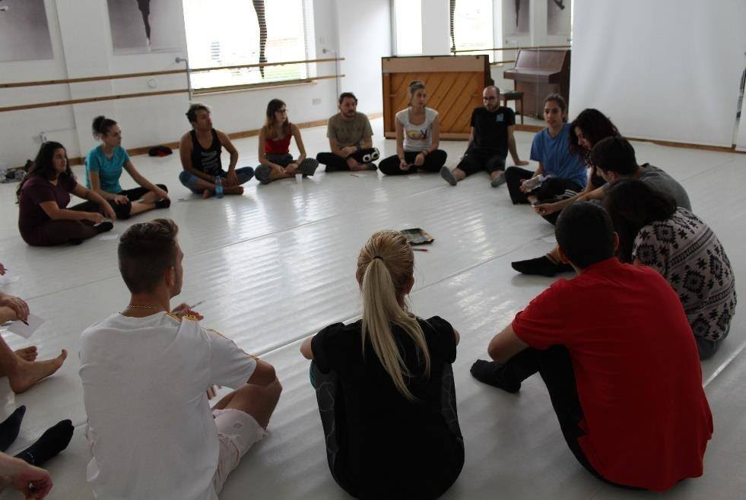
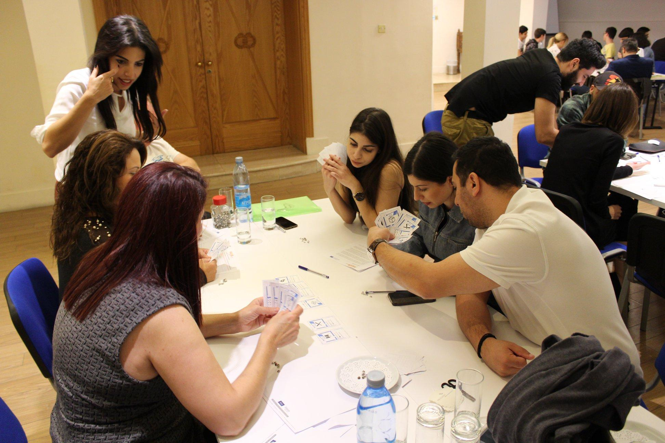
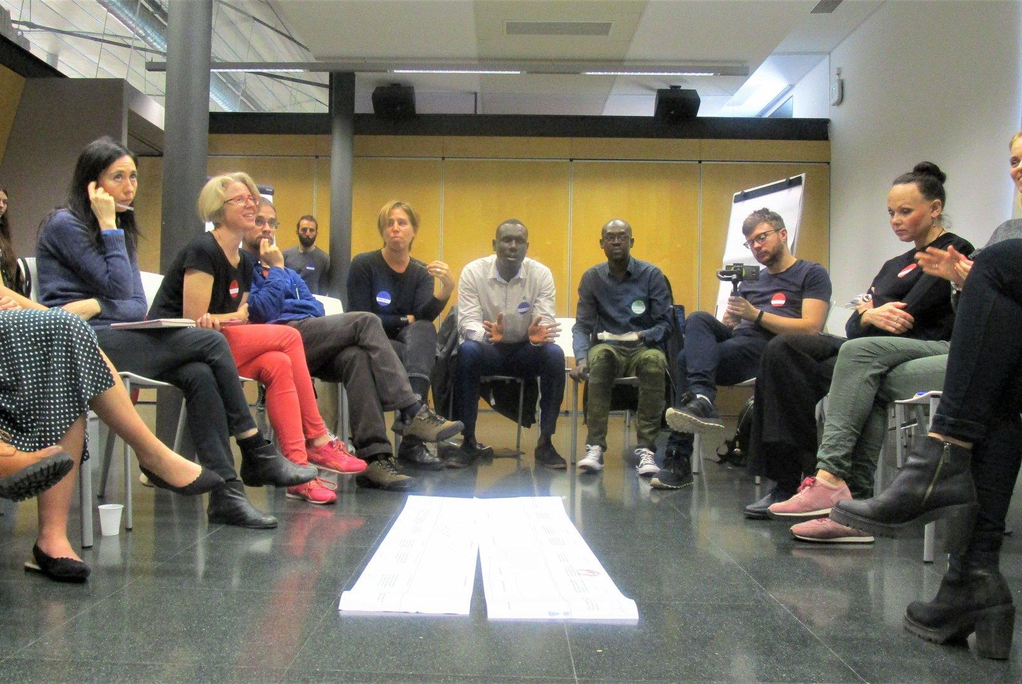

Slide 8
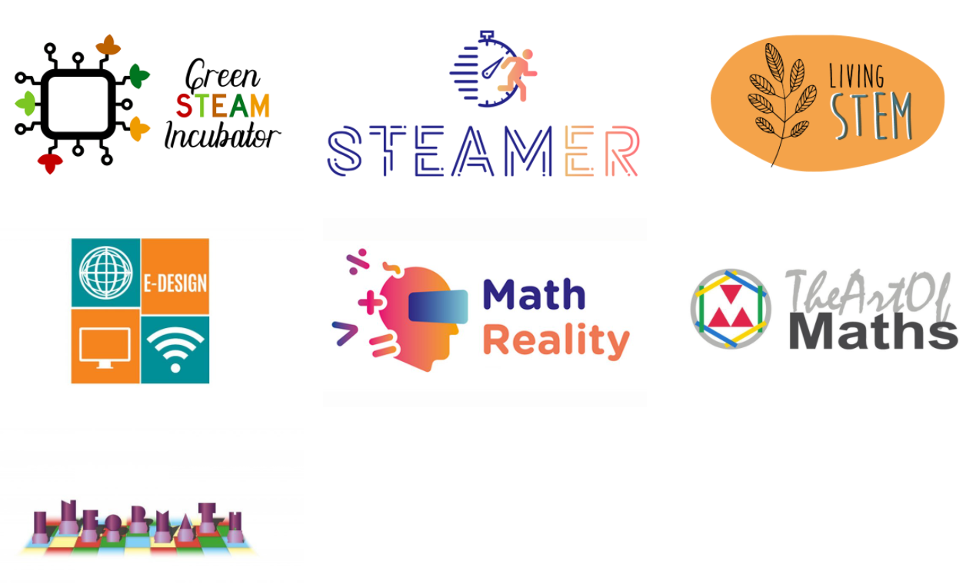
STEM EDUCATION
AND RESEARCH

Slide 9
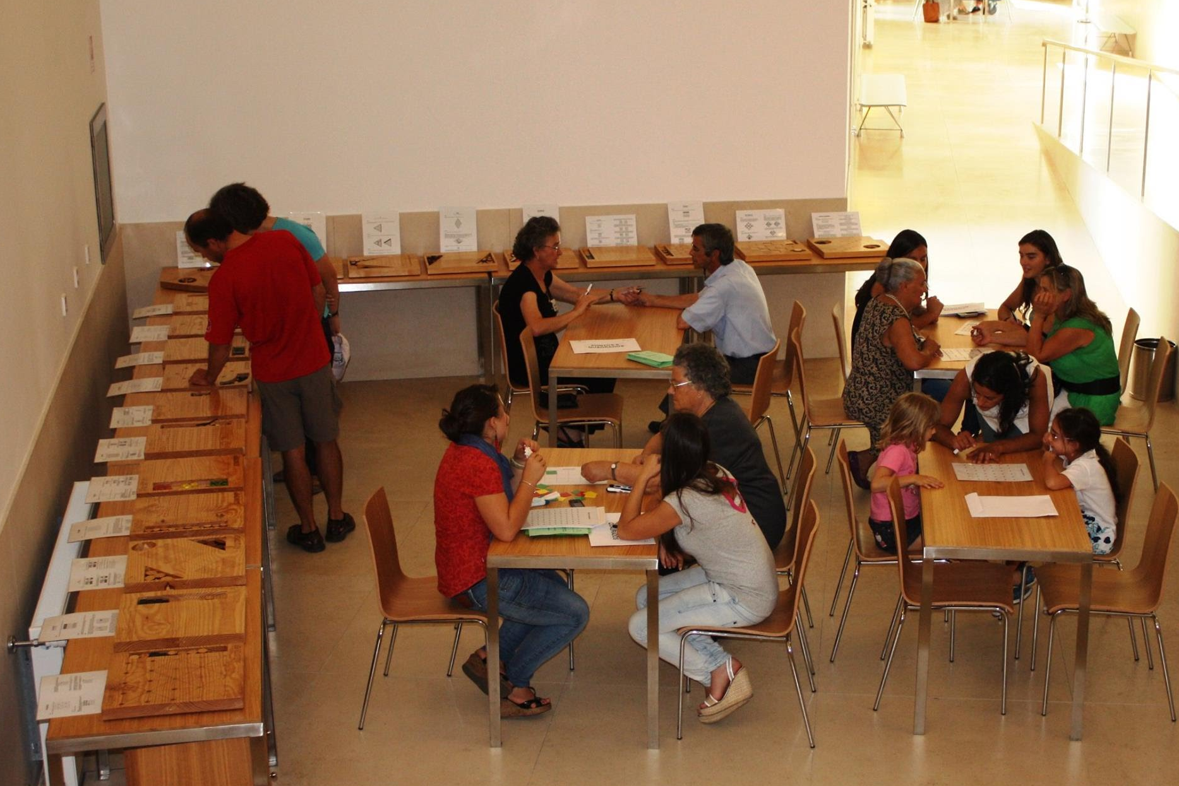
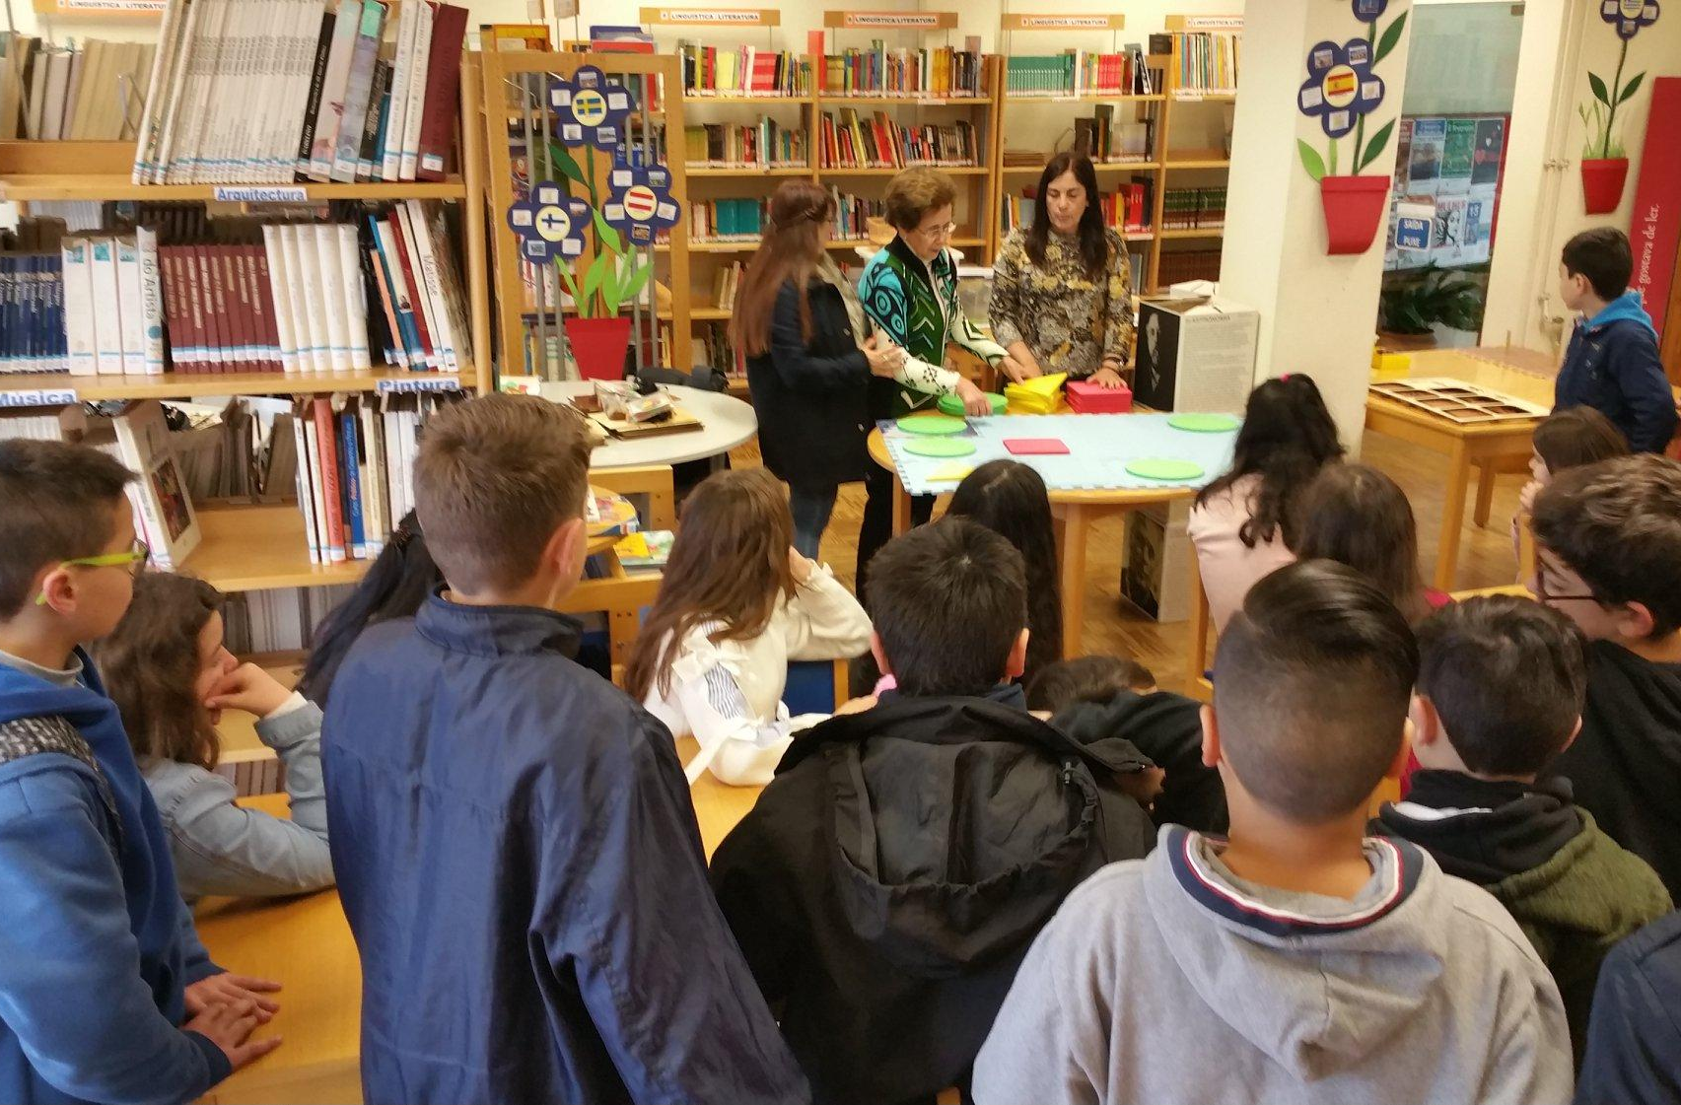
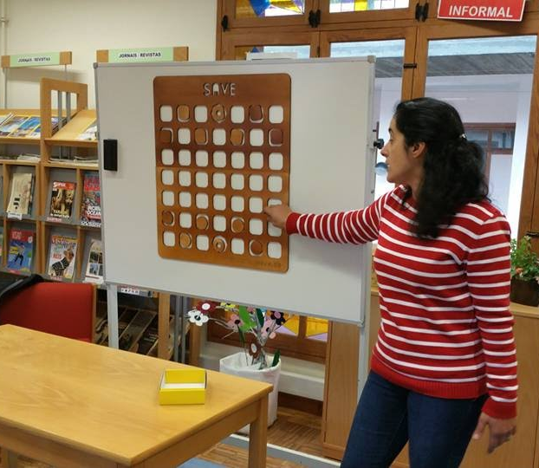
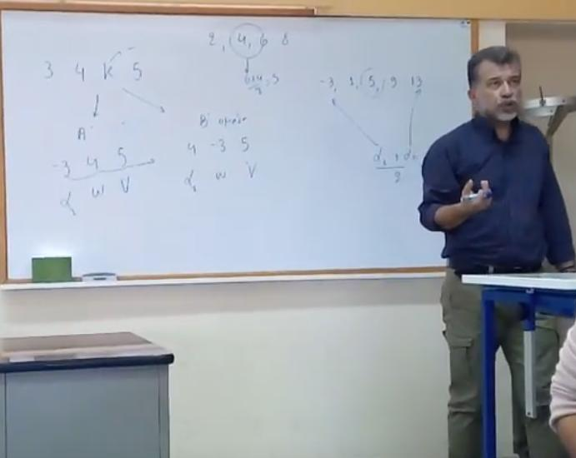
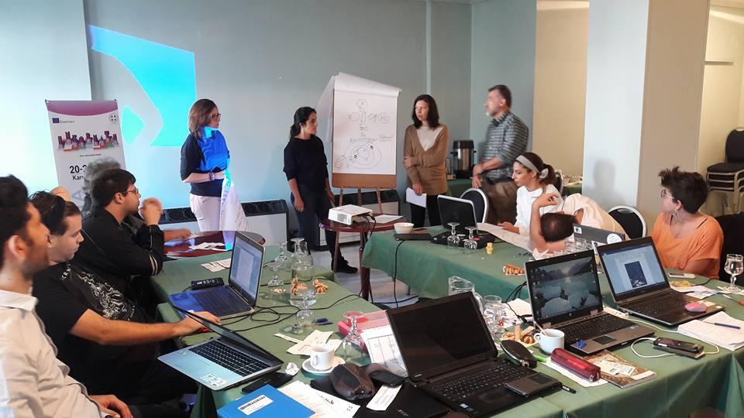

Slide 10
NEW TECHNOLOGIES
AND INNOVATION

Slide 11
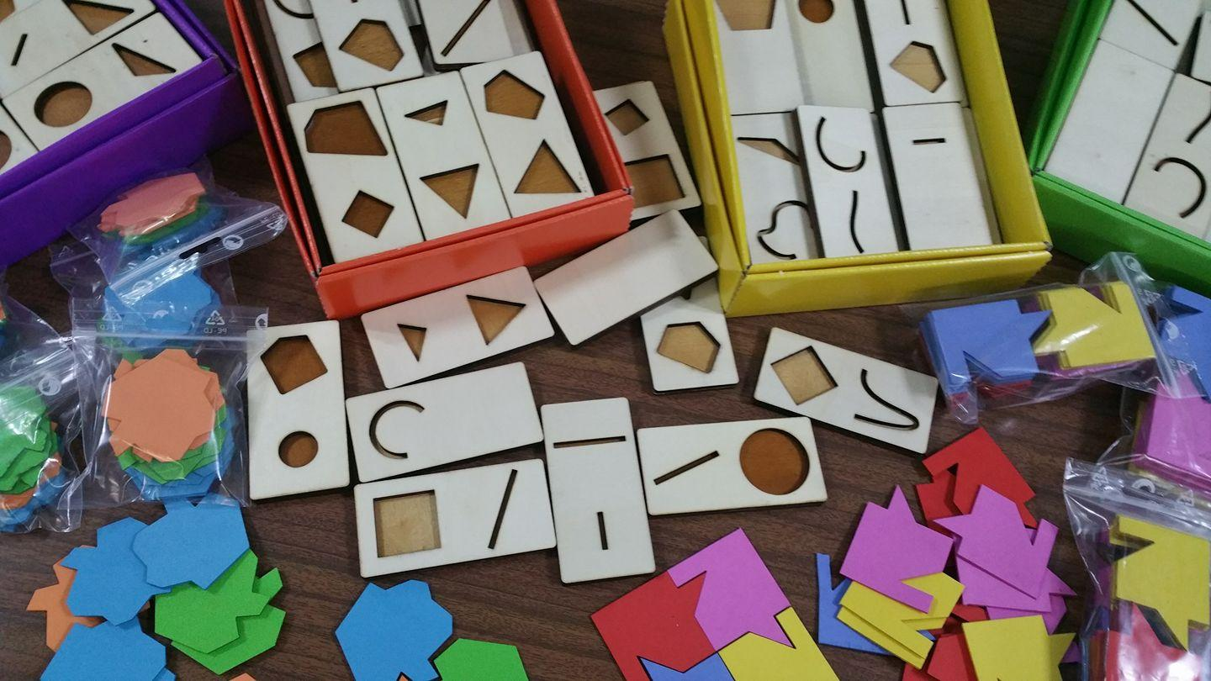
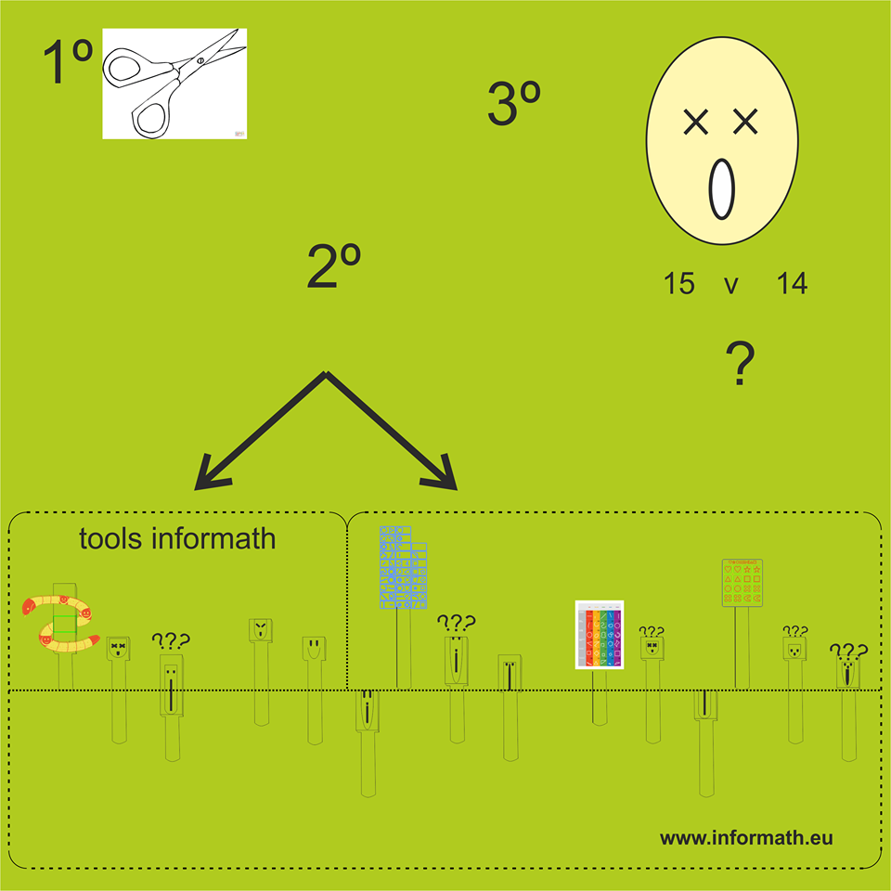
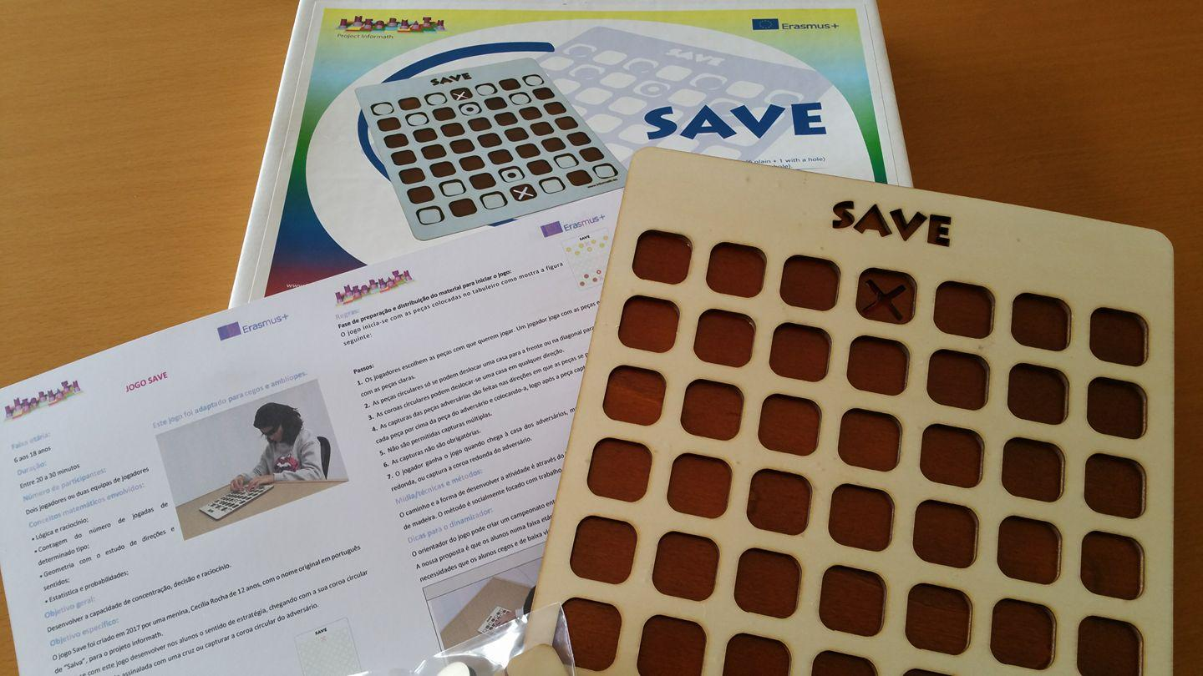
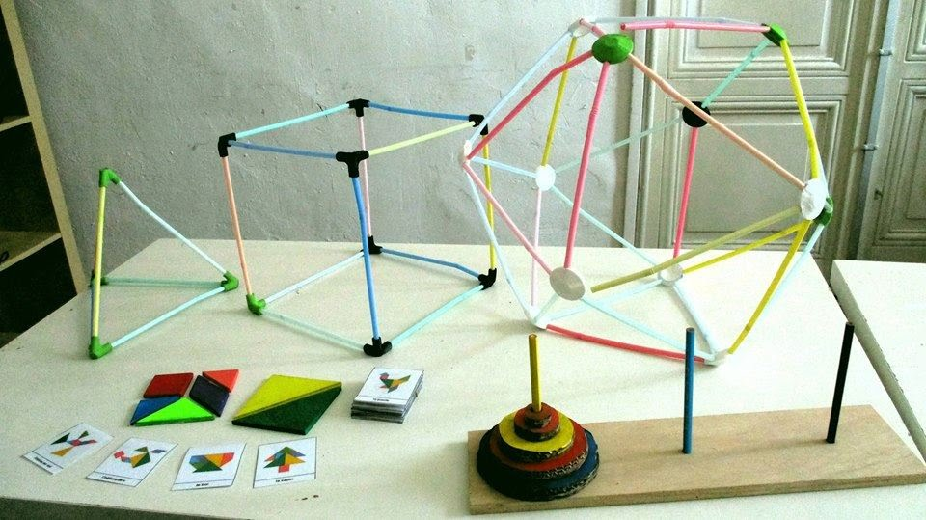

Slide 12
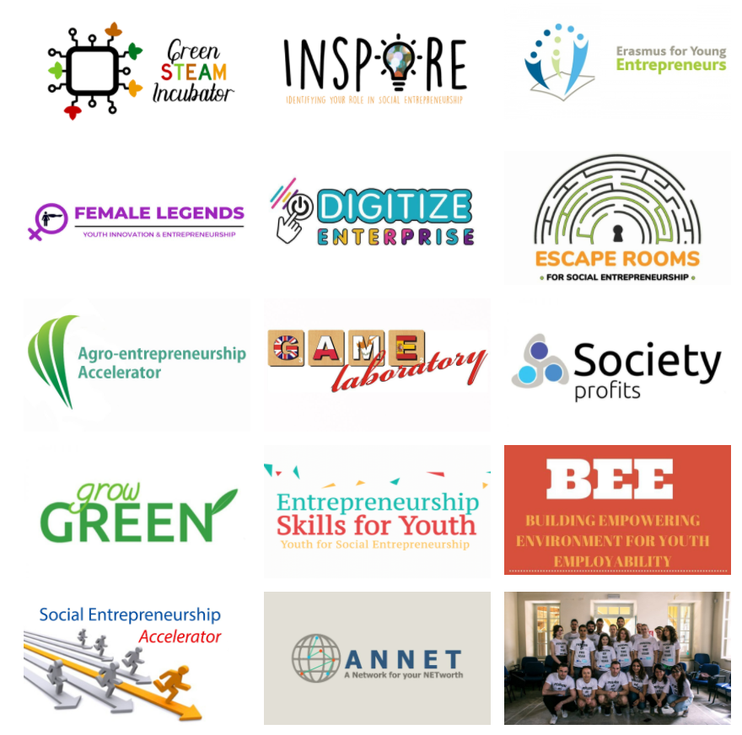
ENTREPRENEURSHIP

Slide 13
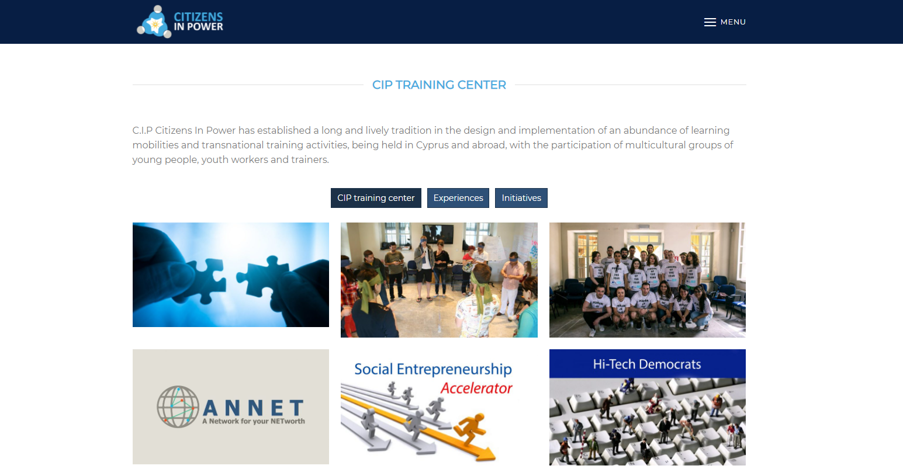
CIP Training center
ACCESS TRAINING CENTER

Slide 14
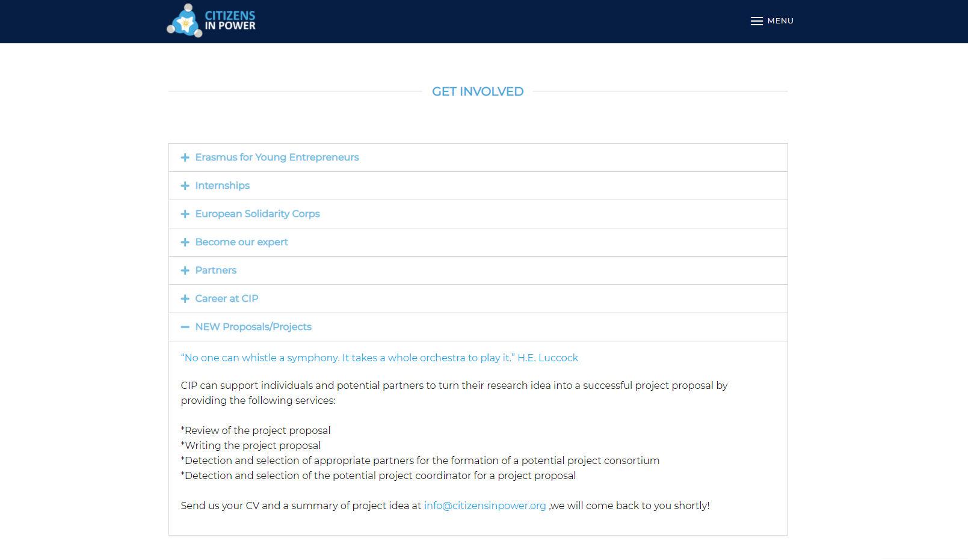
Get involved
ACCESS GET INVOLVED SECTION

Slide 15
CIP’s Social Media channels

Slide 16
This Photo by Unknown Author is licensed under CC BY-SA

