Slide 1
INSPIRE SERIOUS GAME
Intro- Menu- User interface
Results

Slide 2
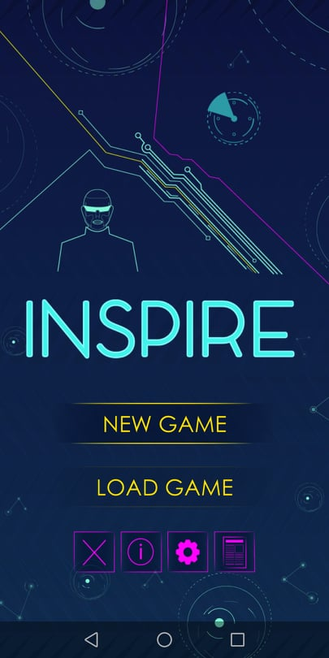
The navigation into the game menu is very easy. You just have to read the text in order to:
Start a new game
or Load a previous one
There are also symbols that lead to:
Info
Settings
Results- Profiles
Exit
The game is available only for Android mobile phones or tablets!!!
Or for PC!
MENU

Slide 3
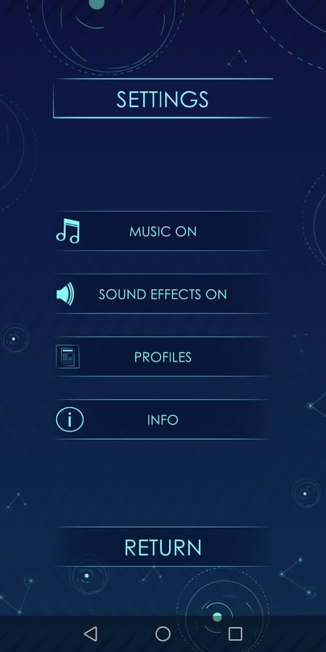
Inside the settings you can find:
Turn on or off the music
Turn on or off the Sound effects (eg. sound of buttons or selection of correct solutions etc)
Profiles- Results (this leads you to another screen where you can see till 4 profiles of the most recent times you or someone else has played the game through this device)
Info (this leads you to a screen with more info about the INSPIRE project)
SETTINGS

Slide 4
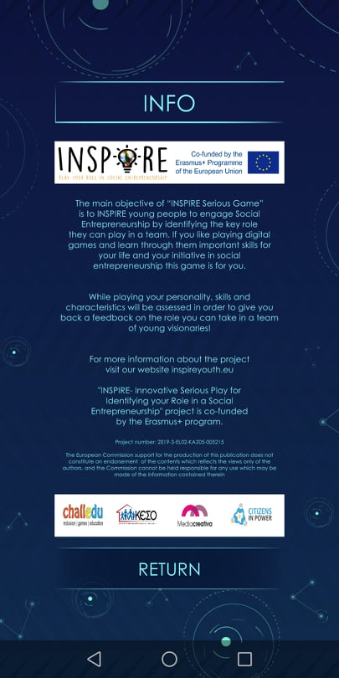
Info screen:
gives you a general idea of the project INSPIRE
invites you to visit the website of the project to find out more
presents you the partners
presents you Erasmus+
INFO

Slide 5
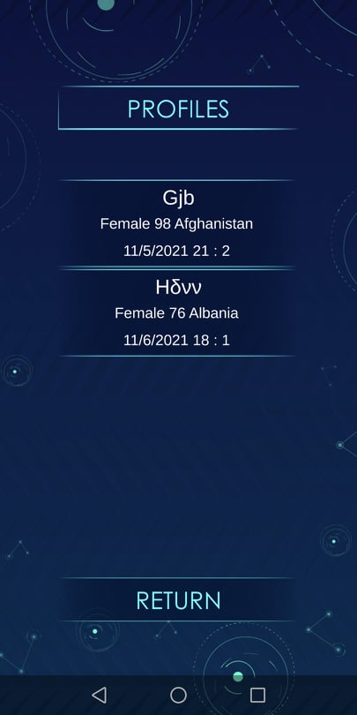
Profiles screen:
allows you to revisit the results of the 4 last times you or someone else played the game from the specific device
allows you to look at the results of someone else (eg. a trainee)
allows you to look again your results and remember which skills are more developed to you and which ones need more effort to built
allows you to look again your results and see which roles you can play in a social startup
PROFILES

Slide 6
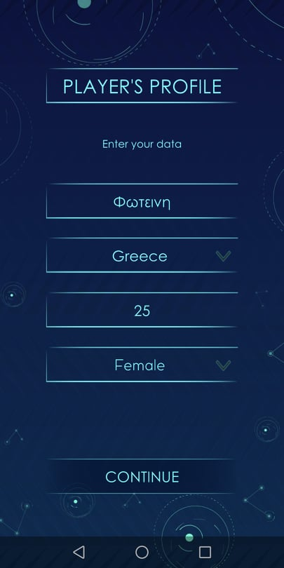
In order to START a NEW GAME you have to click on “New Game”
Once you click it appears a screen where you give some characteristics of your profile
name (or nickname)
country
age
sex (female or male)
This profile will be kept until you start a new game. If you don’t conclude all the levels of the game you will not be able to see Results on this Profile.
When you finish all levels you will be able to revisit the results any time unless you play more games and you pass the 4 profiles in the specific device
STARTING A NEW GAME

Slide 7
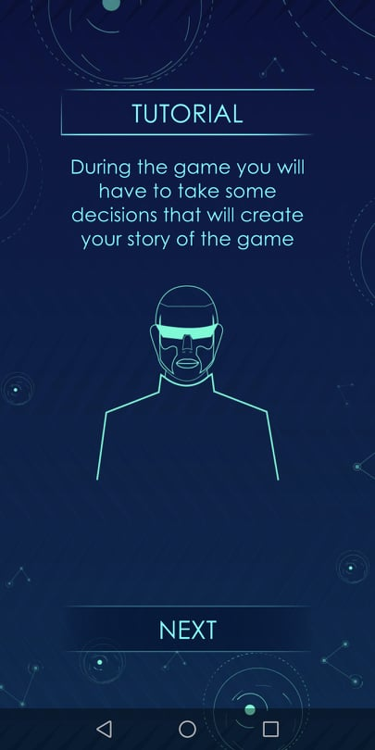
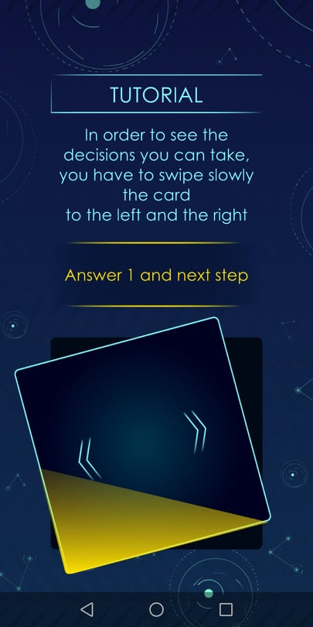
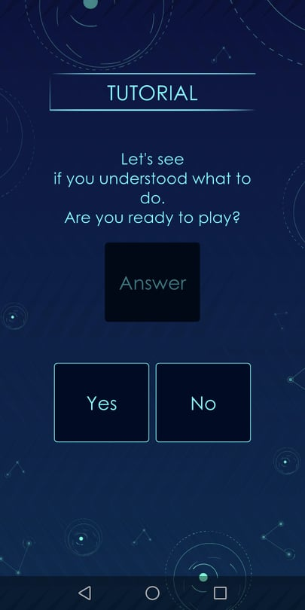
Before starting the game the player learn how to play it by following the instructions of the screens. There are two main processes to learn:
one is swiping the cards left or right in order to select the answer the prefer based on their personality
the second is dragging and dropping boxes on the correct place in order to find the correct solutions in the tools presented in the game
TUTORIAL

Slide 8
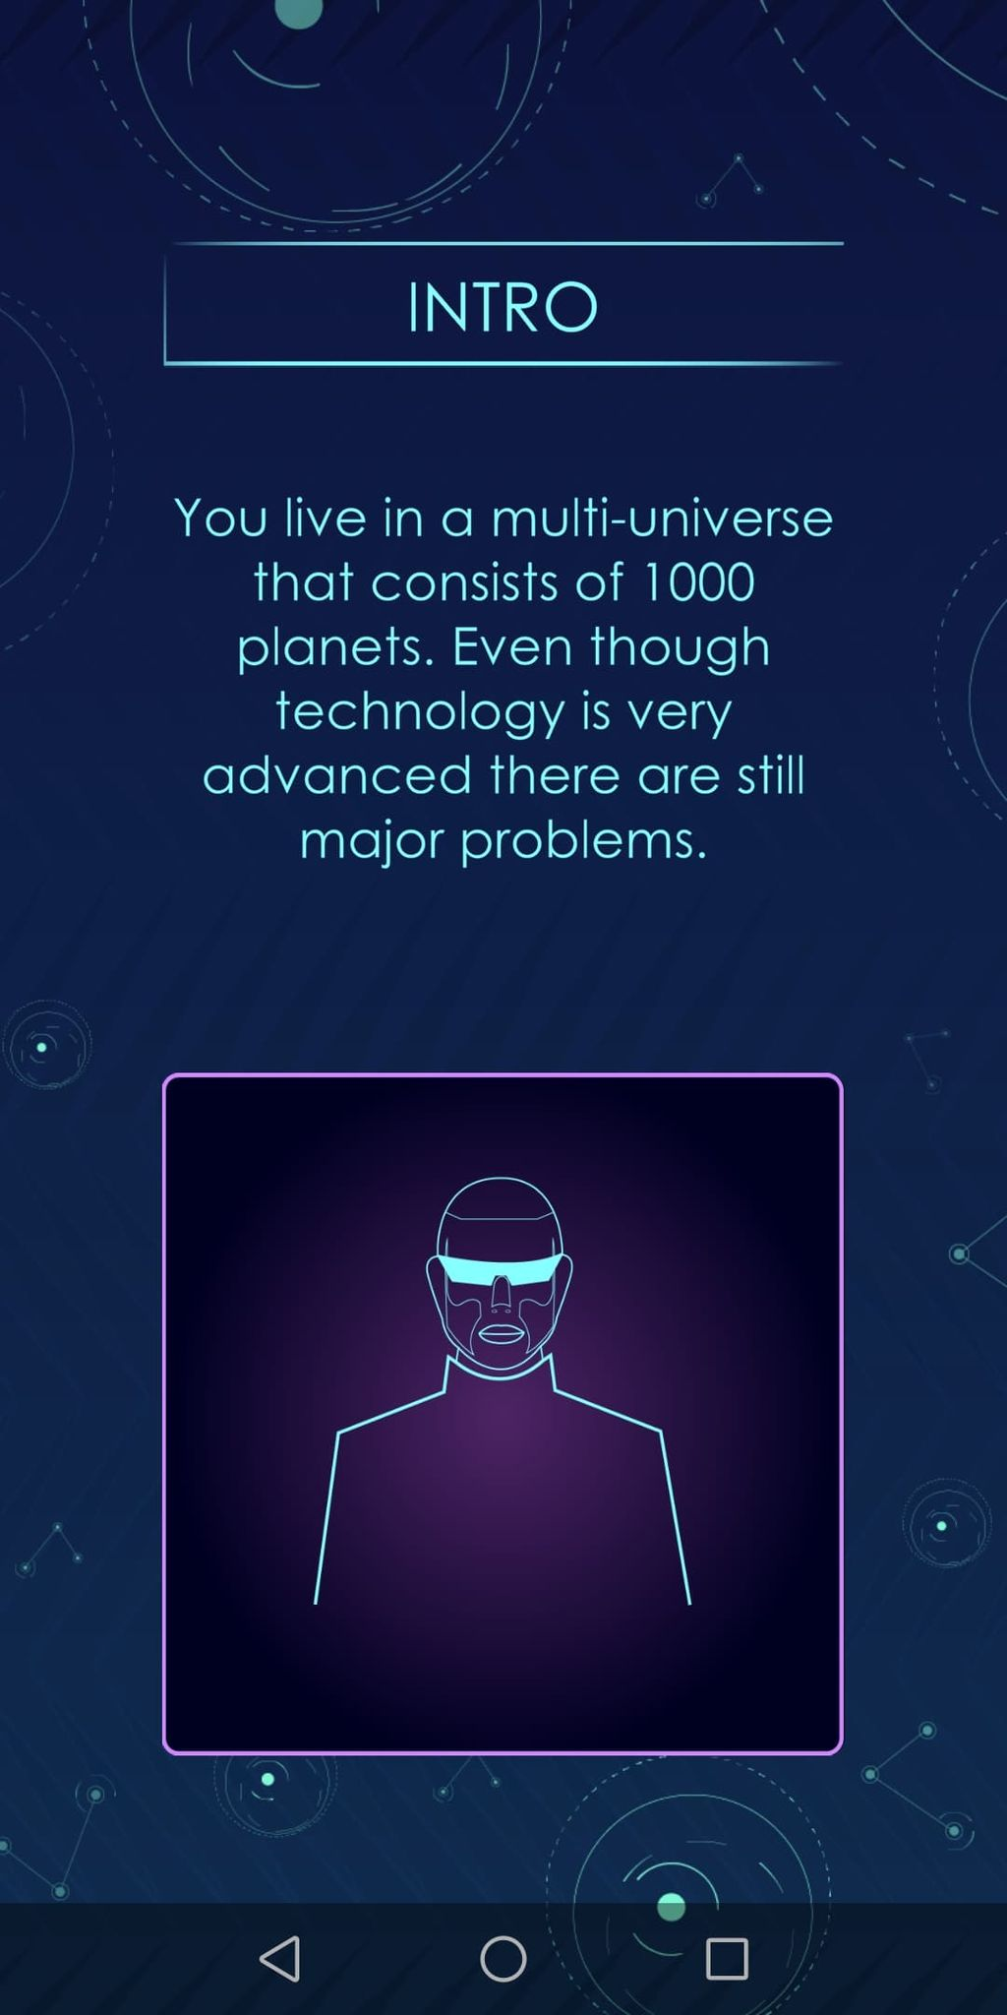
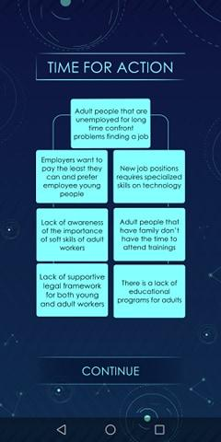
Levels:
each level has an intro in order to give you a hint on the main topic you will investigate
the player is asked to select between two options in order to define his/her story and in the end extract the results about his/her personality and skills
there are some cards that just continues the story and the player does not have to make a choice
at the end of each level there is a business tool that will help the player advance his/her skills
after the tool there are also some tips relevant to this section
at the end of all levels the player can see his/her results on the skills and personality
LEVELS

Slide 9
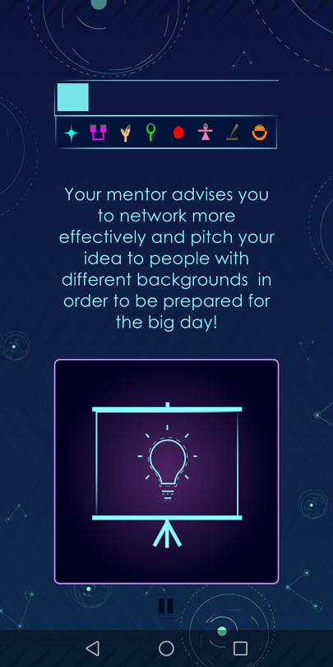
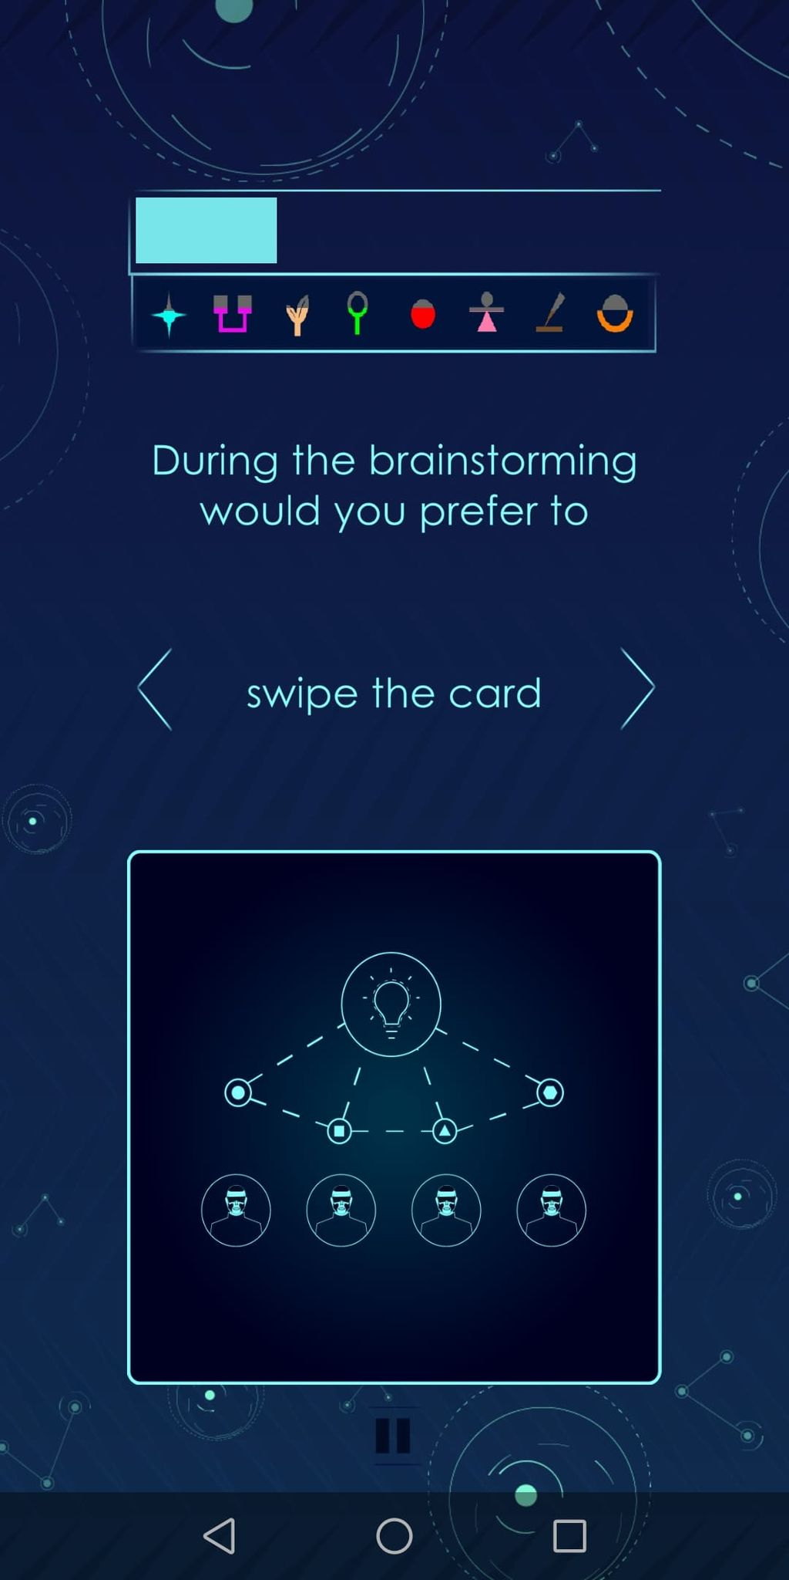
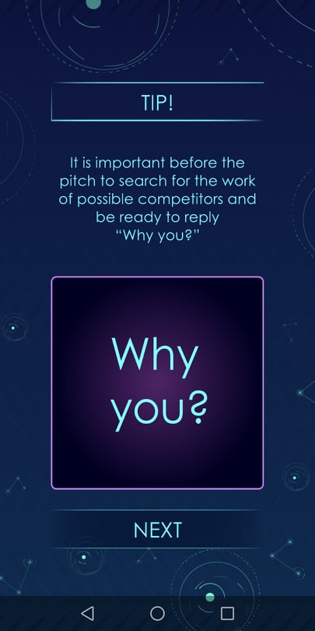
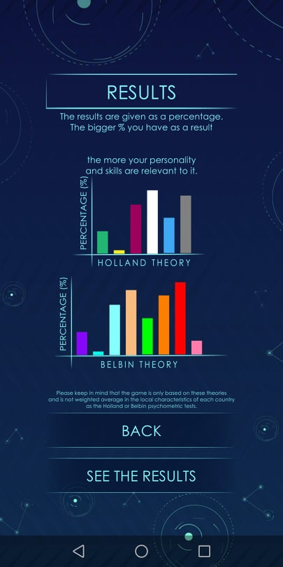
There are 2 types of story cards:
one that it is like an intro or link for the story of the level and has purple background
one that gives 2 different choices to the player and has blue background
In some points (eg. tools, tips, results) there is also a button with the name “Next” that allows player to continue to the next screen
In some other points there are buttons leading you back and forth to some screens (eg. tools, results, menu etc)
STORY
CARDS
NAVIGATION

Slide 10
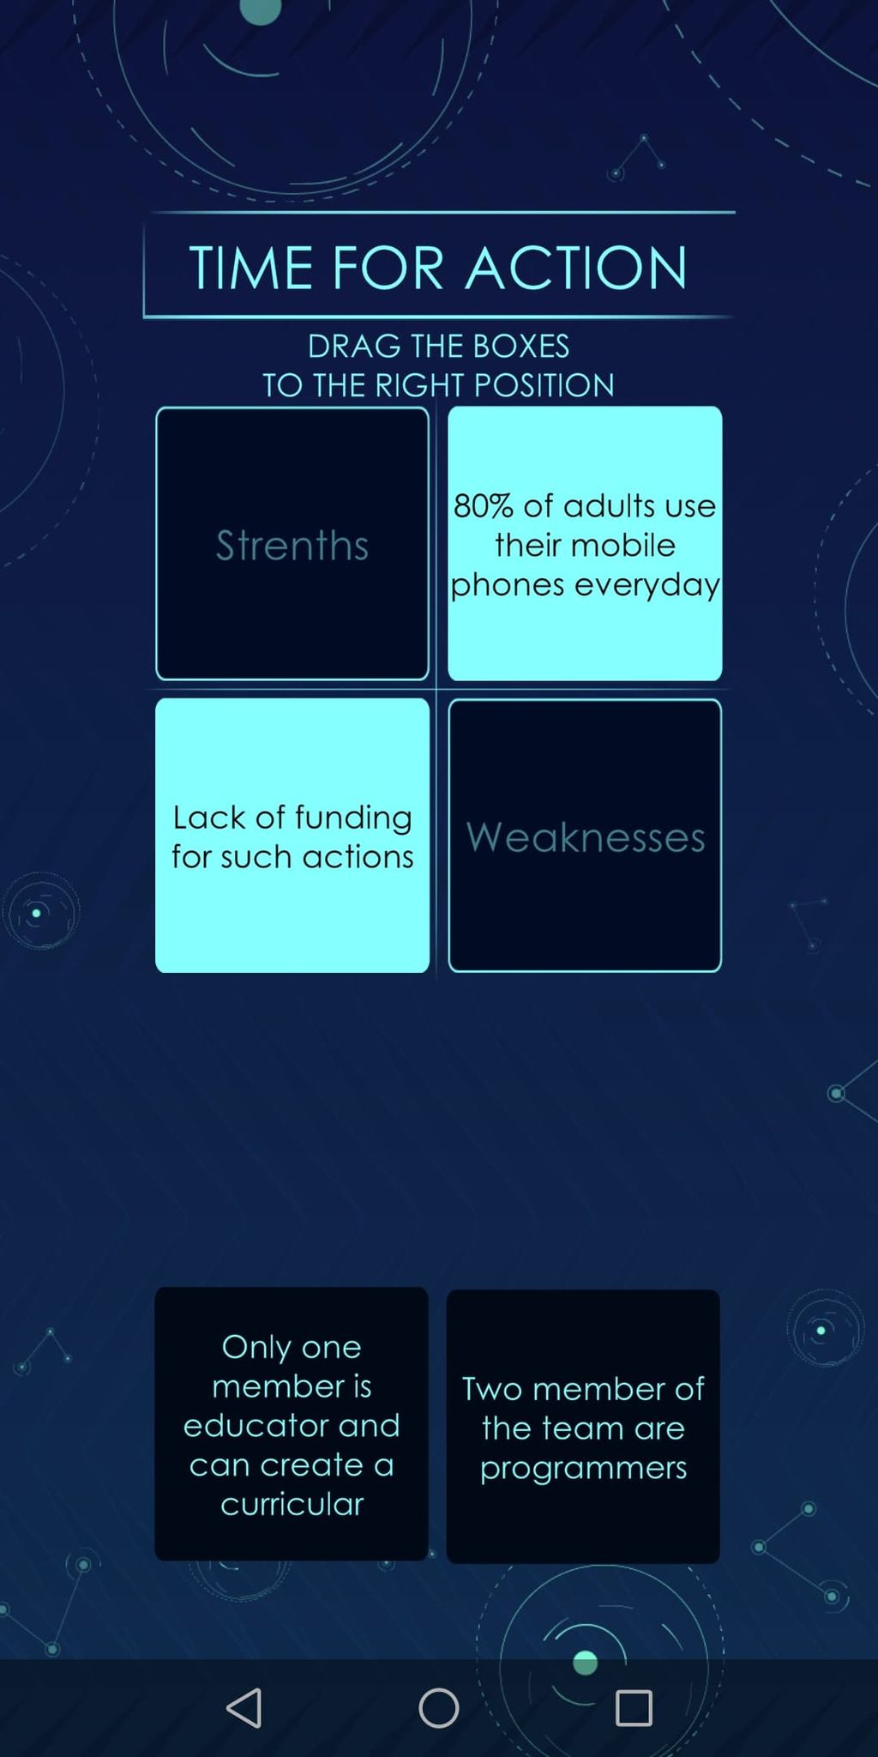
The tools:
are presented in a way that correlates with the story of the game
when an answer is correct it becomes lighter blue and stick on the correct position in order to help players even if they don’t know the correct solution to understand how to use the tool
there is no time restriction to complete the tool in order to let players understand it better and not do it quickly just by trying solutions and not looking at the text.
however you can not pass the level if you don’t complete the tool
TOOLS

Slide 11
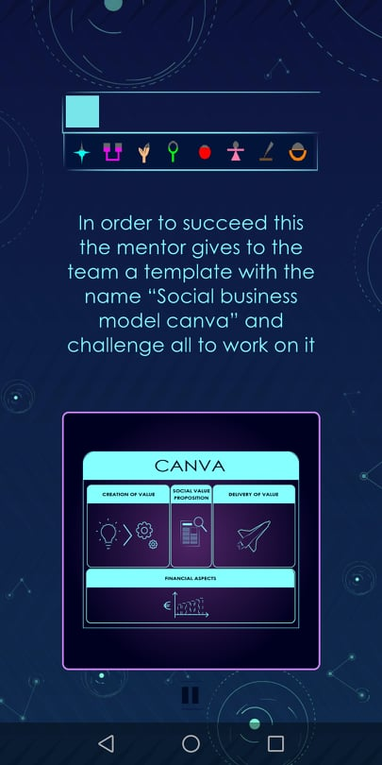
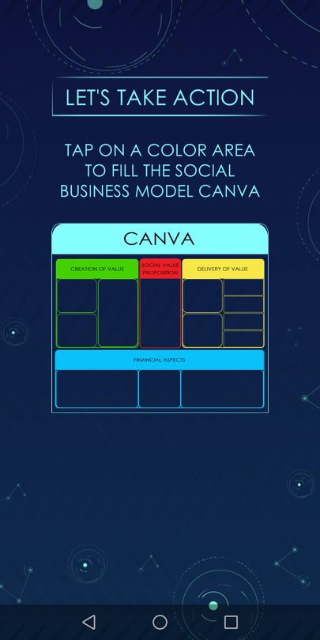
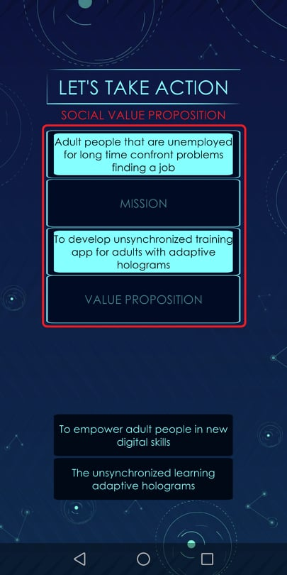
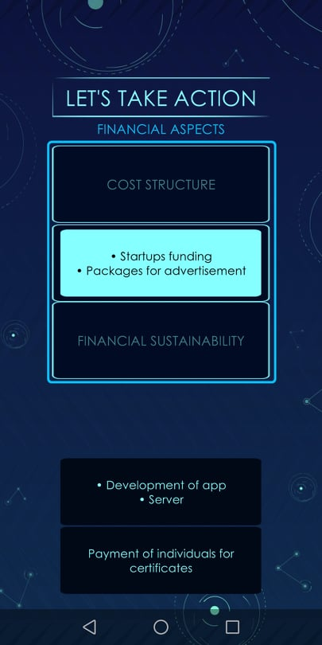
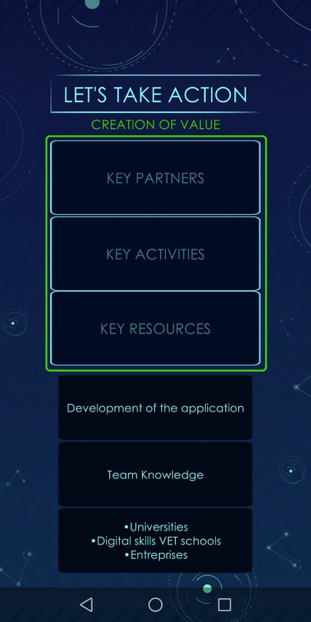
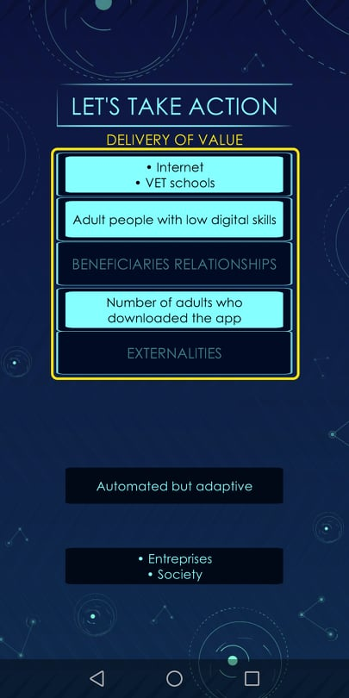
There are some tools that are more complicated than others and players have to click on specific region of the tool in order to complete it and come back to select another region to complete.
For these tools there are specific instruction above or before getting into the tool.
TOOLS

Slide 12
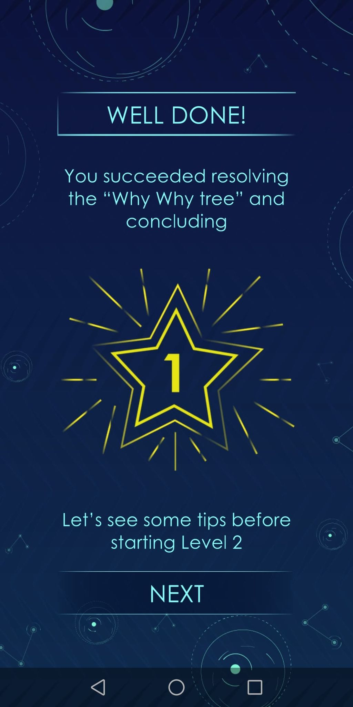
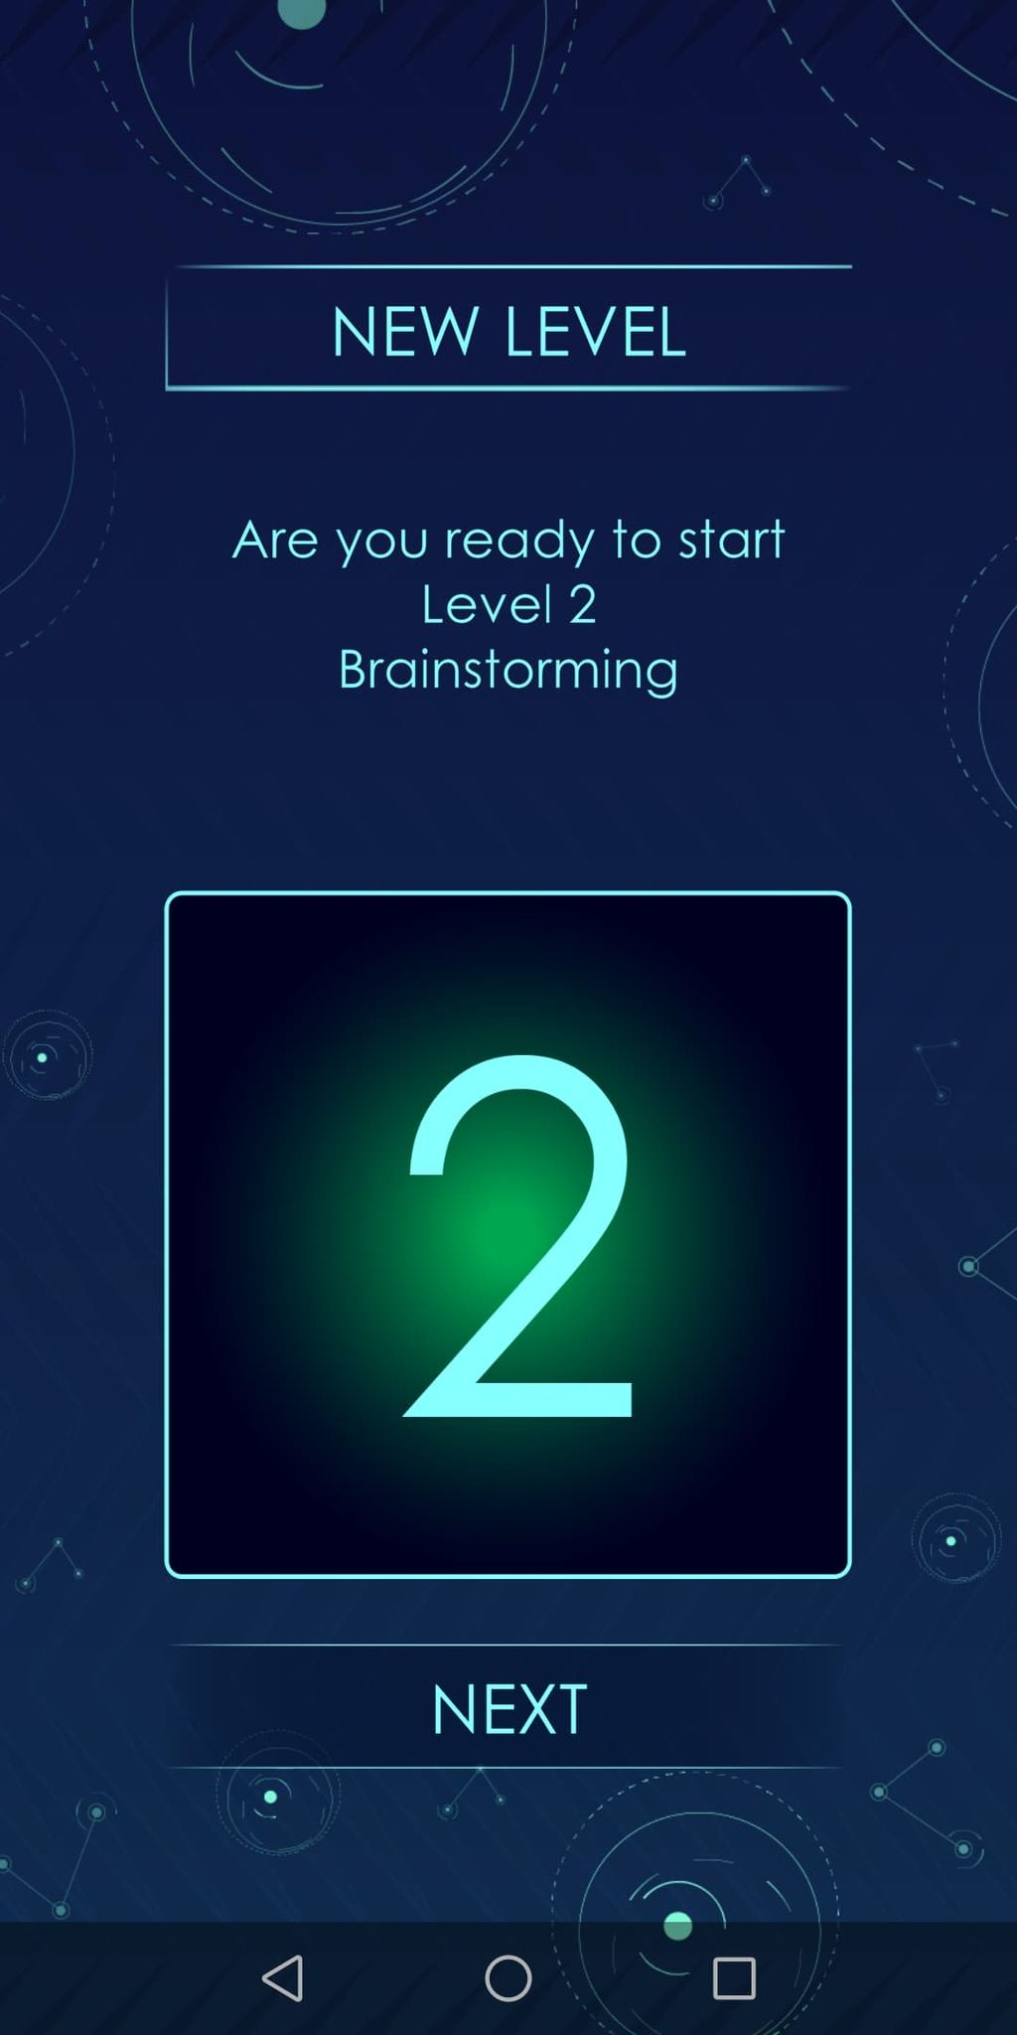
At the end of each level and before receiving some tips you can see a screen saying you welldone. This means that you made correct the tool
After the tips you can also see that you enter to the next level. You can also see the main topic of the next level that you are going to play
It is important to underline that to save the results for a level you have to be at this screen. Or else the game will return to the last level played and not completed!!!
WELLDONE
NEXT LEVEL

Slide 13
In the end of the 9th Level the game gives you results on your personality, skills and role you can play in a team
The results of the game are divided in two categories:
Results based on Holland theory which are more skills oriented and help you understand your skills and the key characteristics of your personality
Results based on Belbin theory which are more oriented to roles you can play as a member in a team
It is important to underline here that the game is based on existing tools but it is not weighted on the local characteristics of different populations
RESULTS

Slide 14
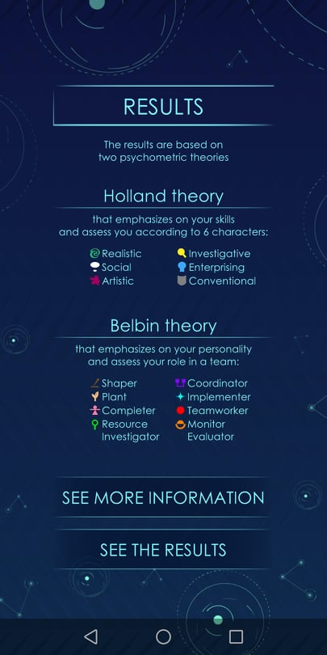
You can also find some key points on these 2 theories
RESULTS

Slide 15
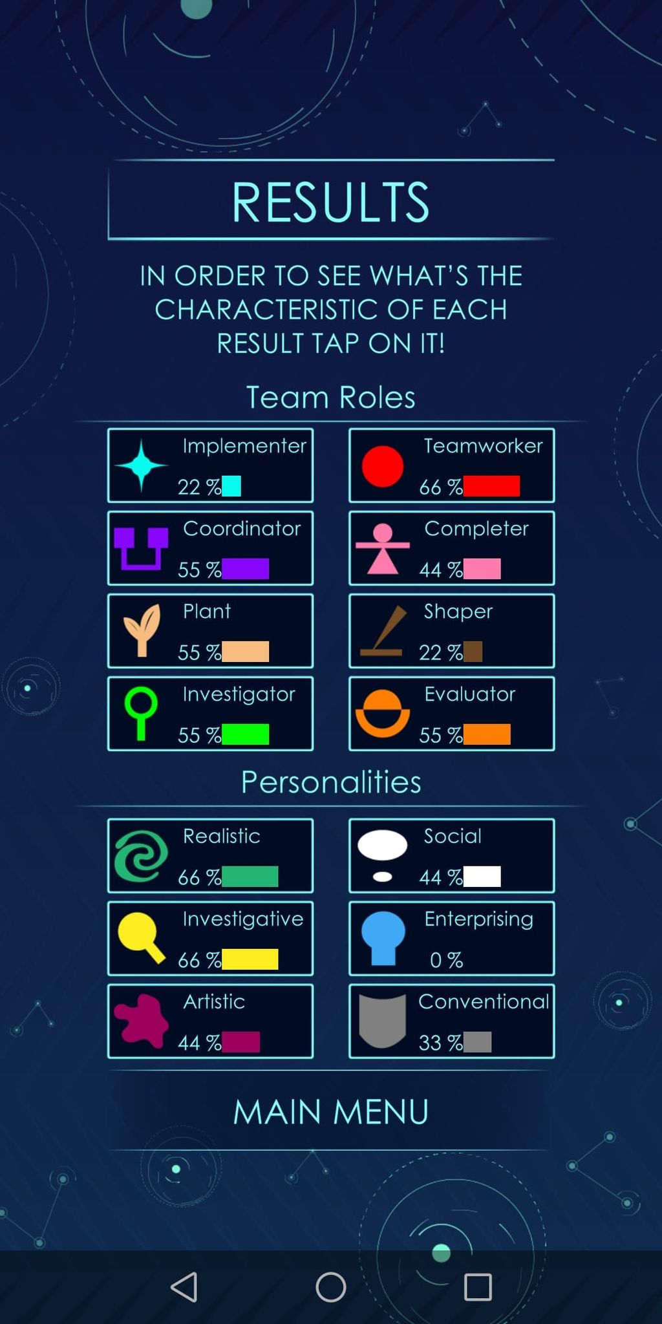
The main screen showing the results includes these 2 categories divided by one line.
In the bar of each personality you can find the percentage you have its characteristics. there larger is the percentage the closer you are to this personality
If you click on one of these personalities you will see more analytical results about the characteristics of this personality, the most common interests, the potential work environments and the potential position in a social startup
RESULTS

Slide 16
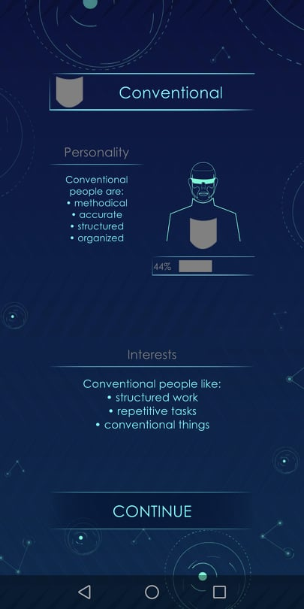
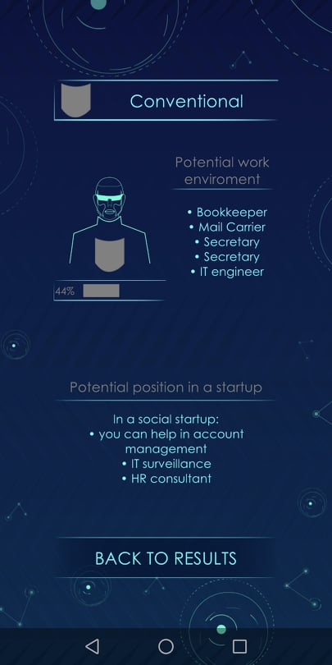
RESULTS

Slide 17
LET’S PLAY the INSPIRE GAME

Slide 18
INSPIRE
2019-3-EL02-KA205-005215
THANK YOU!!
This presentation is related to the Project made by the beneficiaries jointly or individually in any form and using any means shall indicate that it reflects only the authors view and the National Agency and the European Commision are not responsible for any use that may be made of the information it contains.

