Slide 1
INSPIRE SERIOUS GAME
Analysis of final assessment indicators

Slide 2
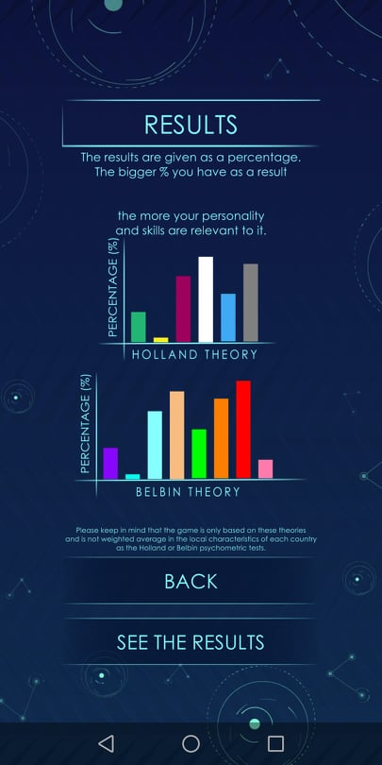
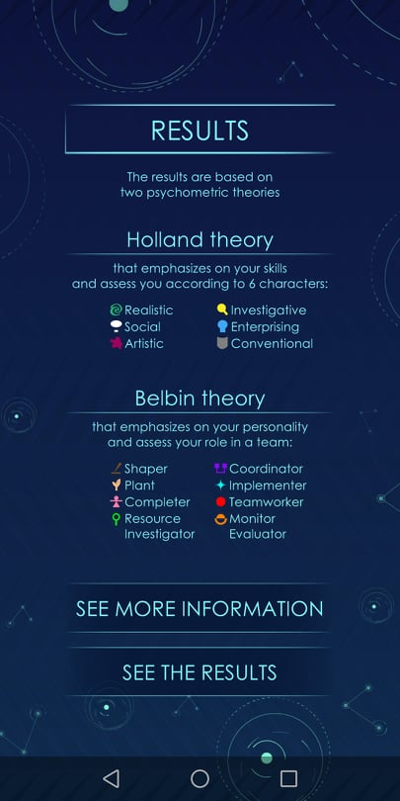
The results of the game are divided in two categories:
Results based on Holland theory which are more skills oriented and help you understand your skills and the key characteristics of your personality
Results based on Belbin theory which are more oriented to roles you can play as a member in a team
It is important to underline here that the game is based on existing tools but it is not weighted on the local characteristics of different populations
RESULTS

Slide 3
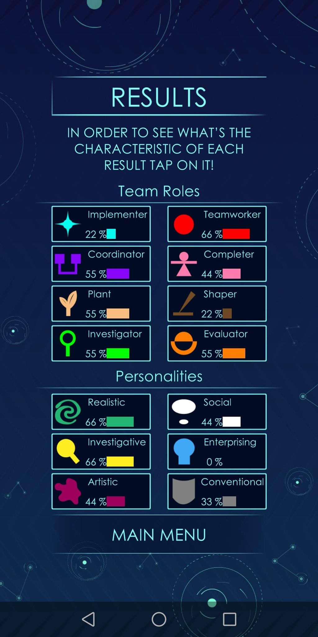
In the bar of each personality you can find the percentage you have its characteristics. there larger is the percentage the closer you are to this personality
RESULTS

Slide 4
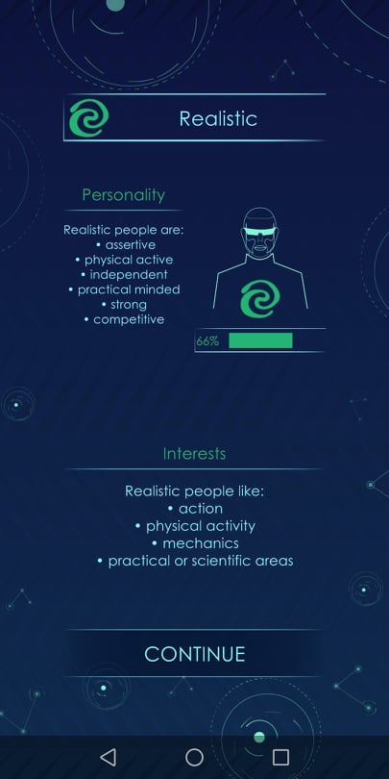
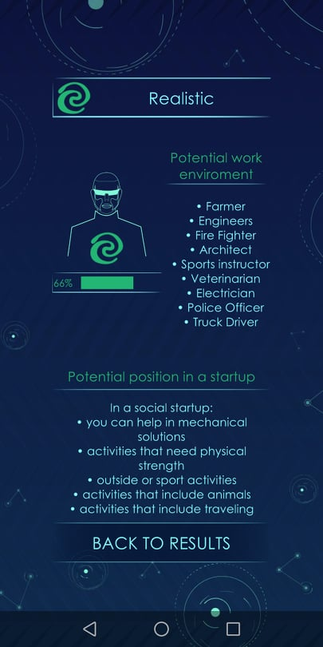
HOLLAND
THEORY

Slide 5
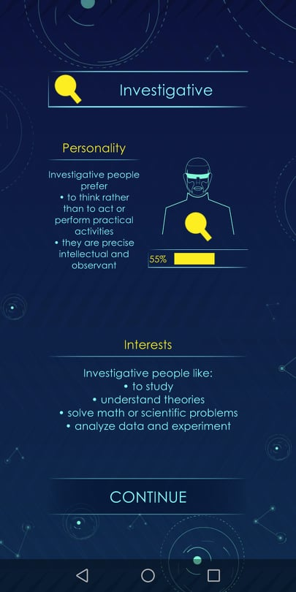
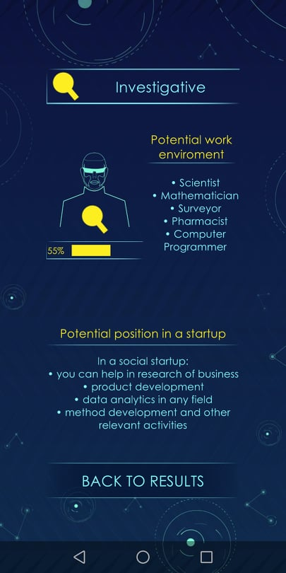
HOLLAND
THEORY

Slide 6
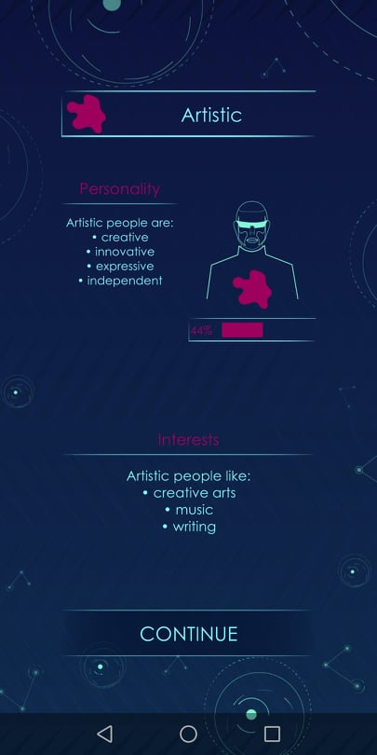
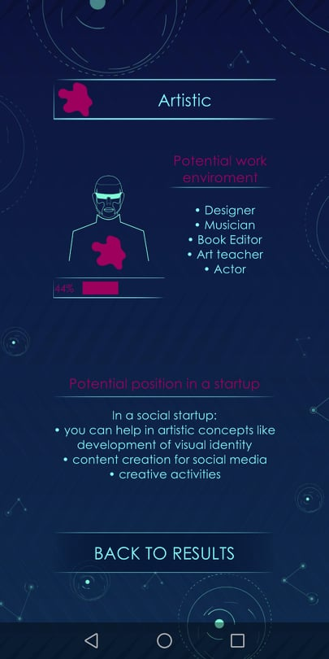
HOLLAND
THEORY

Slide 7
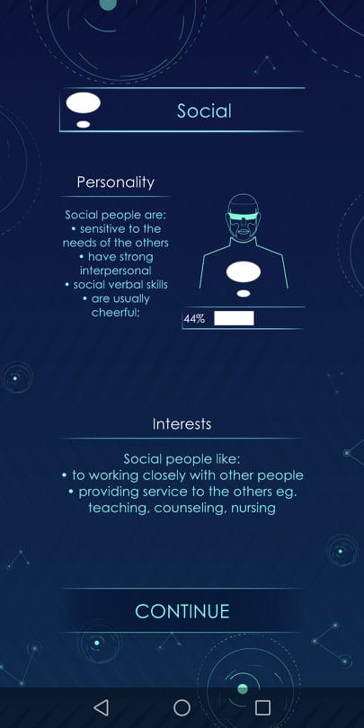
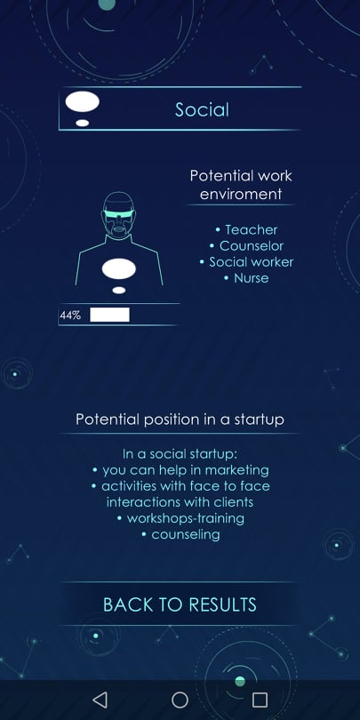
HOLLAND
THEORY

Slide 8
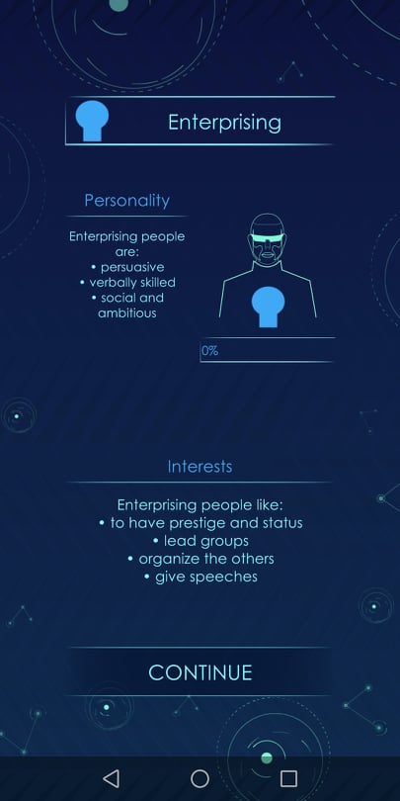
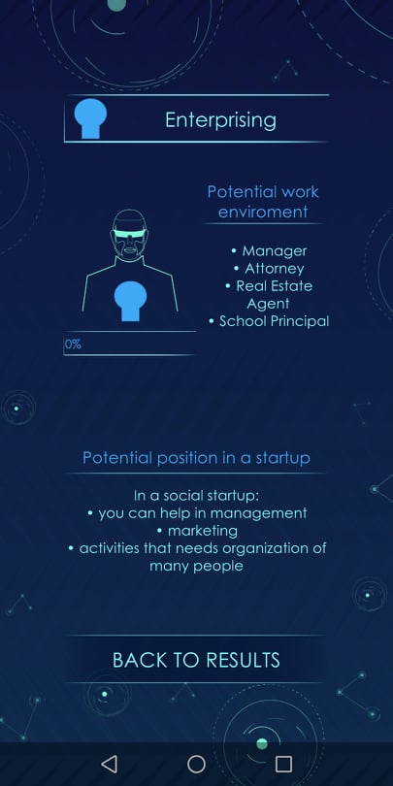
HOLLAND
THEORY

Slide 9
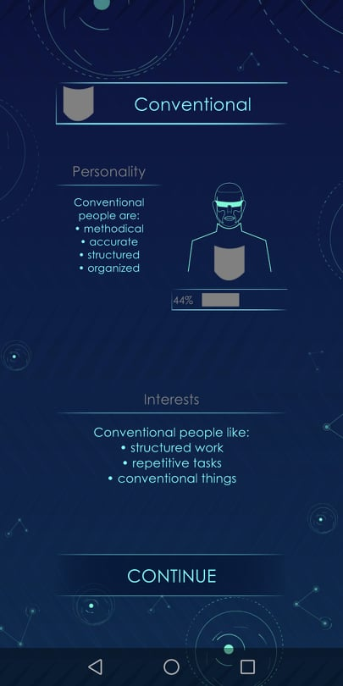
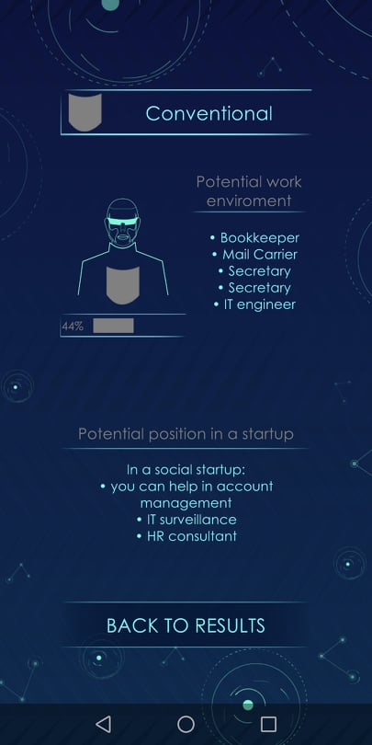
HOLLAND
THEORY

Slide 10
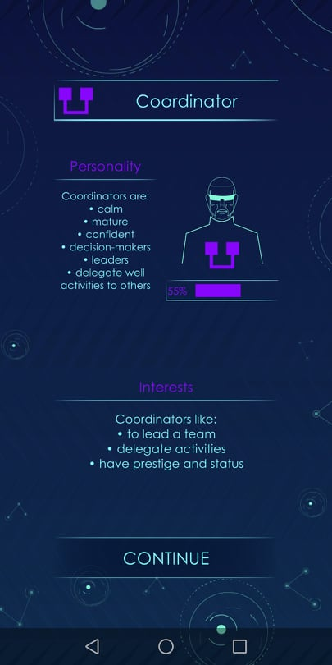
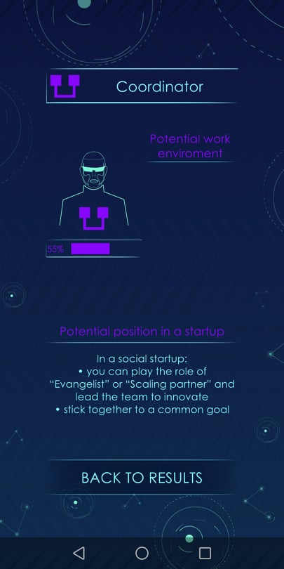
BELBIN
THEORY

Slide 11
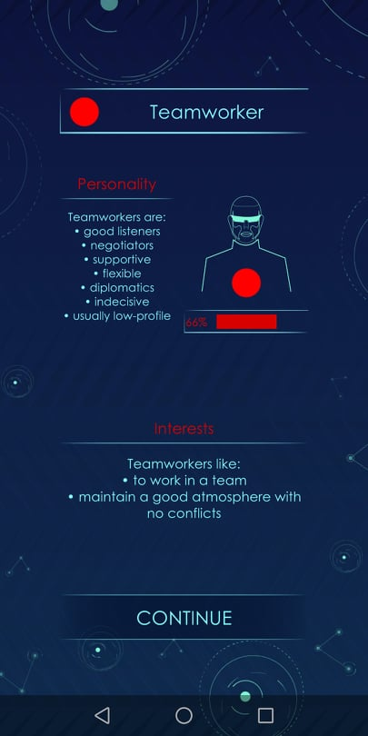
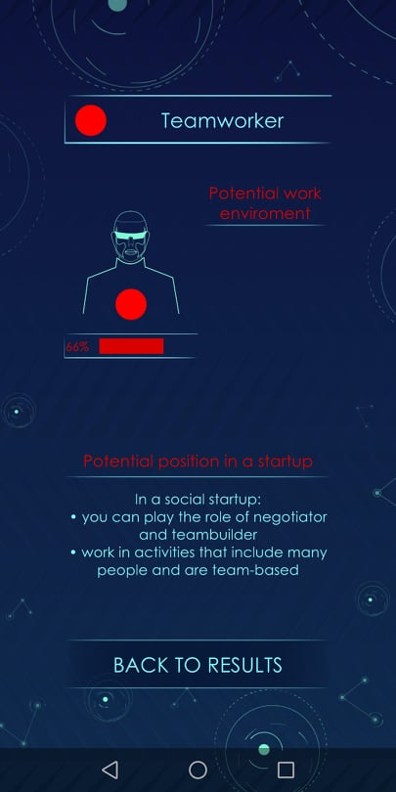
BELBIN
THEORY

Slide 12
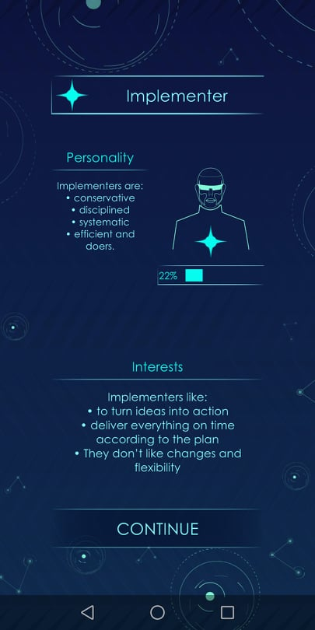
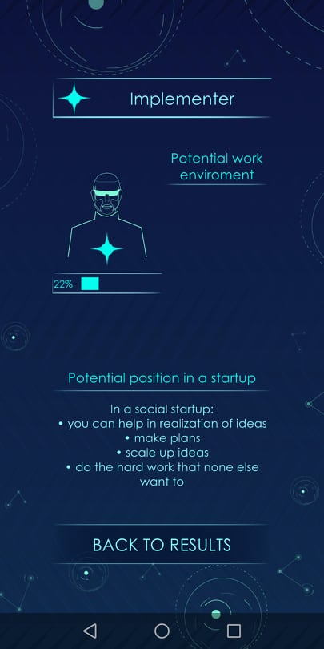
BELBIN
THEORY

Slide 13
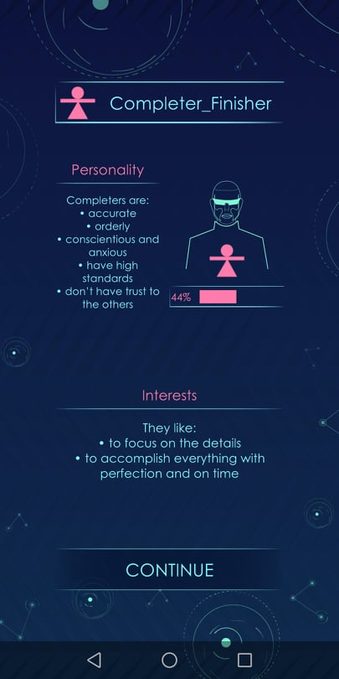
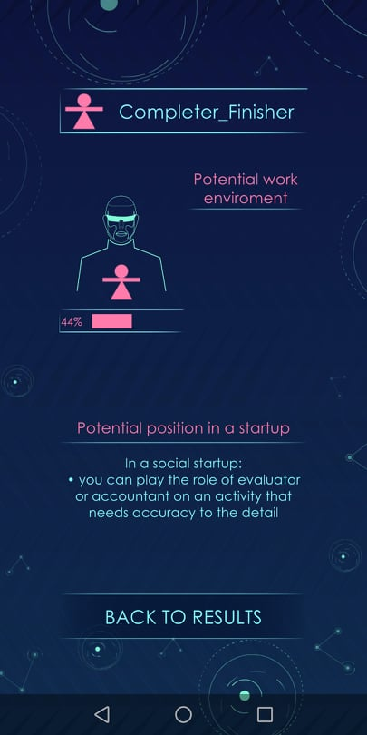
BELBIN
THEORY

Slide 14
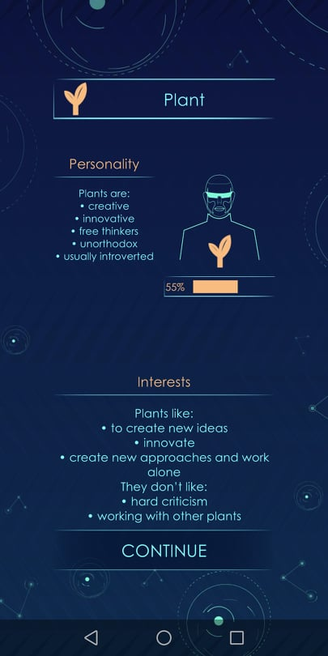
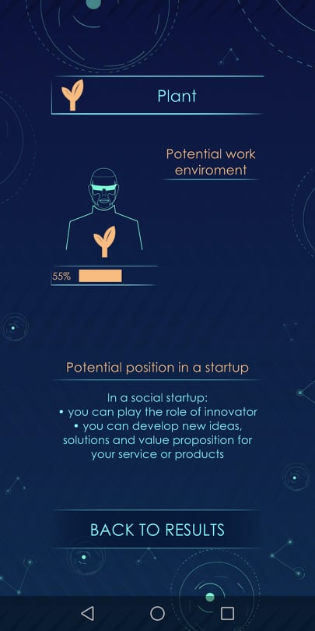
BELBIN
THEORY

Slide 15
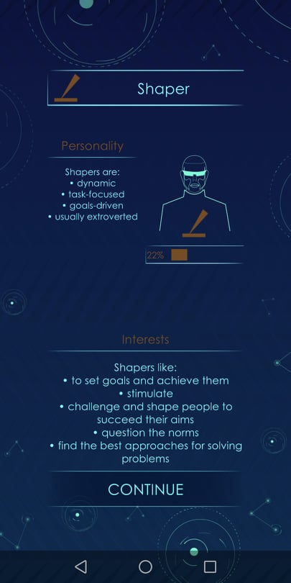
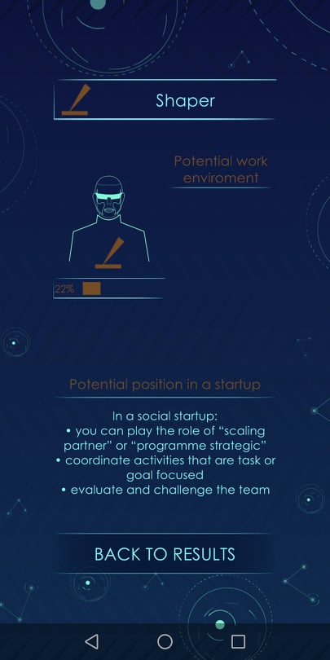
BELBIN
THEORY

Slide 16
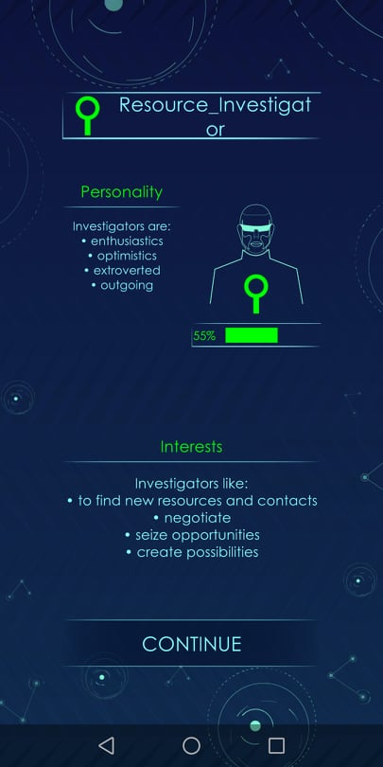
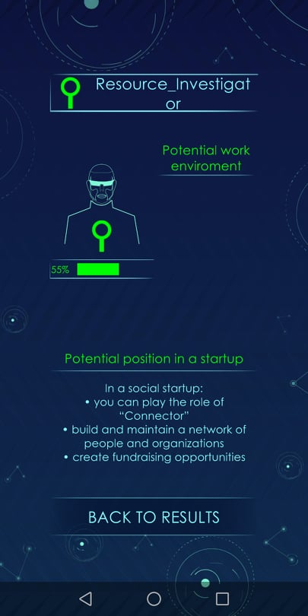
BELBIN
THEORY

Slide 17
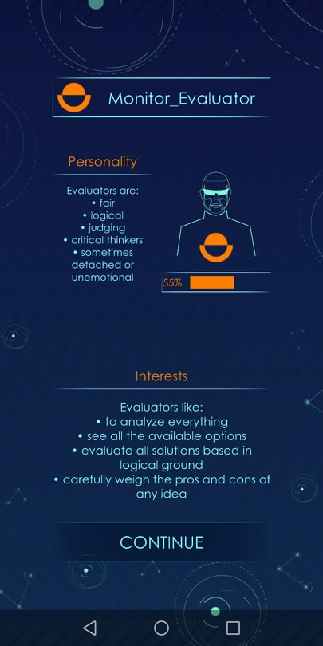
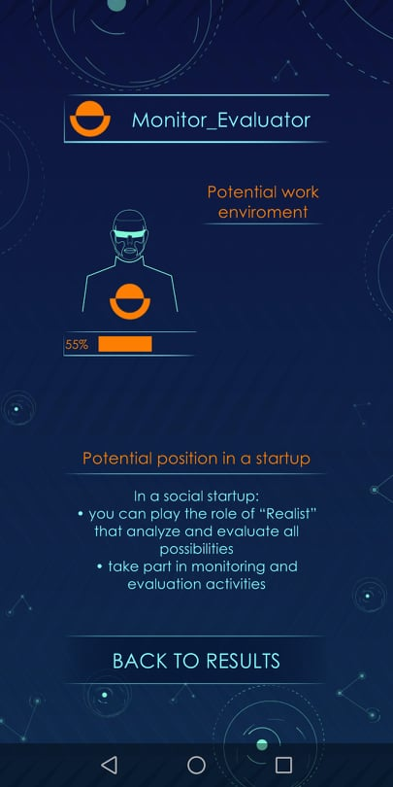
BELBIN
THEORY

Slide 18
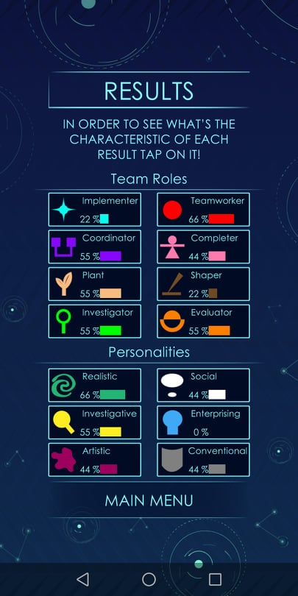
Young people can:
assess their skills and competences and get aware about their strengths and weaknesses
decide to develop new skills missing from their personalities
decide to strengthen more their key skills and competences
have a lead on which careers are more relevant to their skills as well as their personalities
have a lead on the key role they can play in a social startup team
HOW YOUNG PEOPLE CAN USE THESE RESULTS

Slide 19
Young people can develop new skills and strengthen some characteristics of their main or secondary personalities.
The results might not remain stable throughout the whole life of a person.
Moreover the percentages might change a bit according to different choices the person will do.
So the percentages are not very strict. They are just indicators of the specific moment in the life of a person.
ARE THE RESULTS INDICATORS FOR A LIFE?

Slide 20
As we said before the results are just average indicators of the specific moment of the life of a person.
If you are not happy with an indicator this does not mean that will never change. You can give effort to advance the skills on the specific field
If you are very happy with an indicator this is not stable either. Continue to give effort to develop similar skills
Moreover keep in mind that the game is based on existing tools but don’t follow exactly the same template and questions. So it is not a tool weighted as a psychometric tool in local populations. It can only give you a ruff idea on your characteristics and skills
HOW TO READ THE RESULTS
OF HOLLAND
THEORY?

Slide 21
Similarly to Holland theory the results are just average indicators of the specific moment of the life of a person.
If your results shows that you can take a specific role in a team this does not mean that you can not have a double, triple or more roles.
If your results shows that you are not very good on a specific role this does not mean that you can not do what this person does! You can do anything you want!
Moreover keep in mind that the game is based on existing tools but don’t follow exactly the same template and questions. So it is not a tool weighted as a psychometric tool in local populations. It can only give you a ruff idea on the roles you can play in a team
HOW TO READ THE RESULTS
OF BELBIN
THEORY?

Slide 22
INSPIRE
2019-3-EL02-KA205-005215
THANK YOU!!
This presentation is related to the Project made by the beneficiaries jointly or individually in any form and using any means shall indicate that it reflects only the authors view and the National Agency and the European Commision are not responsible for any use that may be made of the information it contains.

