Slide 1
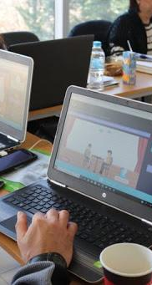


INSPIRE SERIOUS GAME
In Use

Slide 2

The Holland Theory RIASEC
Holland asserts that people of the same personality type working together in a job create an environment that fits and rewards their type.
Within this theory there are six basic types of work environment, which correlate directly to the personality types. Holland emphasises that people who choose to work in an environment similar to their personality type are more likely to be successful and satisfied. This idea is important as it shows Holland’s theory can be flexible, incorporating combination types.
Holland’s theory takes a problem-solving and cognitive approach to career planning. His model has been very influential in career counselling. It has been employed through popular assessment tools.

Slide 3

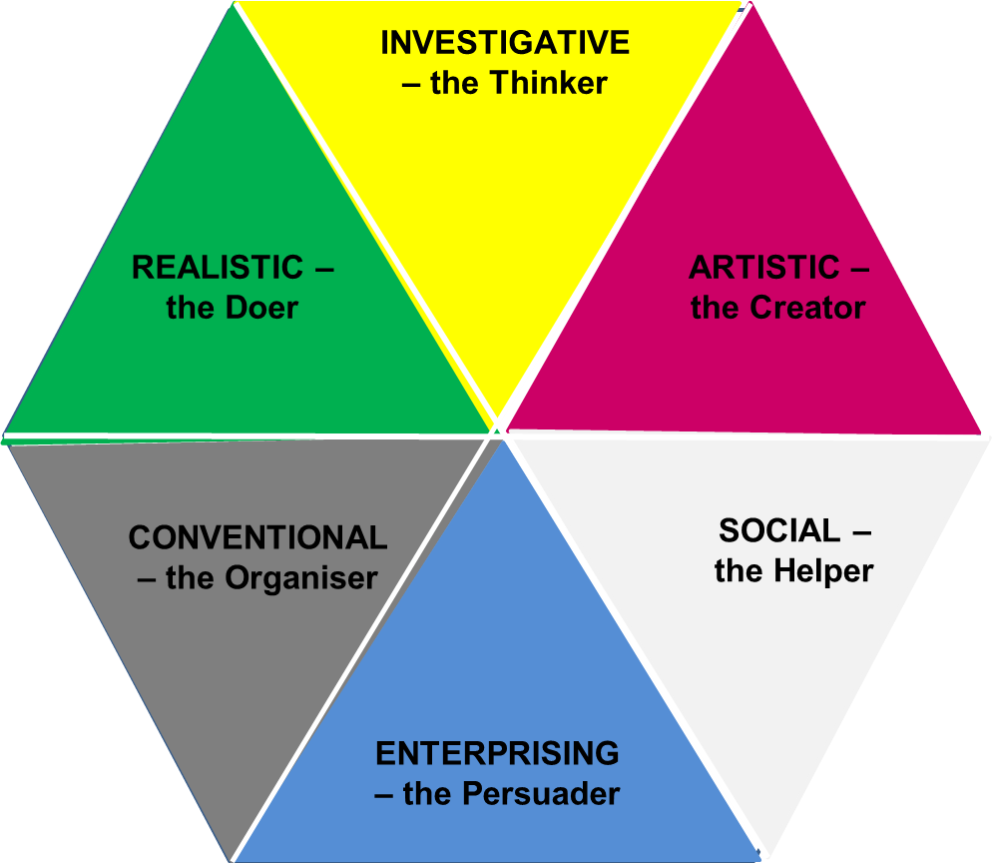

Slide 4
Use the Belbin model in the workplace
The Belbin Team Inventory test is a behavioral exam that establishes which traits you display of nine possible team roles.
You can apply the Belbin model to your team to help create a more balanced team and identify opportunities for growth based on the team role.
When you understand your role within a team, you can improve your contributions by developing your strengths and managing your weaknesses.

Slide 5
Roles and Skills for successful participation in a social enterprise
Nine team – role contribution, Belbin
Action oriented roles | Shaper | Challenges the team to improve
 | Implementer | Puts ideas into action
 | Completer, Finisher | Ensures thorough, timely completion
People oriented roles | Coordinator | Acts as a chairperson
 | Team worker | Encourages cooperation
 | Resource Investigator | Explores outside opportunities
Thought oriented roles | Plant | Presents new ideas & approaches
 | Monitor – Evaluator | Analyzes the options
 | Specialist | Provides specialized skills
Notes:
References
Belbin, R. M. (1981). Management Teams: Why They Succeed or Fail. Oxford: Butterworth Heinemann 
Coleman, M and T Bush (1994) Managing Coleman, M. and T. Bush (1994). Managing With Teams. In Bush, T. and West-Burnham, J. (eds ). The Principles of Educational Management. Harlow, Essex: Longman

Slide 6

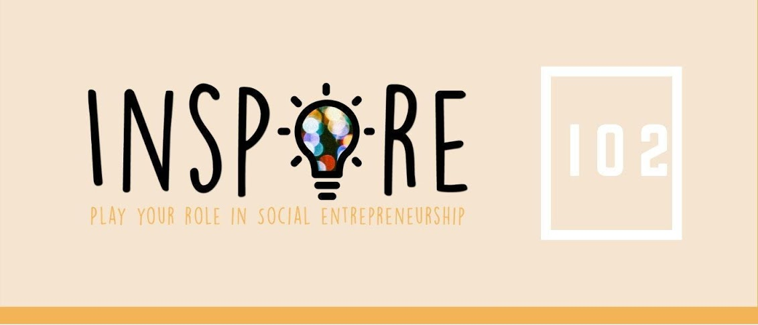
How to use the game
in personal meetings with young people

Slide 7
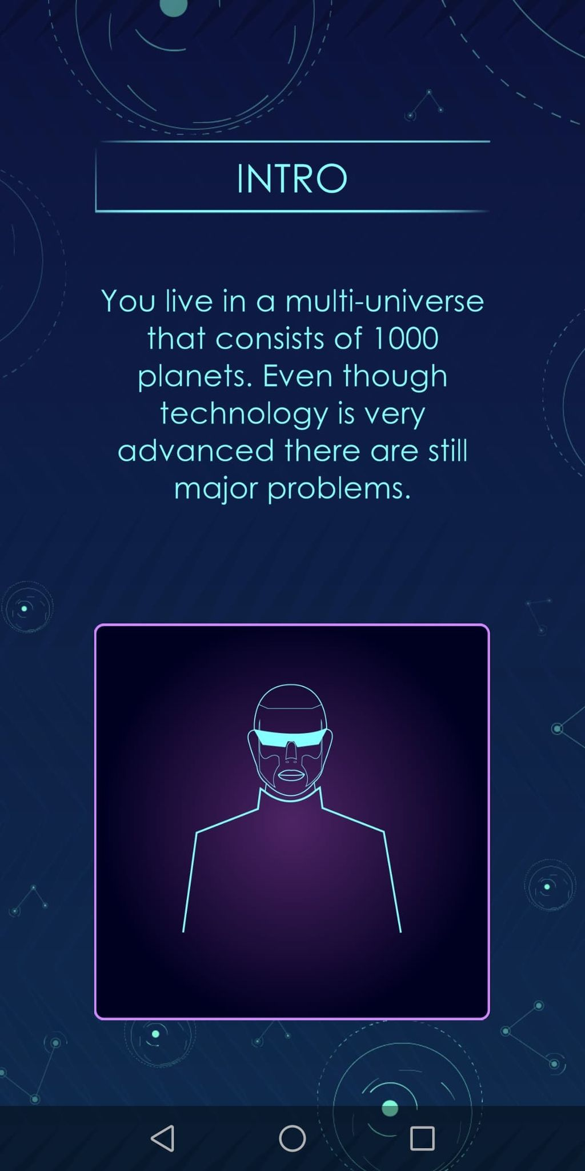
Level 1- Analyze and understand the problem
Imagine you having the opportunity to found a social enterprise addressing existing challenges, what would be your values and drives?
Go to the jamboard for some self-awareness choices

Slide 8
Holland’s theory of career choice – six personality types
R You value practical things you can see, touch and use; you are concerned for plants & animals
I You value science, you like discover & research ideas, observe, investigate & experiment
A You avoid highly ordered or repetitive activities. You like expressing yourself, communicating, performing, creating
S You are concerned for others’ well-being and welfare
E You value success in politics, leadership, or business
C You like working indoors at tasks that involve organizing, being accurate, following procedures, planning
Level 1: Values, Drives

Slide 9
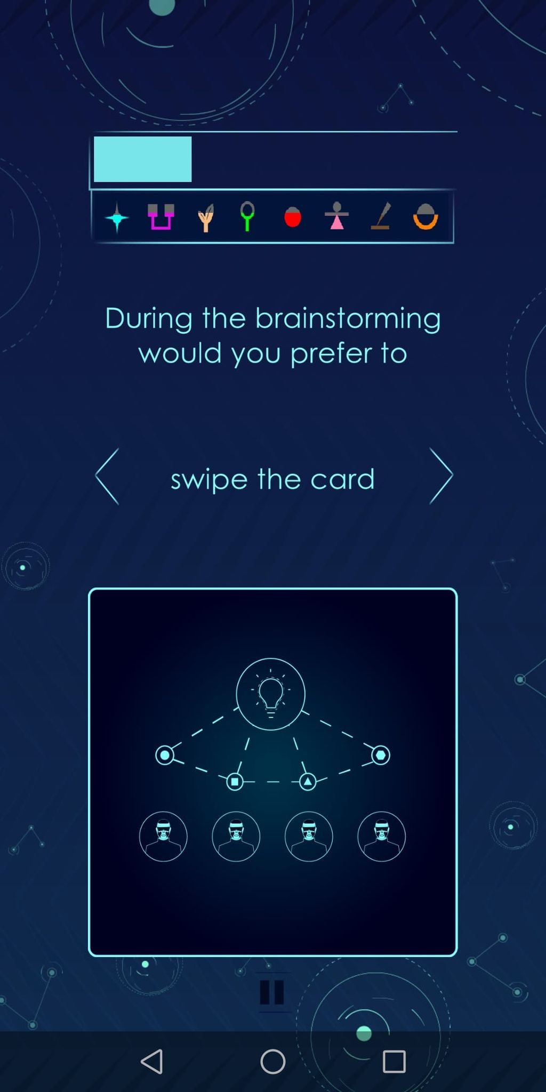
Level 2
Data gathering
Define the Strategy you will follow
Now, lots of information are needed in order to start planning
Your next step consist of data gathering and environmental studying
How are you going to deal with it?
Go to the jamboard for some self-awareness choices

Slide 10
The 9 Belbin’s Team Roles
ME make decisions based on facts and rational thinking as opposed to emotions and instincts.
SH extroverts who tend to push themselves and others to achieve results, remain positive and seem to thrive under pressure, create unique goals and strategies
CO tend to concentrate on helping team members accomplish their individual objectives, good at identifying talent in a team and utilizing it to achieve the group’s objectives
SP is an expert in a specific field, has in-depth knowledge in a narrow subject, tends to be loner
IM like to make concrete plans from abstract ideas, are highly disciplined and self-controlled who can disregard their self-interest to focus on the needs of a team or an organization
TW extroverts with mild and friendly dispositions, tend to be good listeners and are adept at getting a team to function well together as a unit
PL free-thinkers and creative people who produce original ideas and suggest innovative new ways of doing things, prefers to work alone
FI introverted individuals who perform quality assurance during key stages of a project, perfectionists & they tend to expect the same from those around them
RI extroverts who have a talent for networking, who like to explore new opportunities and investigate new developments
Level 2: Planning contrbution

Slide 11

Level 5- Everyday- management tools
It's time to define your role and work towards your objectives
But not all of us have the same skills and abilities; this is why we are good at specific activities and/or we prefer to use different tools
Go to the jamboard for some self-awareness choices

Slide 12
Holland’s theory of career choice – six personality types
R Using and operating
tools, equipment &
machinery, designing,
building, repairing,
maintaining, measuring,
working in detail, driving
I Thinking analytically &
logically, computing,
Studying & solving problem, calculating, diagnosing, experimenting,
investigating
A Expressing artistically or physically, communicating by
performing, designing, presenting, planning, composing
S Communicating by writing and speaking,
caring and supporting,
training, meeting,
greeting, assisting,
teaching, informing,
interviewing, coaching
E Selling, promoting & persuading, developing ideas, public speaking,
managing, organisng, leading, computing, planning
C Computing and
keyboarding, recording
and keeping records,
paying attention to
detail, meeting and
greeting, doing
calculations, handling
money, organising,
arranging, working
independently
Level 5: Key Skills

Slide 13
The 9 Belbin’s Team Roles
ME works best when challenges arise that require advanced analytical ability and astute problem-solving. He has the ability to consistently make effective decisions.
SH are born leaders who tend to get results, they quickly move upward in organizations, they act decisively in crises and drive progress
CO mature individuals, have excellent interpersonal and communication skills, normally in management positions with democratic approach that includes open communication
SP becomes very engaging and helpful when it comes to his field of expertise, will have no issue in sharing his knowledge with junior members who want to learn
IM the backbones of organizations since they implement workable strategies to ensure the team completes tasks quickly and effectively
TW are adept at solving interpersonal issues within a team and also support members who may feel neglected
PL may not fit into the traditional concept of how a team member should act, but is the team members who bring about growth and progress
FI ensure that teams produce high-quality work, especially valuable in work environments where precision and adherence to deadlines are essential
RI outgoing personalities, good at making new business contacts and carrying out subsequent negotiations; also talented at finding new ideas and opportunities and bringing these back to the team.
Level 5: Team Roles

Slide 14
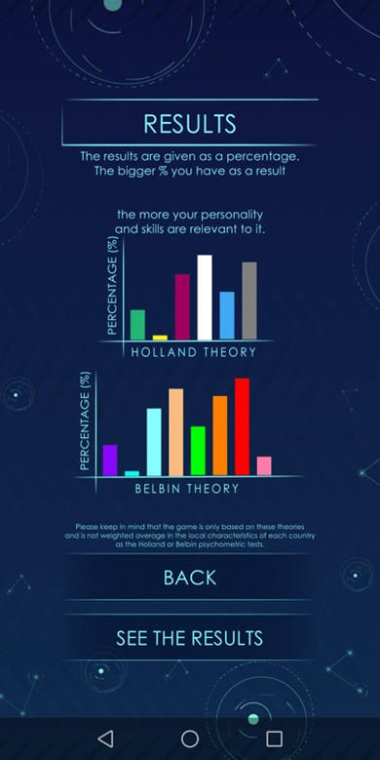
Results
Now that you have a more clear idea about who you are and what your role could be within the team in a social enterprise, it is time to recruit the rest of the team members.
You need to enroll the right person in the right position
Work with your colleagues to create the appropriate “bait” questions

Slide 15
Using Holland & Belbin to gain an edge in Job Interviews

Slide 16
common teamwork interview questions
How do you feel about working in a team?
What makes good teamwork?
What skills do you bring to a team?
How do you feel about working with a colleague you don’t like?
Give an example where a team project failed?
How do you keep a team motivated?
Tell me about a rewarding team experience
How do you give feedback to team members?
https://www.glassdoor.co.uk/blog/common-teamwork-interview-questions/

Slide 17
How to use the game
in group meetings with young people

Slide 18
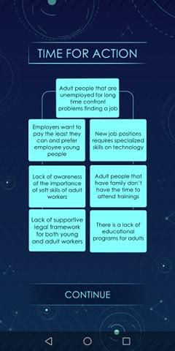
Level 1-
Analyze and understand the problem
“Why Why tree”
Problem and Solution Tree
is similar to mind map
is used by community organizations to understand community problems, and develop solutions.
We will use Problem and Solution Trees to become active global citizens, plan actions to make change!

Slide 19

Problem or “Why – Why” Tree
Effects
Core Problem
Causes
What negative effects does this problem have?
What is the main problem that you notice in your community?
What are the ‘root causes’ of this problem?

Slide 20
Problem or “Why – Why” Tree
More Crimes
More accidents
Difficulty in finding a job
Higher teenage pregnancy rate
Higher drug & alcohol use
Effects
Core Problem
Causes
So what?
e.g. Teenagers don’t finish school
Why?
School is not interesting
Need to find a job to support family
books haven’t been renewed for years
teachers are unaware of new technologies
Low family income

Slide 21
Solutions Tree
How can I solve this problem? Knowing how much time, money, or other constraints you may have, which ‘root cause’ of the problem can you address?
Impact
Goal /
Outcome
Condition
/ Output
What long term impact will this project have?
What overall outcome, or result, will your project achieve?
What main output, or activity, will you do to achieve your project outcome?

Slide 22
Solutions Tree
Impact
Goal /
Outcome
Condition
/ Output
SO THAT…
e.g. Teenagers WILL finish school
THEN…
IF…

Slide 23
Making a Project Statement
Output – Activities
If…
Outcome – Result
Then…
Impact
So that
We digitalize the book and train the teachers, the school will be more interesting
Teenagers will finish school
They won’t have difficulty finding a job and will increase their income
How do you know your project is successful?
Find evidence, Evaluate, Measure!

Slide 24
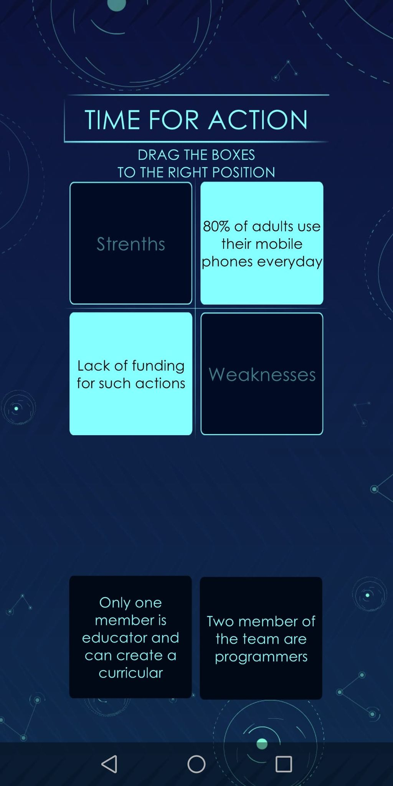
Level 2- define the strategy you will follow
“SWOT Analysis”
Consider the Environment
Internal (within the organization) & External
Strength & Weaknesses in the organization and among team members
Opportunities and threats from the environment

Slide 25
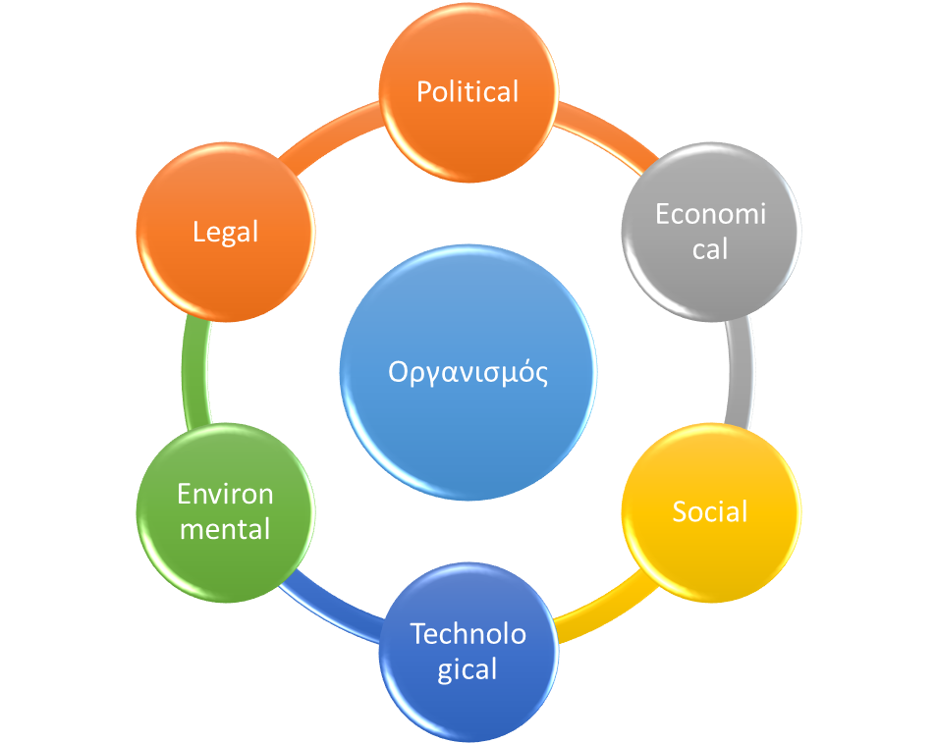
PESTEL analysis
A tool used to identify the macro (external) influences that may impact on an organisation and its project, as part of its strategy
Political,
Economical,
Social,
Technological
Environmental
Legal

Slide 26
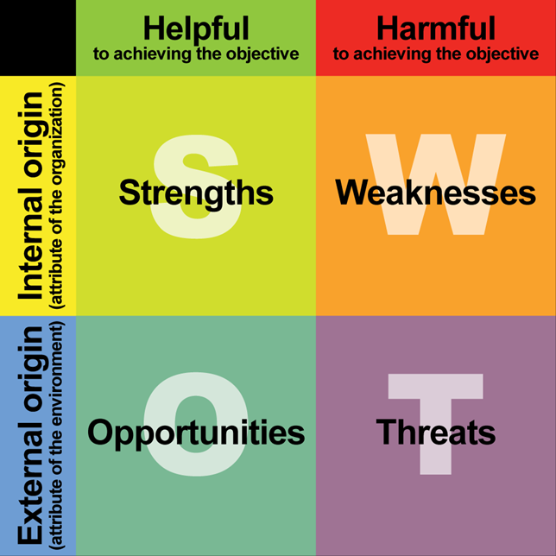
SWOT Analysis – Internal Influences
The primary objective of a SWOT analysis is to help organizations develop a full awareness of all the factors involved in making a business decision

Slide 27
Combined use of SWOT & PESTEL Analysis
STRENGTHS e.g. Experienced team members | WEAKNESSES e.g. insufficient use of new technologies
OPPORTUNITIES P e.g. a new regulation support our initiative E S T E L | THREATS P E e.g. our donors changed their priorities S T E L

Slide 28
 | Strengths: Attributes of the organization / team member that are helpful to achieving the objective | Weaknesses: Attributes of the organization / team member that are harmful to achieving the objective
Opportunities: External conditions that are helpful to achieving the objective | How do I use these strengths to take advantage or maxinaze these opportunities? | How do I overcome the weaknesses that prevent me taking advantage of these opportunities?
Threats: External conditions that are harmful to achieving the objective | How do I use my strengths to reduce the likelihood and impact of these threats? | How do I address the weaknesses that will make these threats a reality?
Translate into Objectives, Strategies, Tactics, Projects, Tasks
internal factors
SWOT - PESTEL & Strategic planning
external factors
Notes:
To evaluate a public relations project or campaign, you can use the SWOT analysis, a strategic planning method that allows you to get a better understanding of the situation so you can make justified and positive adjustments.
This tool, credited to Albert Humphrey, is one that, if done at the beginning of a project or start of a decision-making process, can certainly be returned to at any point of the projects implementation. This SWOT analysis is the core of your project, its foundation, that if you are ever lost while on the path to making a decision, you can simply refer back to your SWOT analysis to redirect yourself on a profitable course.
Strengths: Attributes of the organization that are helpful to achieving the objective.
Weaknesses: Attributes of the organization that are harmful to achieving the objective.
Opportunities: External conditions that are helpful to achieving the objective.
Threats: External conditions that are harmful to achieving the objective.
What you may have noticed is that this analysis focuses both on internal affairs as well as external. Strengths and Weaknesses are regarded distinctly as internal factors, whereas Opportunities and Threats are regarded distinctly as external factors.
It is extremely important to label the conditions and attributes correctly in relation to whether they are internal or external as it is this sort of labeling that assists you in prioritizing, classifying your actions in order of importance.
For a visual examples and more information on the SWOT analysis, I suggest visiting this site.

Slide 29
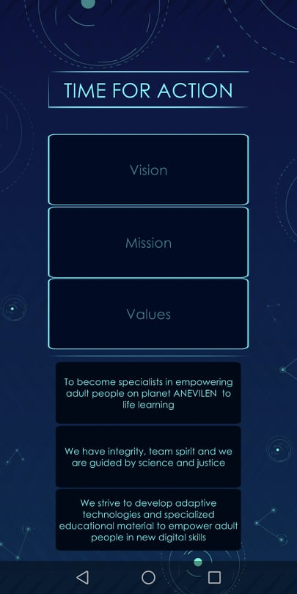
Level 3- Capacity building
“Vision, Mission, Values”
This concept is interesting in that it can be both the easiest and hardest area of your business to tackle.
It’s the easiest in the sense that it largely comes from you. What do you want this organization to be? Where do you see it going? What are your values? These are questions that only you can answer.
In other ways it’s the hardest, because these questions really tap into a personal connection between who you are as a person and what your business represents.

Slide 30

The “big” picture
Why​ your organization exists, in a fundamental sense
What​ the world will look like if you accomplish everything you set out to do
How​ you and your team will conduct yourselves as you execute your plans
Which​ big milestones you’ll hit along the way
Separate from any financial aspirations, what was the driving force for creating this organization?
Was it connected to a passion, area of expertise, particular technological / product breakthrough, or simply an emotional drive to create a new path?
https://mapandfire.com/field-guide/purpose

Slide 31
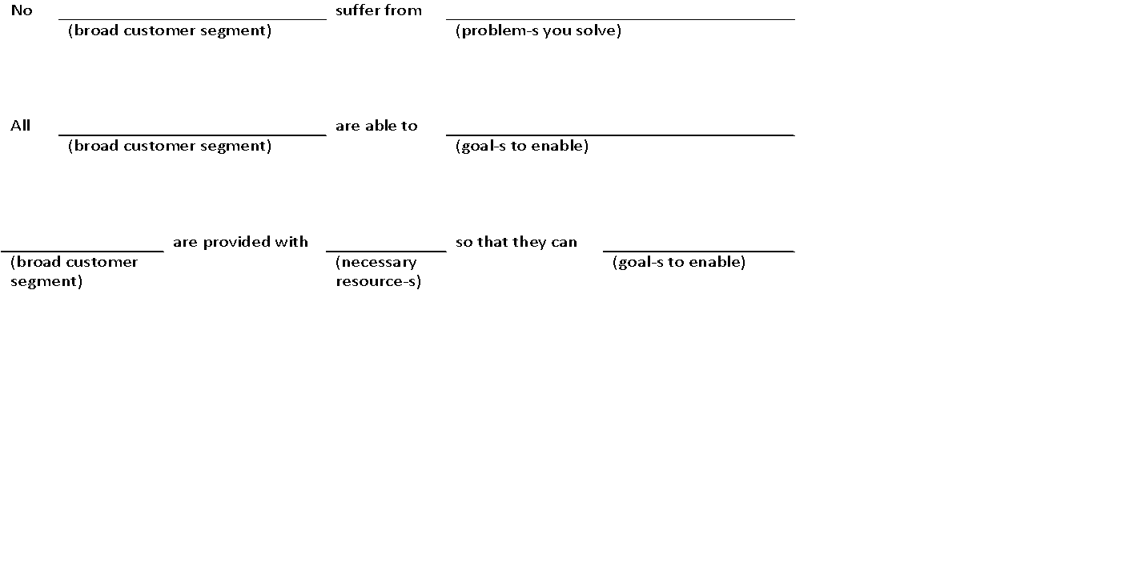
Vision Statement
Your Vision Statement describes the ultimate outcome of your efforts in terms of your impact on the world. It can be helpful to think of your Vision in terms of an “Envisioned Future” - that is, a description of what the world could be like if you achieve everything you set out to do.
Exercise:
Questions
If you executed perfectly on everything you dream of doing, how would people’s lives be different?
How would the world be changed?
What does that ideal future look like in six months, a year, and several years down the road?
What if you took your concept as far as you can possibly imagine?
Notes:
https://mapandfire.com/field-guide/purpose

Slide 32
Core Values
Core values describe what we believe and how we behave. They are our principles and standards of conduct even (and especially) when things get difficult. Values give meaning to your business beyond financial goals and are independent of specific business activities.
Questions
What behaviors are important and non-negotiable regardless of what you’re doing?
How will you conduct yourself as you work to bring your vision to life?
How would you describe you and your team when you’re performing at your best?
Notes:
https://mapandfire.com/field-guide/purpose

Slide 33

Level 4- Strategy
“Social Business Model Canva”
The Social Business Model Canvas is a method used to obtain a clear overview of key aspects of a social enterprise’s operations and structure
Social entrepreneurship needs a business strategy that goes further than making a profit. Using this tool to analyze social business models make their strengths and weaknesses become apparent.
It also reveals the emerging opportunities and dangers new social enterprises may face, showing that social enterprises may need to become even more transparent as well as consider broadening their social impact.

Slide 34
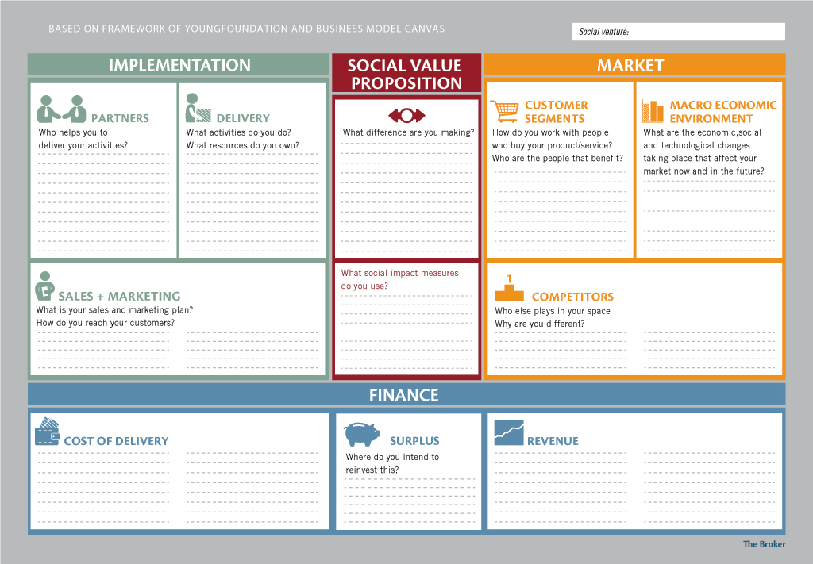
Social Business Model Canvas

Slide 35
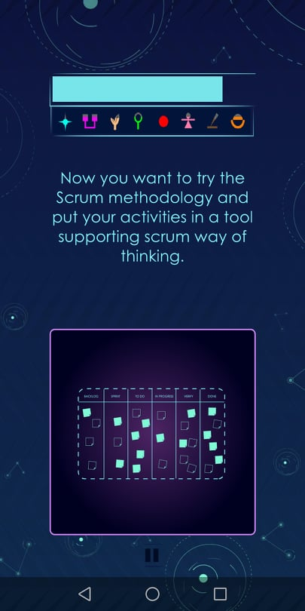
Level 5-
Everyday- management tools
“Kanban Board”
A kanban board is an agile project management tool designed to help visualize work, limit work-in-progress, and maximize efficiency (or flow).
Kanban boards use cards, columns, and continuous improvement to help technology and service teams commit to the right amount of work, and get it done!
Kanban boards visually depict work at various stages of a process using cards to represent work items and columns to represent each stage of the process. Cards are moved from left to right to show progress and to help coordinate teams performing the work.

Slide 36
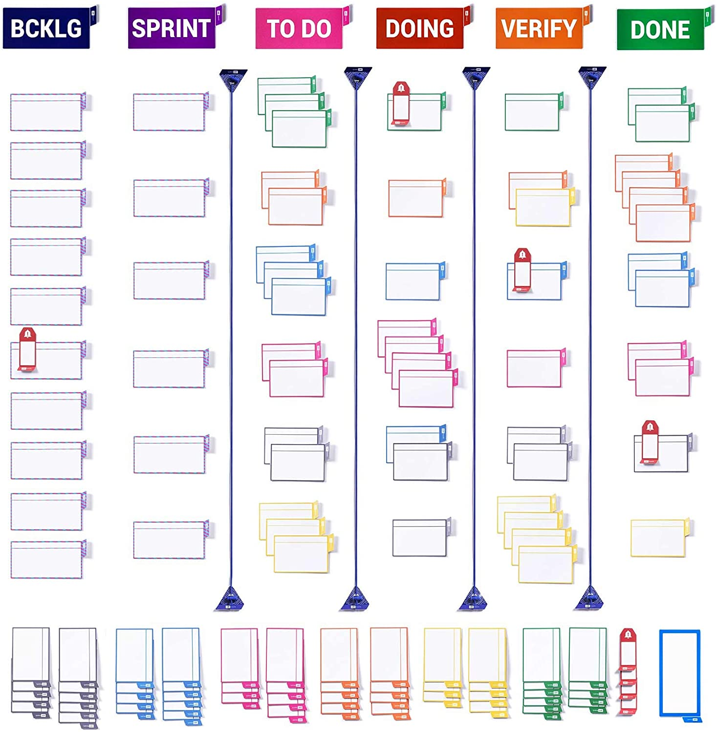
Notes:
https://www.amazon.com/PATboard-Scrum-Board-Kanban-Toolset/dp/B07R5ZFWFM

Slide 37
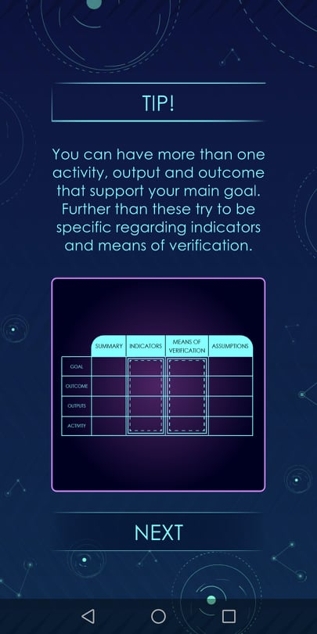
Level 6: Fundraising
“Logical Framework”
It is a highly effective strategic management tool to monitor, evaluate and control project activities. Following are the components of an LFA:
Project Description - A brief description stating what the project is about.
Project Goal - What will be the broad impact of the project?
Outcome(s) - What is the immediate outcome of the project?
Outputs - The deliverables of the project
Activities - List of activities (as highlighted by the “why-why tree”) that need to be carried out along with their sequencing.
Verifiable Indicators - Indicators that relate to each of the above mentioned components.
Means of verification - How each one of the indicators will be verified? Must mention a source.
Assumptions - State the assumptions relating to the Goal, Outcome, Outputs and all the Activities of the Project

Slide 38
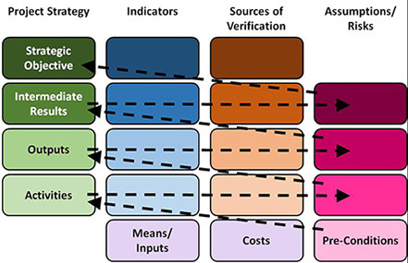
SWOT & PESTEL
Aspiration
Why
What
How
Problem-Solution Tree
Notes:
What is a LogFrame?
https://programs.online.american.edu/online-graduate-certificates/project-monitoring/resources/what-is-a-logframe

Slide 39
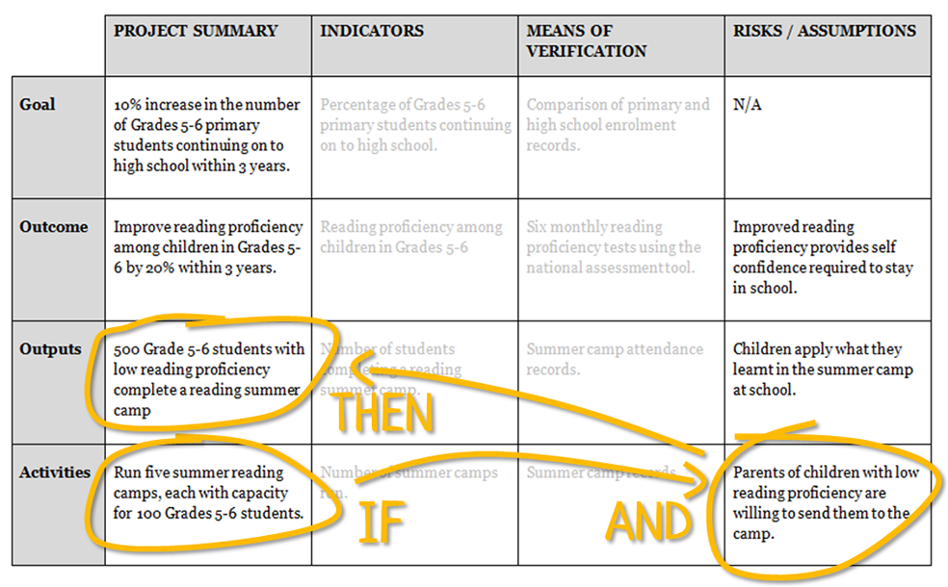
example
Notes:
How to write a logical framework (logframe)
https://www.tools4dev.org/resources/how-to-write-a-logical-framework-logframe/

Slide 40
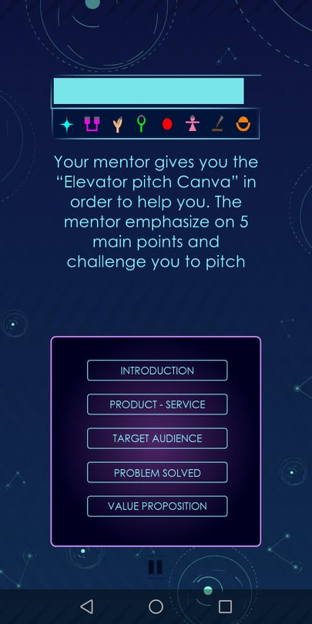
Level 7 -
Networking
“Elevator pitch”
pitching your Organization in 45 sec…
Climax!
Moment to sell!
Vision
What we can became!
Team
Why are we the best?
How?
What are we doing?
Why?
Origin / Problem
Other Info
Epilogue
End
Who?

Slide 41
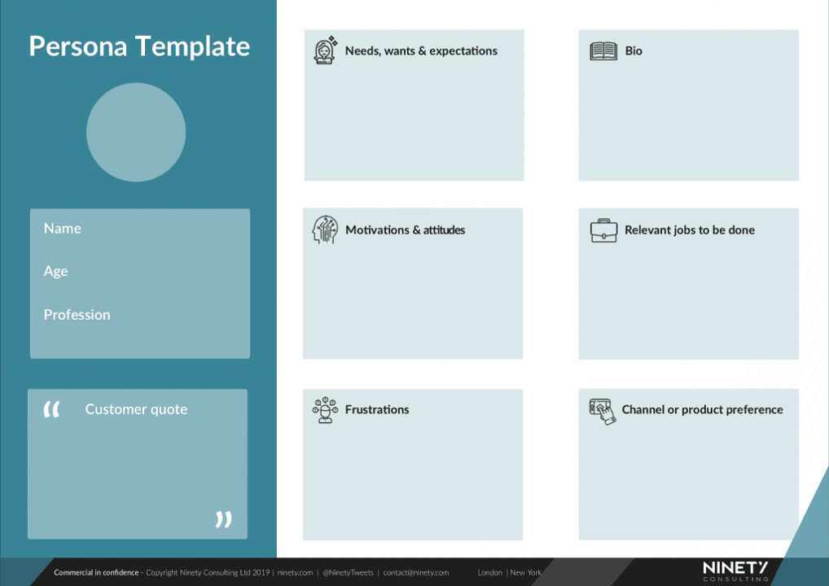
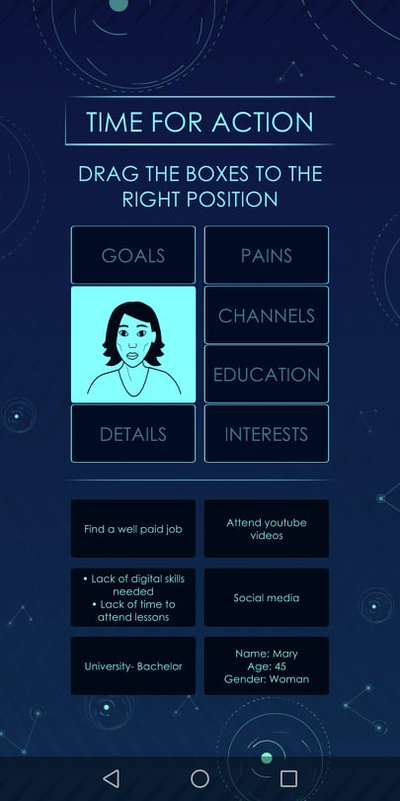
Level 8: Dissemination
“Persona canva”

Slide 42
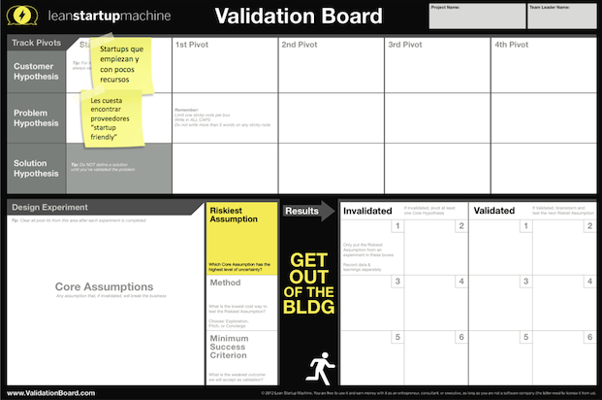
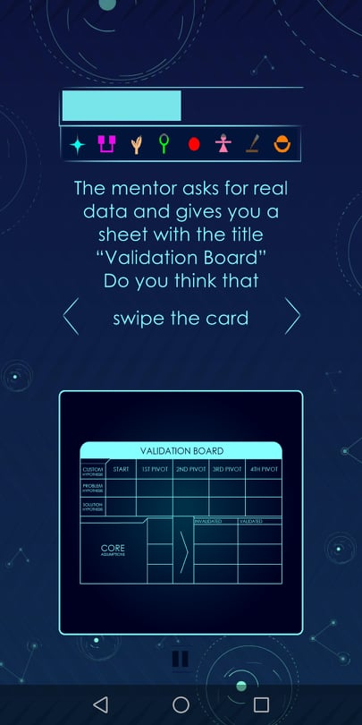
Level 9:
Evaluation
“Validation board”

Slide 43
Connection of the game with IO2 contents
How to use the guide before or after the game

Slide 44
INSPIRE
2019-3-EL02-KA205-005215
THANK YOU!!
This presentation is related to the Project made by the beneficiaries jointly or individually in any form and using any means shall indicate that it reflects only the authors view and the National Agency and the European Commision are not responsible for any use that may be made of the information it contains.

