Slide 1
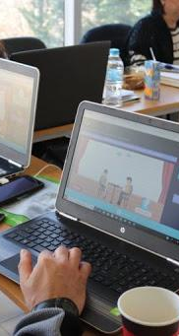


INnovative Serious Play for Identifying your Role in Social Entrepreneurship

Slide 2
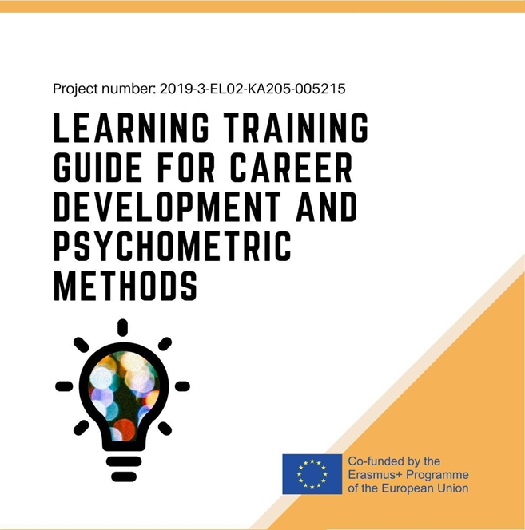
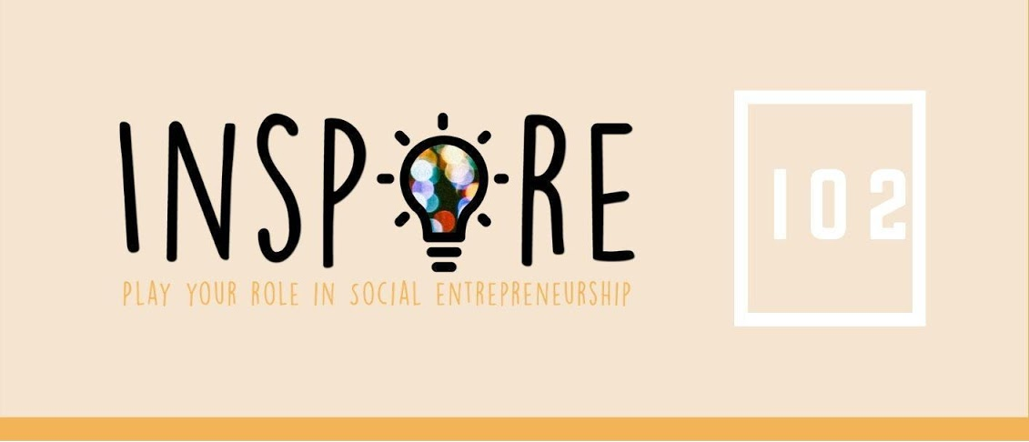

Slide 3

Why read this Guide?
Main objective
to provide young people and their trainers with the necessary knowledge as well as the tools to assess personality characteristics and skills in order to create strong TEAMS and work complementary together to ensure the success of their Vision and Social enterprise
Additionally, this guide helps readers learn:
What is career choice and development
How this is led by personality skills and competences
Which are the main skills for an entrepreneur
Which are the main qualities and roles needed in the founding team of a Social enterprise
How to self-assess skills, personality and competences

Slide 4




Who should read this Guide?
&
youth trainers, career advisors, coaches
young people
They can both :
learn how to implement methods, activities or tools in order to assess their skills, competences and personality
found links and materials to implement the specific tools or activities

Slide 5

What’s the content?
Introduction to key concepts
  Career development and vocational choice
  Personality, Skills and competences, difference between hard and soft skills
  Entrepreneurship: skills, competences and roles
  Team vs Groups
Career development and Vocational choice
  What is & some Popular career development theories
  Most popular assessment methods and tools for career choice and development
  How can these methods and tools be used for identifying your self as social entrepreneur
Personality, skills and competences
  How can they be identified?
  What is psychometric tests & What do they measure?
  When and how (which method) to apply psychometric tests?
  How these tools can be used to identify your role in social entrepreneurship
Working groups, teams and leadership in Social enterprises

Slide 6
Career Development & Vocational Choices

Slide 7
Career Development
Is the lifelong process of managing learning, work, leisure, and transitions in order to move toward a personally determined and evolving preferred future.
In organizational development the study of career development looks at:
how individuals manage their careers within and between organizations,
how organizations structure the career progress of their members, it can also be tied into succession planning within most of the organizations.

Slide 8
Vocational Choices
Vocational choice is the choice of a job or profession.
A realistic process frequently starts during the teenage years, with an analysis of strengths, personal interests, and hinderances in association with a chosen vocational framework.
A mature vocational choice necessitates adequate self-understanding to suit personal interests and resources to the needs of and circumstances of a particular job or career.
Self-understanding of the aforementioned, is an important characteristic for a mature vocational choice.

Slide 9
Career development theories
Holland’s Theory of Vocational Personalities in Work Environment, which is based on the idea that “career choice is based on personality”, and it identifies six personality types; after the assessment of a person’s personality the 3 letters code shaping by the capital letters of the most relevant personalities reveal the person’s interests which lead to career choice and satisfaction
Roe’s personality theory: claims that an individual’s career choice is influenced by his/her interaction with his/her parents; the nature of this interaction would lead them to develop an orientation either toward or not toward people and to pursue either person-oriented or non-person-oriented jobs.
Self-concept Theory of Career Development formulated by Super and more recently by Savickas. This theory argues that “time and experience help shape the way a person values their careers and the goals they set”. In this theory career development is disaggregated into five stages which are growth, exploration, establishment, maintenance and decline.
Gottfredson’s Theory of Circumscription and Compromise which describes the career choice as a procedure of elimination of occupational alternatives. Through childhood and adolescence, a person eliminates occupations while the role of compromise is also important.
Theory of Work-Adjustment (TWA) which is based on how the person correspond with the work environment and creates a continual process of career development and satisfaction for both sides the person and the organization-environment.
Bandura’s Social Cognitive Career Theory (SCCT) which declares that “an individual’s motives and behaviours are based on experience” and his/her view of his/her own abilities influences career choice.

Slide 10
Personality, Roles, Skills & Competences

Slide 11
Personality, Skills & Competences
the personality of an entrepreneur is defined by four main aspects, those being motivation, traits, identities and skills
A review of 50 empirical studies by Stephan & Andreana, 2017
to be a great and successful social innovator the following skills are necessary: leadership, optimism, grift, resilience, creativity and innovation, empathy and lastly emotional and social intelligence.
A social innovator can identify a social problem and use it in terms of entrepreneurial principles.
Sherman, 2011
To achieve their visions, successful social entrepreneurs need to take direct action and be directly engaged with their work.
Direct action includes important changes that social entrepreneurs want to see achieved by organizations, networks and infrastructures
“Seven Skills for Social Entrepreneurs,” 2018

Slide 12
Some Assessment Methods
Strong Interest Inventory evaluates your work and career interests instead of your personality, skills or values, using the Holland codes as a basis for its assessment.
The Clifton StrengthsFinder, the results of this instrument provide the user with a set of strengths that can be applied to both career and academic pursuits
The Big Five Personality Traits Model, there are five main factors that determine human personality. Your results will rank where you fall on the dimensions of emotional stability, extroversion, openness, agreeableness and conscientiousness. These results can be used to better understand your work performance, organizational citizenship and job fit
Myers-Briggs Type Indicator, the completed instrument places you in one of 16 personality types based on your preferences among pairs of characteristics. Is a four-letter code that explains how preferences combine to form interests, views, motivations and actions
DiSC.measures your patterns of behavior based on preferences and priorities. The theory behind this test is that everyone has a dominant characteristic or reference point. The four DiSC characteristics are dominance, influence, steadiness and conscientiousness. in your career and personal life
The General Aptitude Test Battery, also known as the GATB, is a professional career aptitude test which measures nine different aptitudes and can be used to help assess the likelihood that you will be successful in specific careers or training programs.it refers to your innate ability to do well at tasks that require a specific type of skill

Slide 13
Psychometric tools

Slide 14
What Do Psychometric Tests Measure?
Interest tests measure how people differ in their motivation, values, and opinions in relation to their interests.
Personality tests measure how people differ in their style or manner of doing things, and in the way they interact with their environment and other people.
Aptitude tests measure how people differ in their ability to perform or carry out different tasks.

Slide 15
Using Psychometric tests
Selection of personnel
Individual development and training
Team building and development
Career development and progression

Slide 16
The psychometric test provides fair and accurate results each time it's given
to ensure this, the test must meet these three key criteria:
Standardization – must be based on results from a sample population that's truly representative of the people who'll be taking the test. By using a standardized test, you can compare the results with anyone whose characteristics are similar to those of the sample group.
Reliability – must produce consistent results, and not be significantly influenced by outside factors. For instance, if you're feeling stressed when you take the test, the test results shouldn't be overly different from times when you were excited or relaxed.
Validity – This is perhaps the most important quality aspect of a test. A valid test has to measure what it's intended to measure. If a test is supposed to measure a person's interests, then it must clearly demonstrate that it does actually measure interests, and not something else that's just related to interests.

Slide 17
Working Groups vs Teams
Teambuilding, Leadership

Slide 18
Working Group vs Teams
Τwo or more members work together to complete a task, while one leader directs them, delegating work among group members, monitoring and controlling the progress.
Members of a group work on their own specializations, with each individual driving toward their own goal.
Working groups share information and insights, but create their own independent goals and responsibilities.
Collaborative or combined work does not occur within a group.
Groups measure success by what an individual completes
A team has a shared goal but focuses more on a collective purpose. Teams work together to build one product through both individual and mutual contributions. This interdependent work lends to one combined end result.
A team’s common goal gives each member a shared responsibility toward it. Team members elevate each other’s strengths and fill in the gaps where teammates’ skills are lacking. Because of this, teams are able to do more than the members would on their own.
Team members need a collaborative environment to combine their specialized skills and achieve their end goal.

Slide 19

Teambuilding Activities
The guide contains more than 15 activities either located and processed by the web or configured by the project team

Slide 20
INSPIRE
2019-3-EL02-KA205-005215
THANK YOU!!
This presentation is related to the Project made by the beneficiaries jointly or individually in any form and using any means shall indicate that it reflects only the authors view and tha the National Agency and the European Commision are not responsible for any use that may be made of the information it contains.

