Slide 1
INSPIRE
INnovative Serious Play for Identifying your Role in Social Entrepreneurship

Slide 2
The INSPIRE is aiming to inspire and empower young people between 18-24 engage with Social Entrepreneurship, create strong teams which will found their companies, through an innovative toolkit and a psychometric serious game that assesses and identifies their competences and personality characteristics while it presents them ways of overcoming challenges of entrepreneurial world and opportunities according to SDGs.

Slide 3
Challedu
an NGO focusing on creation of serious games for specific educational or other aims
FSC
an family support center implementing the last 20 years career coaching workshops and seminars as well as personal advisory especially to vulnerable groups like young people, refugees, women, economic excluded people
PARTNERS
CIP
an NGO dealing with young people and empowerment of entrepreneurial skills
MC2020
a youth educational center with expertise in development of training material and implementation of workshops for entrepreneurship and employability of young people

Slide 4
A. Promote entrepreneurship education and social entrepreneurship among young people (18-24)
B. Support young people to identify their skills and competences, in order to develop them more or acquire new for succeeding in developing sustainable Social Enterprises
OBJECTIVES
C. Enhance acquisition of key skills and competences in Social entrepreneurship, SDGs, Self-awareness, Social Media from young people
D. Create an innovative digital toolkit and serious game promoting open education and innovative practices in a digital era

Slide 5
EXPECTED RESULTS OF THE PROJECT
Creating motivation to young people (age 18-24) to form teams and found their own social enterprise.
Creating motivation to young people (age 18-24) to improve their skills, competences and identify the roles they can play in any team or company.
Enhancing the use of serious games in youth training, psychometric evaluation, career coaching, HR and relevant fields.
Strengthening the skills, competences and toolkit of youth trainers, coachers, career advisors and relevant professionals

Slide 6
ID | Leading Organization | Output Title
O1 | CIP | O1-Development of Methodological Guide of INSPIRE project
O2 | FSC | O2- Learning training guide for career development and psychometric methods.
O3 | MC2020 | O3- Learning training guide for viable Social Enterprises business models addressing challenges based on SDGs (Sustainable Development Goals) and for effective use of Social Medias.
O4 | CHALLEDU | O4- Innovative psychometric Serious Game.
INTELLECTUAL
OUTPUTS

Slide 7
Kick off
meeting

Slide 8
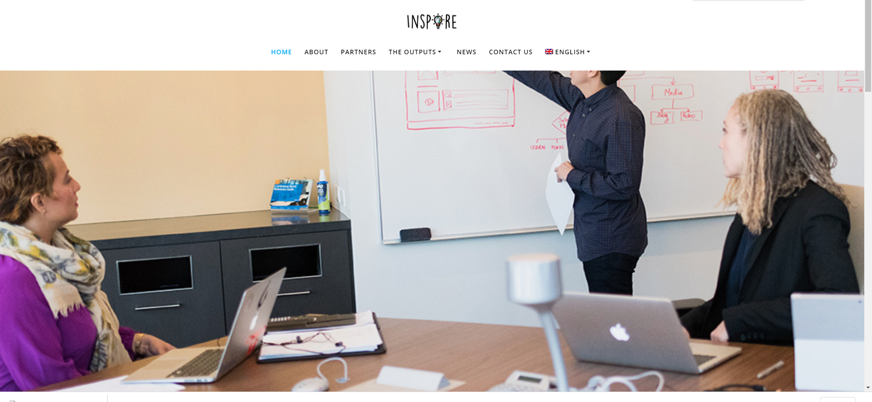
WEBSITE
You can visit our website to find out all details of the project
WWW.INSPIREYOUTH.EU

Slide 9
In the methodological guide you will find:
Youth unemployment rates in Europe
How entrepreneurship can be used as a tool to fight unemployment
Characteristics of Startups in Partners countries
What is Sustainable Development Goals (SDGs) and initiatives for their promotion in Europe
How social-startups can help towards SDGs
Educational projects that promotes Social entrepreneurship
Intellectual Output 1
Methodological guide of INSPIRE
project

Slide 10
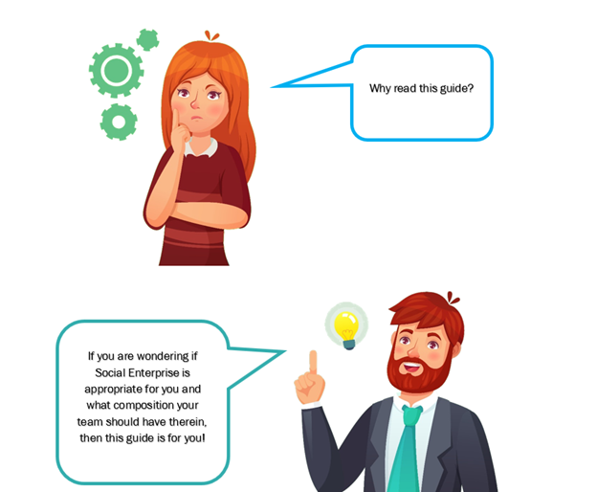
The key points of the guide are:
Career Development and Vocational choices
Skills, competences and personality
Psychometric methods and tools
Roles in a social entrepreneurship
Importance of Teambuilding
Intellectual Output 2
Learning training guide for
career development and psychometric methods.

Slide 11
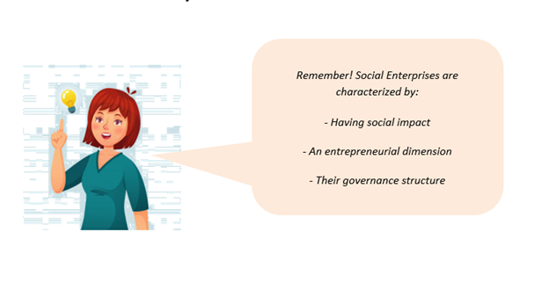
Main contents of part 1:
Business models for Social enterprises
SDGs and Social enterprises
Skills and competences of Social entrepreneurs
Activities and tools to develop a strategy for a social enterprise to deal with SDGs
Main contents of part 2:
Social medias in social enterprises
Effective use of social media
Activities and tools to develop a social media strategy for a social enterprise
Intellectual Output 3
Learning training guide for viable Social Enterprises business models addressing challenges based on SDGs (Sustainable Development Goals) and for effective use of Social Medias

Slide 12
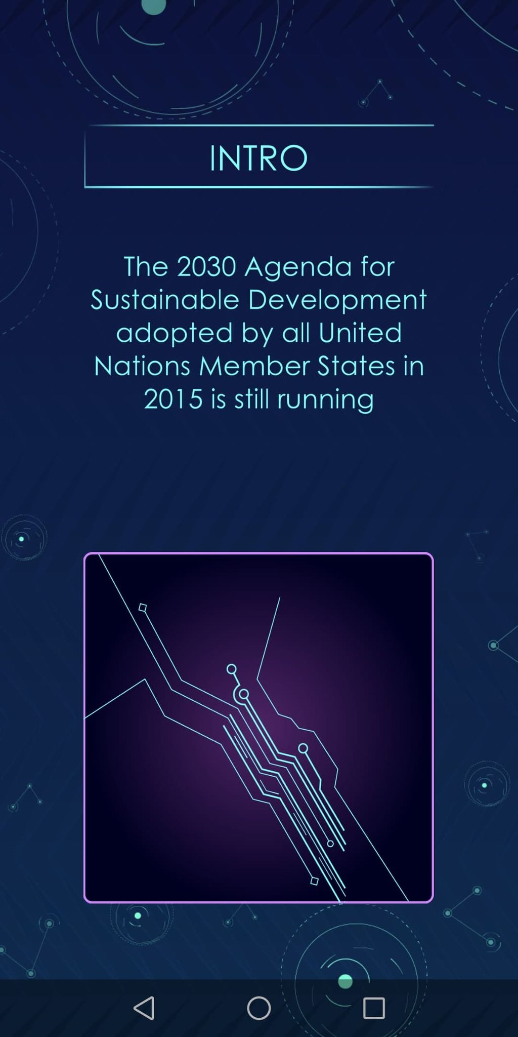
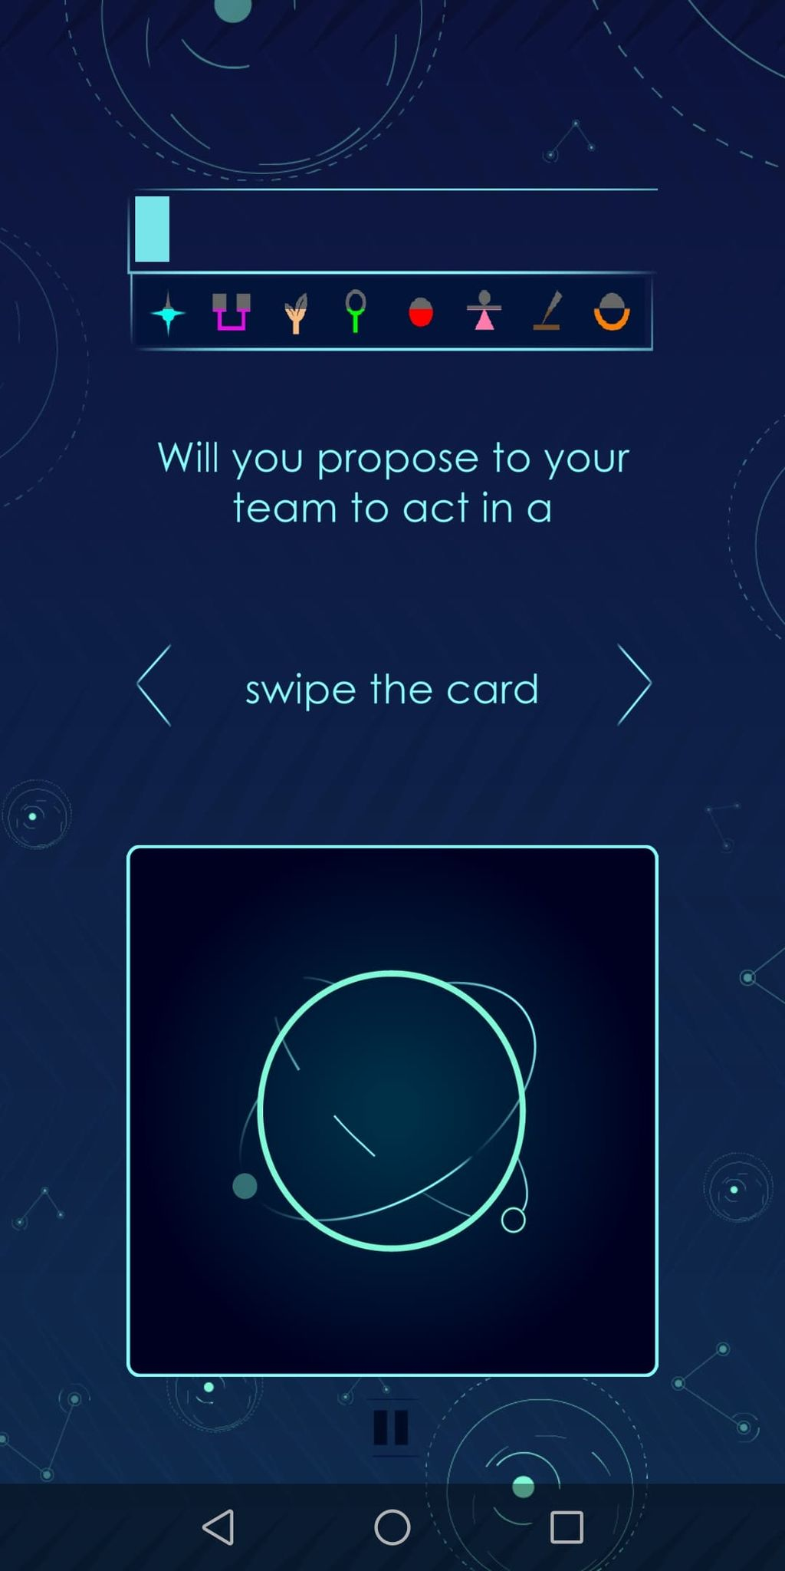
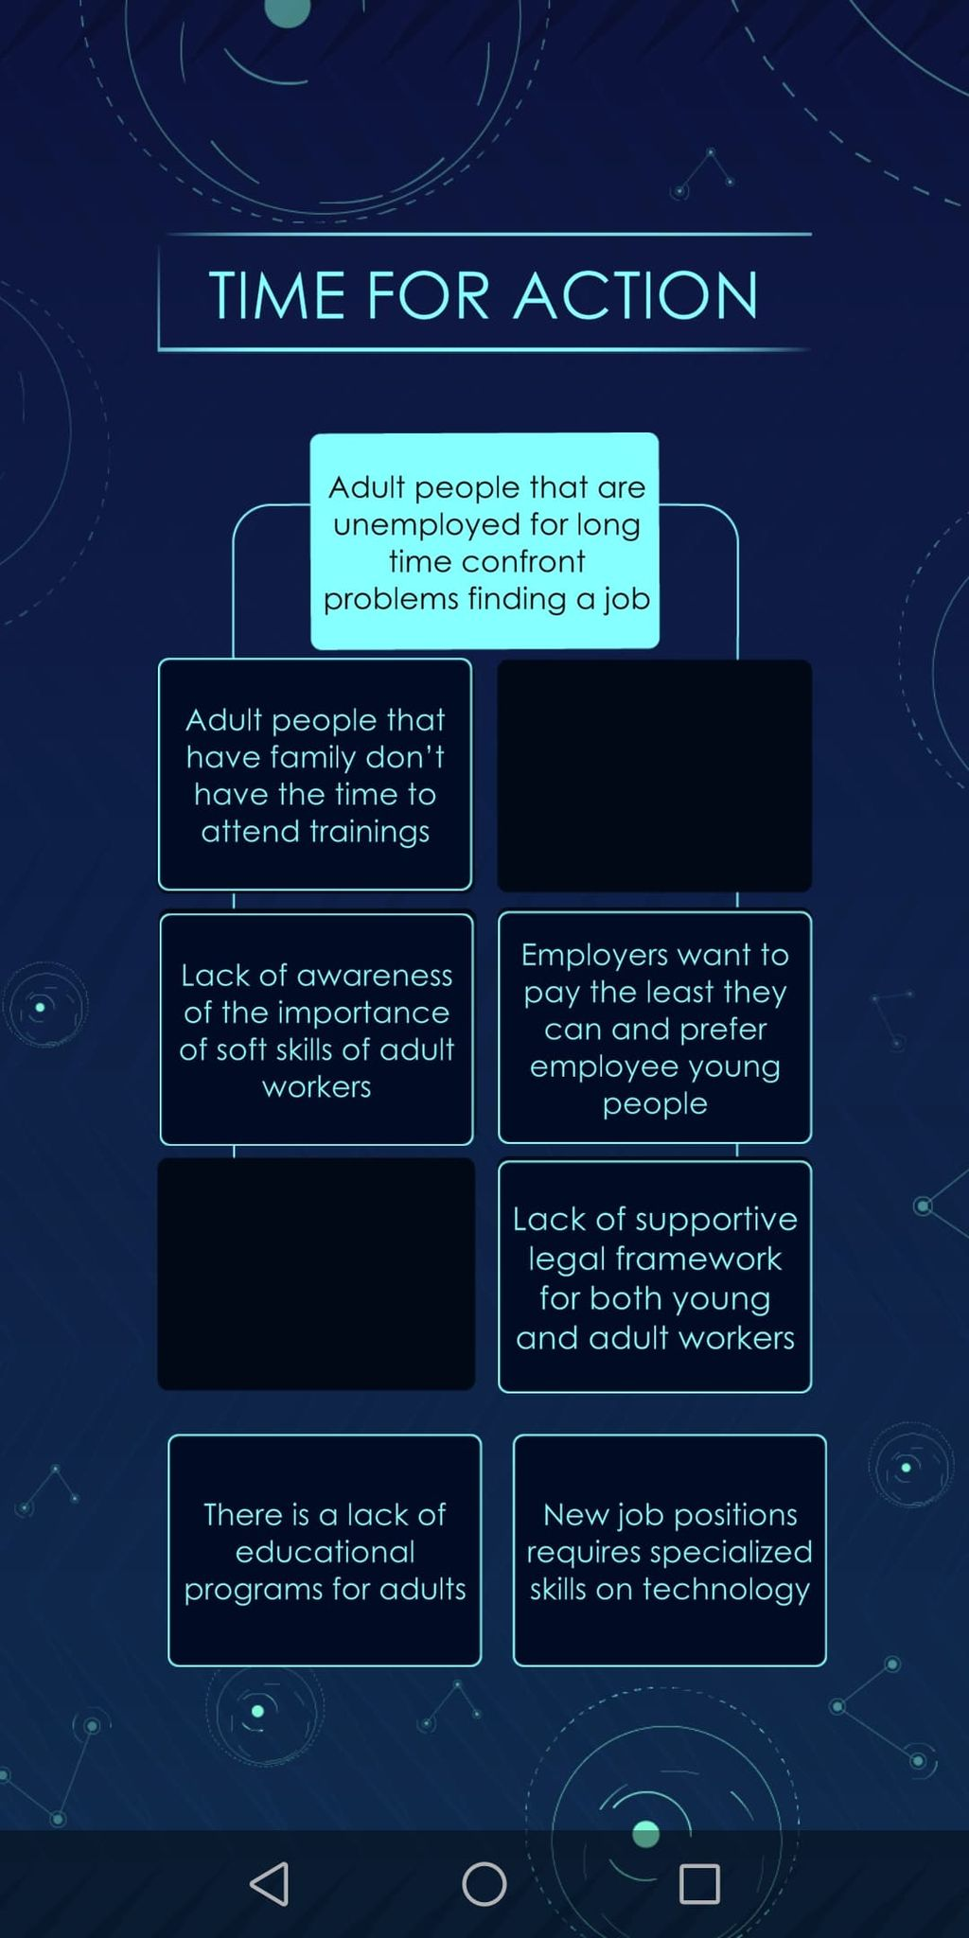
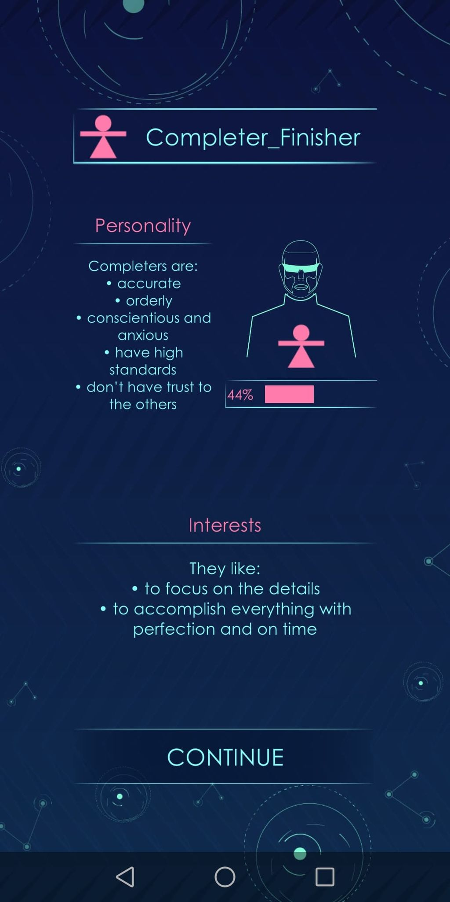
The serious game of INSPIRE project is under development!
We need your feedback today!!!
Intellectual Output 4
Innovative psychometric Serious Game

Slide 13
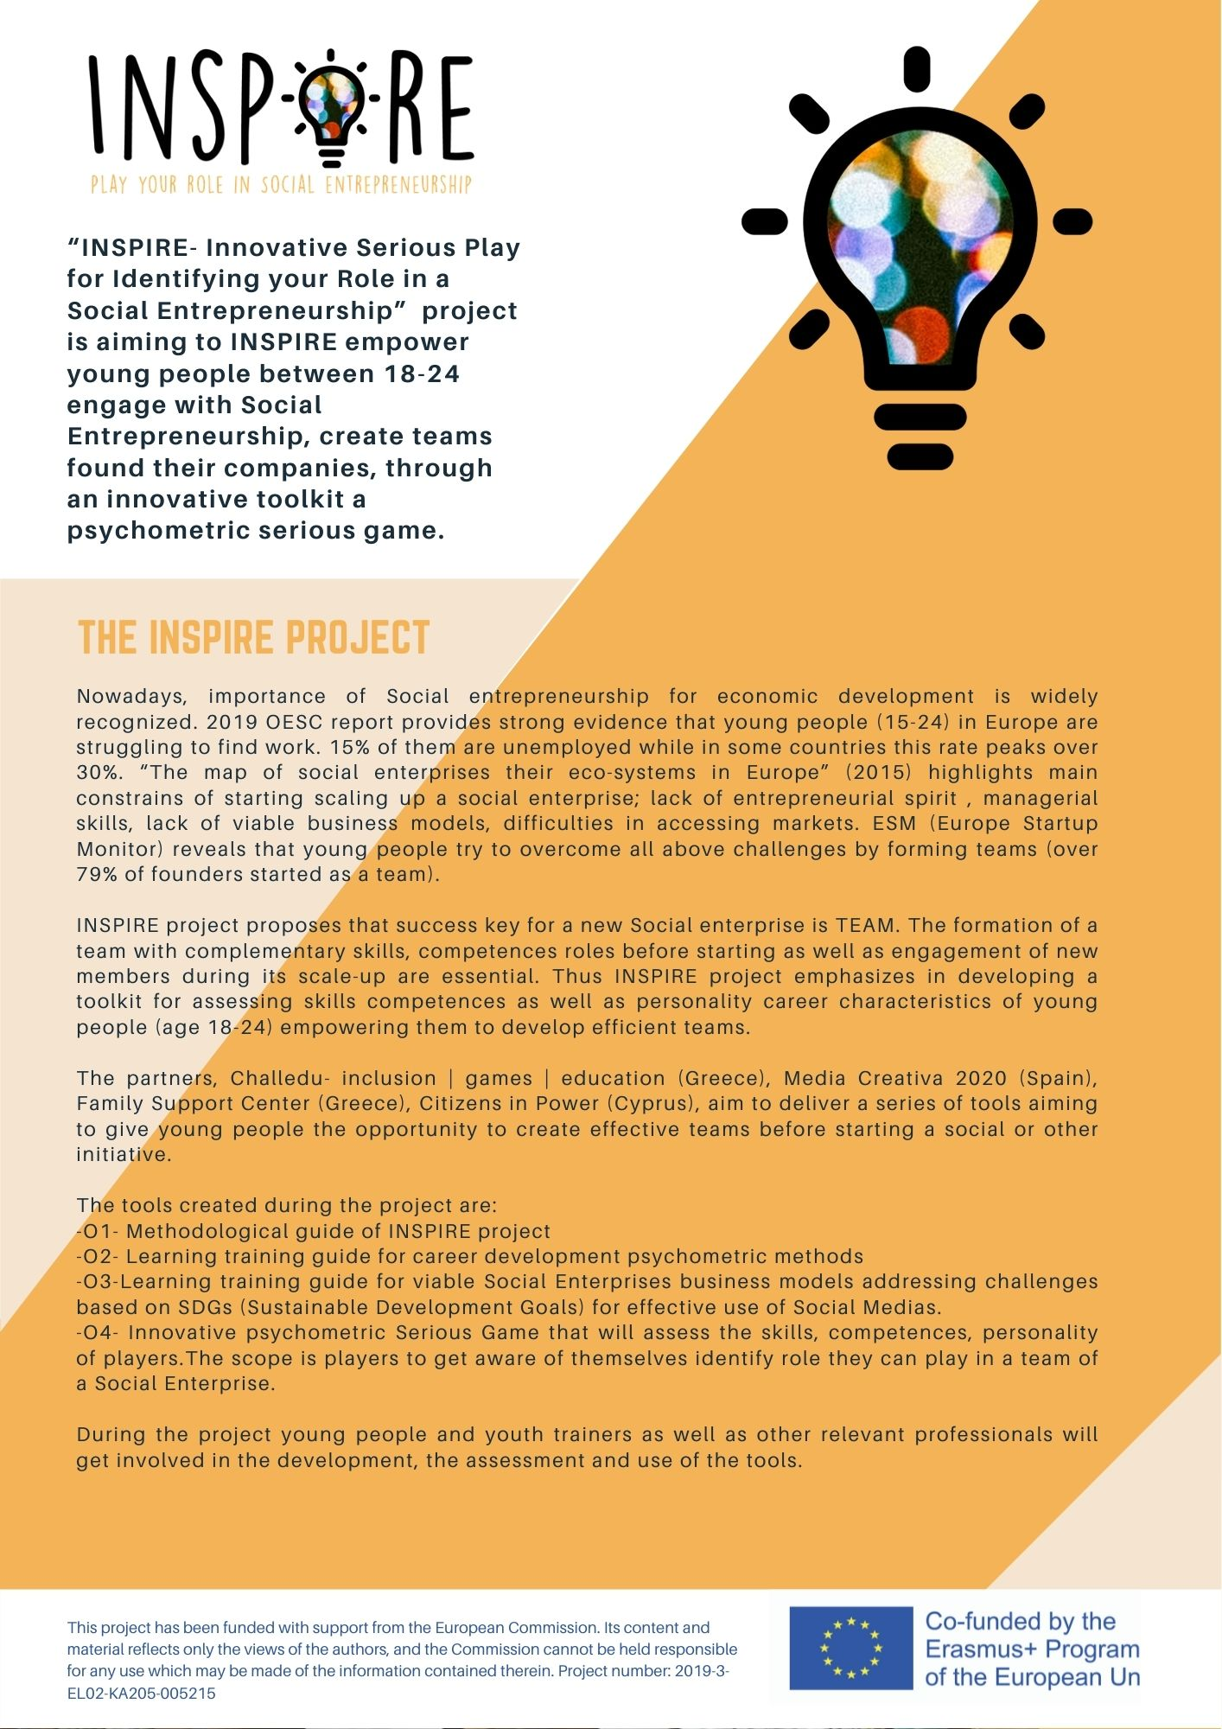
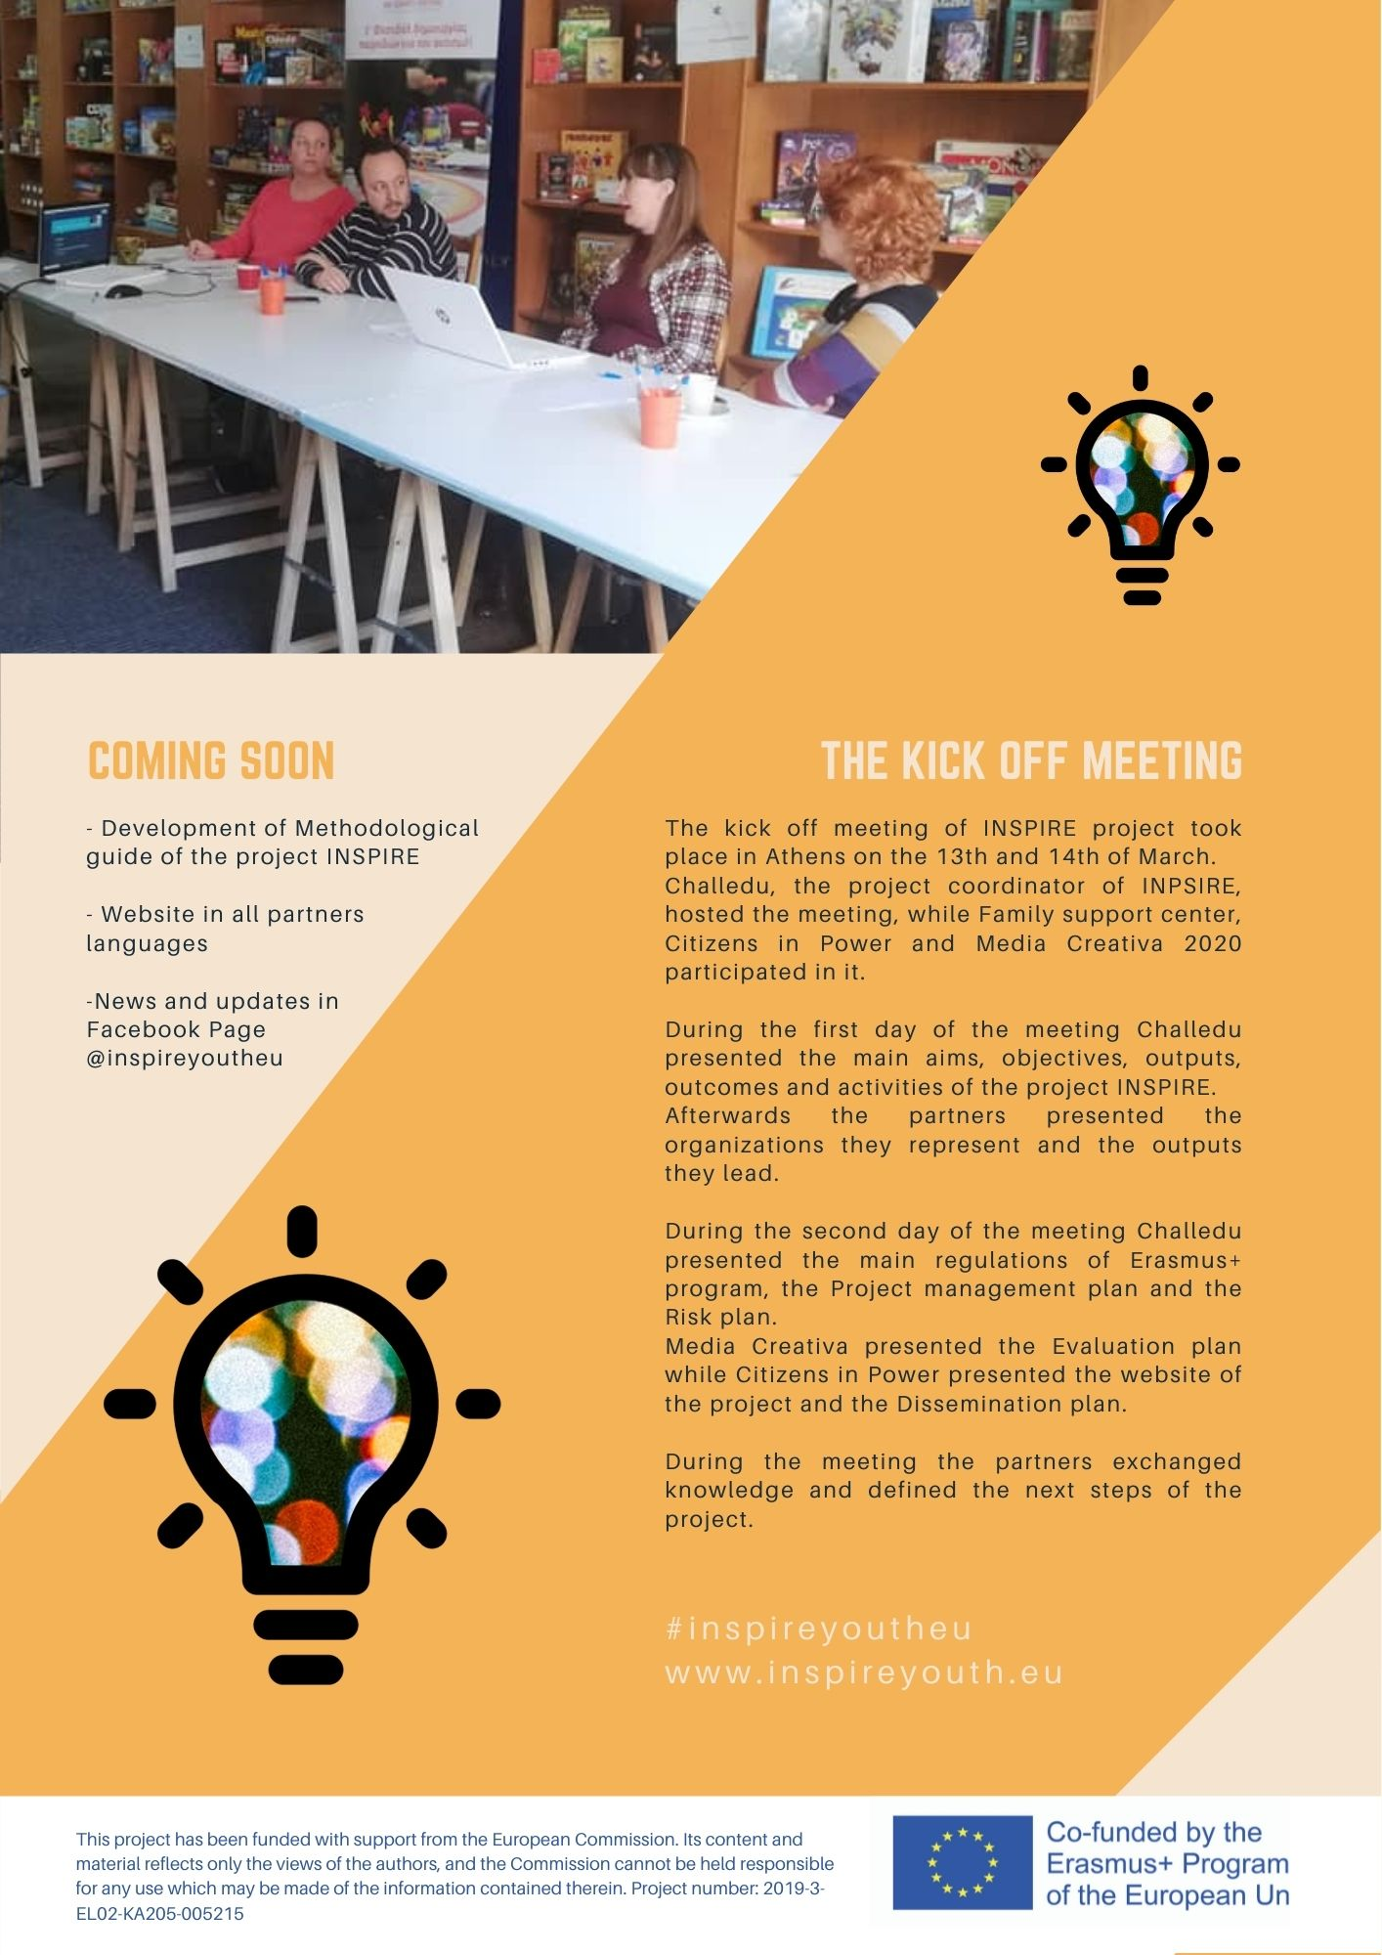
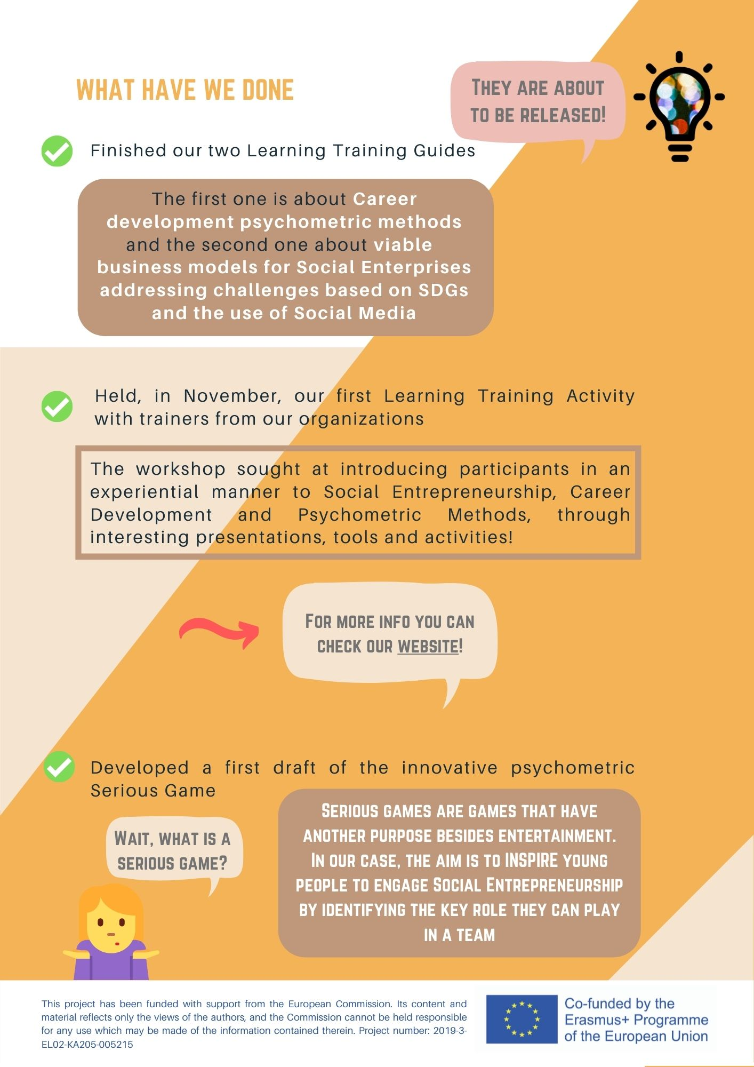
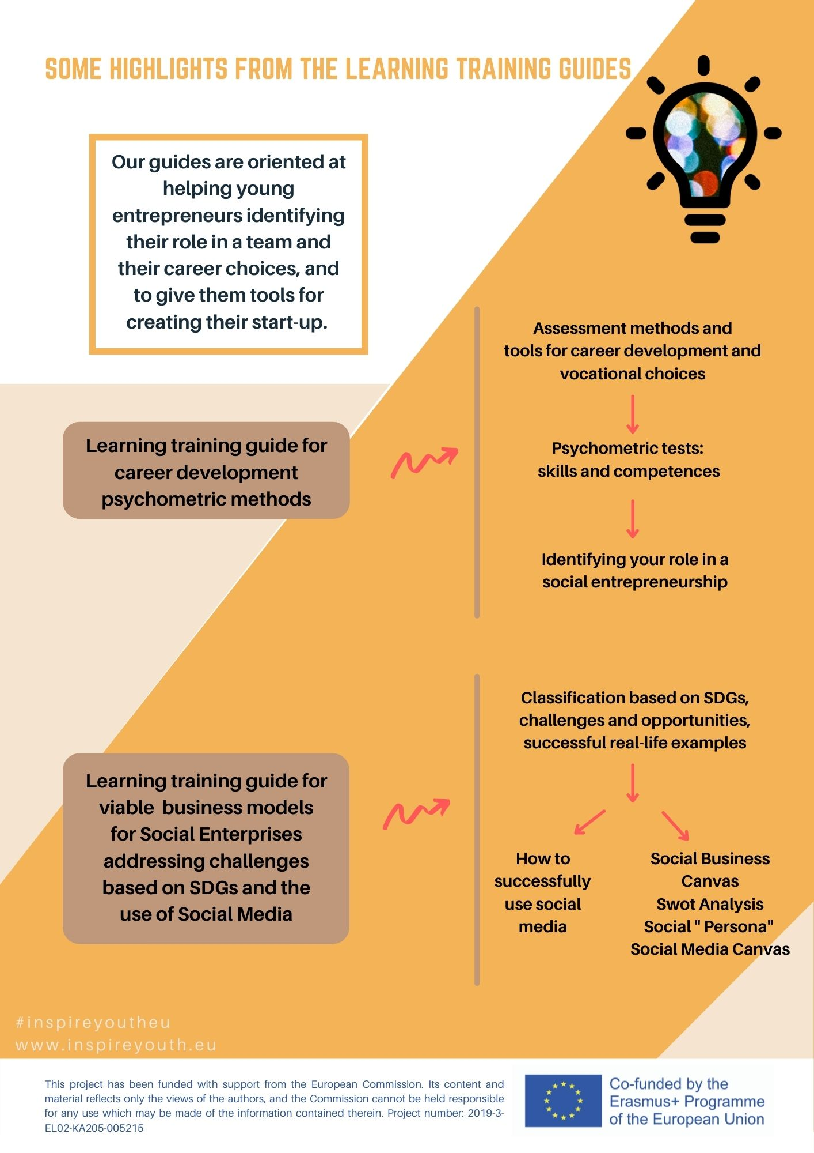
1st: ABOUT & KICK OFF
2nd: FINDINGS for IO1
Newsletters
3rd: Methodological guide
4th: IO2+ IO3

Slide 14
Newsletters
5th IO1+ IO2+IO3
START developing the game

Slide 15
1st: ABOUT
2nd: FINDINGS for IO1
5th: Local workshops
Press Releases
3rd: Methodological guide+ trainings
4th: LTTA 1

Slide 16
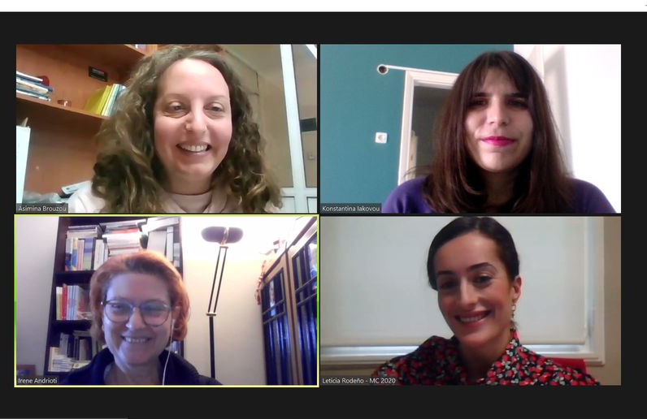
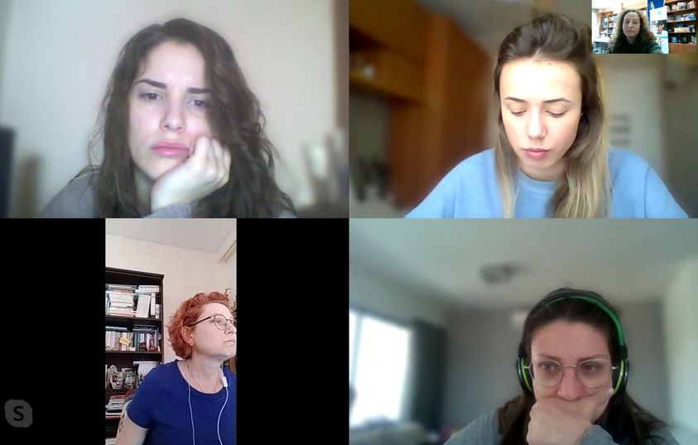
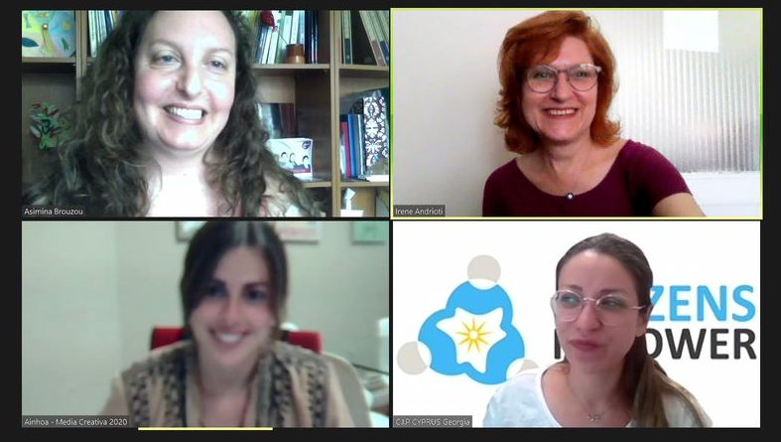
Online
meetings

Slide 17
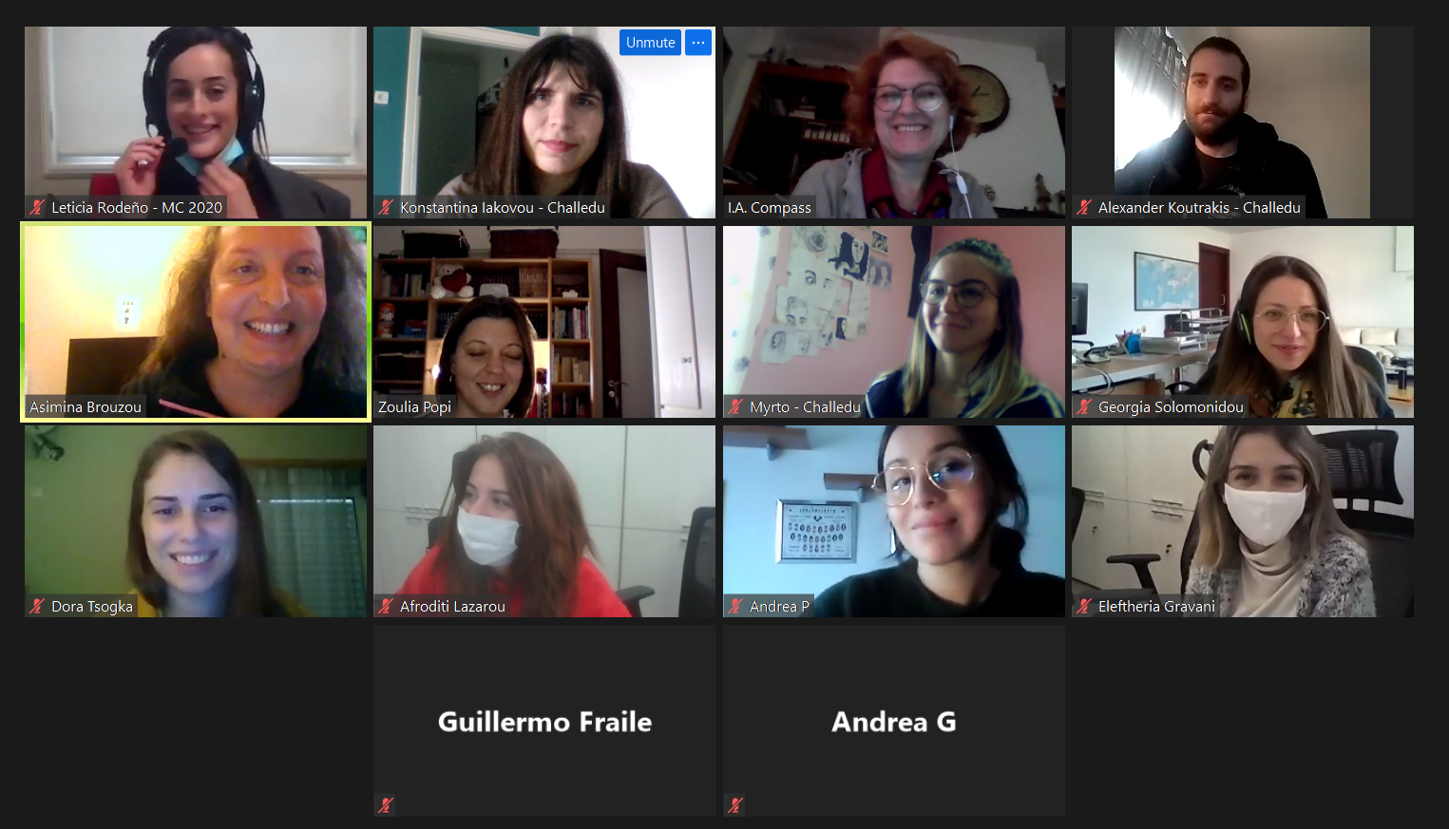
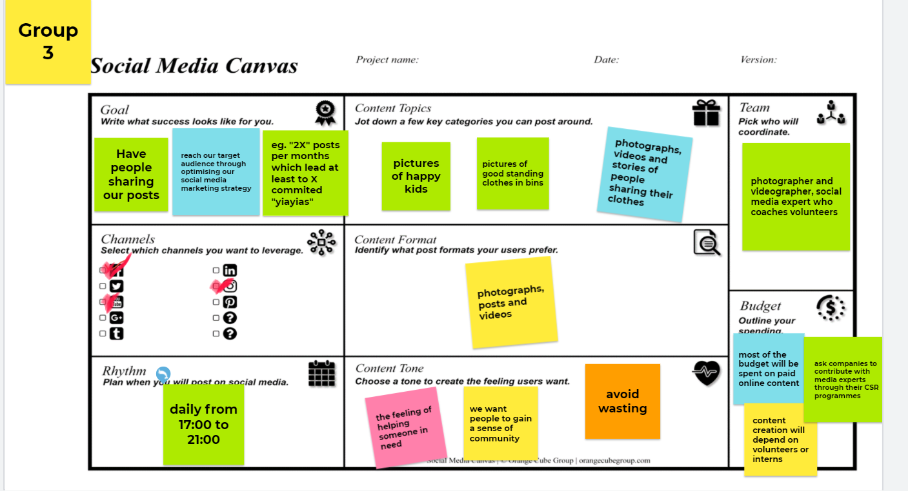
1st LTTA

Slide 18
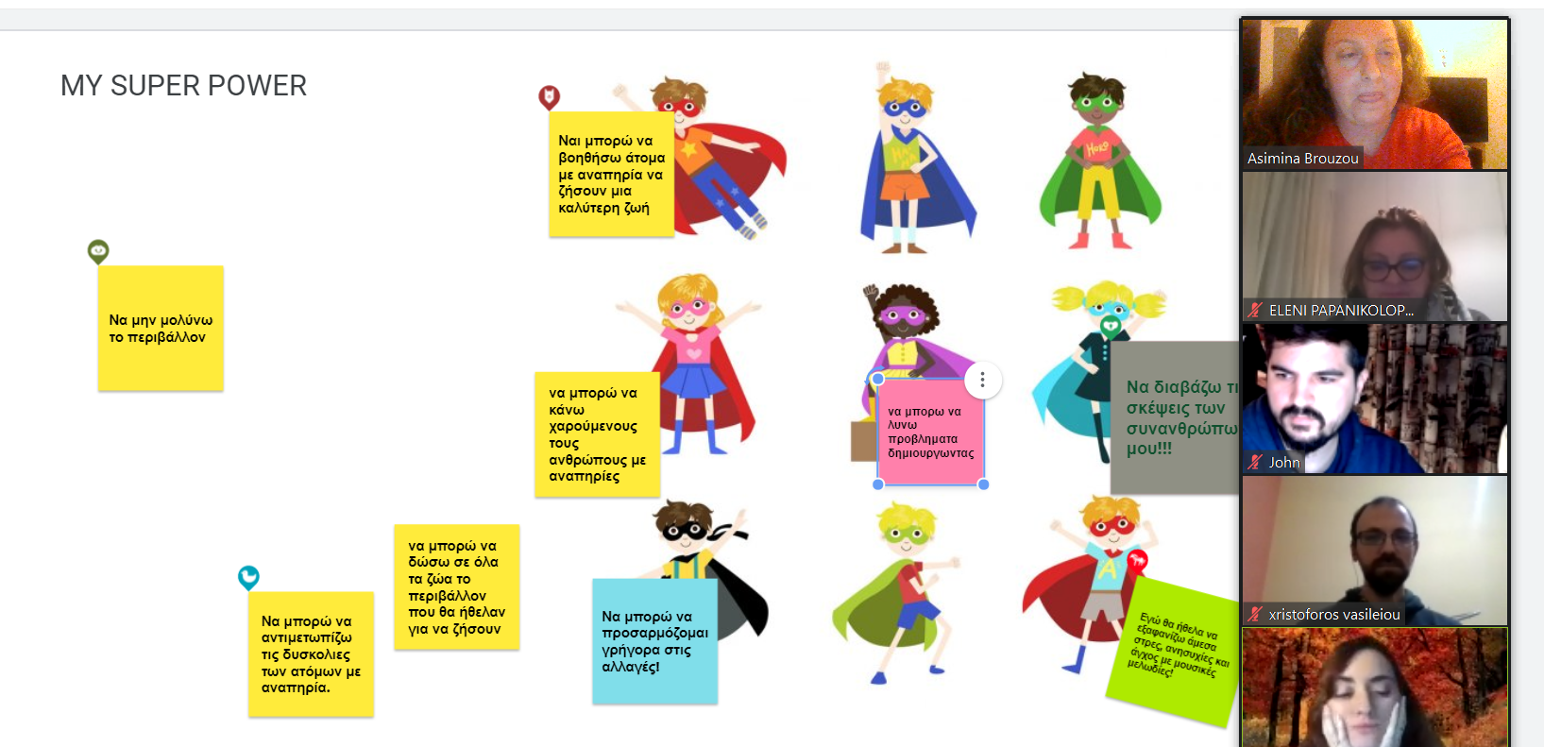
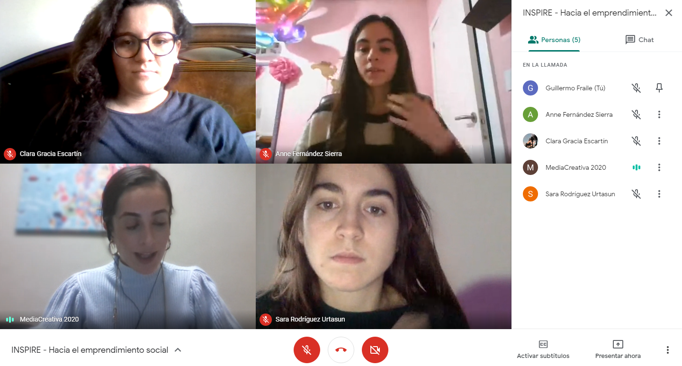
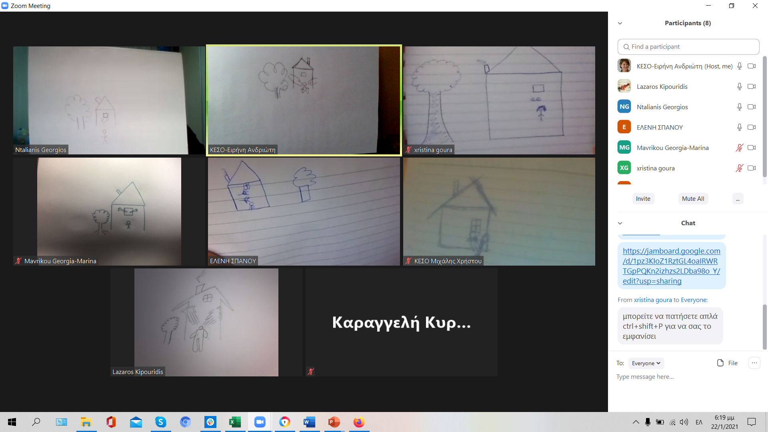
LOCAL
WORKSHOPS
2 Greece
Spain
Cyprus

Slide 19
INSPIRE
2019-3-EL02-KA205-005215
THANK YOU!!
This presentation is related to the Project made by the beneficiaries jointly or individually in any form and using any means shall indicate that it reflects only the authors view and the National Agency and the European Commision are not responsible for any use that may be made of the information it contains.

