Slide 1
INSPIRE
INnovative Serious Play for Identifying your Role in Social Entrepreneurship

Slide 2
Methodological Guide for Inspire project
It set the main framework of the project
It gave guidelines for the "O2-Learning training guide for career development and psychometric methods", "O3- Learning training guide for Viable business Models of Social enterprises addressing SDGs (Sustainable Development Goals) and for effective use of Social Media“
It set the framework for the innovative digital assessment tool "O4- INSPIRE game“
It directly addressed the needs of young people and youth trainers
It involved the experiences, approaches, tools and research of partners from 3 different countries
.

Slide 3
Content of the Methodological Guide Part 1
An overview of today’s situation of Social Entrepreneurship in partners’ countries (Greece, Cyprus and Spain)
A status of the Unemployment of Youth of the aforementioned partner countries
A definition of Entrepreneurship as a solution to improve employment, including an overview of the social start-ups in partner countries
The role of Sustainable development goals (SDGs) in Social Entrepreneurship (SE)
The most common types of social enterprises in the partner countries
The role of teams in start-ups
EU policies, programs and funding schemes prompting SE
Percentages of active social enterprises in partner countries
Social Start-ups (definition, statistics of social star-ups in partner countries)
Factors driving young people to social entrepreneurship and obstacles they might face

Slide 4
Unemployment of Youth Overview
In 2019 the youth unemployment rate in European countries was 15%. In several countries it rises to more than 30% (e.g Greece, Spain, Italy). Youth unemployment rate is almost double than the overall unemployment rate which is less than 7% in most EU countries.
*Each of the partners’ countries unemployment status is given in detail within the guide

Slide 5
Entrepreneurship as a solution to improve employment of youth
The European Framework considers entrepreneurship as a key competence, and a vital part in the current Rethinking Education Commission Communication. The Annual Growth Survey of 2013 emphasises the role of entrepreneurship as a tool to improve employability levels. Many European countries have effectively introduced strategies within their nation for entrepreneurship education or even introduced entrepreneurial learning as an obligatory subject of curricula
*Each of the partners’ countries unemployment status is given in detail within the guide

Slide 6
“Courage plus prudence yields enterprise.” (McCloskey, 2011, p.4)

Slide 7
Research has shown that although in previous years, experienced businesspersons were considered as more suitable to strengthen the economic growth, several characteristics of the younger generation makes them absolutely capable of contributing towards economic growth such as:
Acquaintance with new technologies
Young people can become good entepreneurs
Ease in accessing global labour markets
The flexibility of the younger minds to welcome change and embrace the progress
Younger entrepreneurs consider themselves as free agents who take their portable skills wherever they can do the most good (social entrepreneurship) or make the most profit
McCloskey, 2012

Slide 8
Social Entrepreneurship Definition
“Social Entrepreneurship has been identified as a powerful mechanism to confront poverty (Bloom, 2009; Ghauri et al., 2014), empower women (Datta & Gailey, 2012), catalyze social transformation (Alvord et al., 2004), foster inclusive growth in subsistence marketplaces (Ansari, Munir & Gregg, 2012; Azmat et al., 2015), and bring about institutional change (Nicholls, 2008). These are clearly quite different phenomena.” (as cited in (Saebi et al., 2019, p. 72).

Slide 9
Definition of Start-ups
Younger than 10 years.
Feature (highly) innovative technologies and/ or business models.
Have (strive for) significant employee and/or sales growth

Slide 10
TYPES OF SOCIAL ENTERPRISES
Associations, Foundations
Cooperatives
Non-profit organizations
Social Services

Slide 11
Start-ups in Greece | Start-ups in Spain | Start-ups in Cyprus
2010 there were only 16 start-ups in Greece. This number was multiplied by ten in 2013. Each year it increases drastically. | The Spanish start-up ecosystem has been growing meaningfully throughout the last couple of years, reaching volumes of investment over one billion euros during 2018 (Mobile World Capital Barcelona, 2019) | Cyprus is considered as an ideal place when starting your enterprise. Cyprus is quickly becoming a centre for innovation, entrepreneurship and start-ups.
25% of start-ups have succeeded and have created new career opportunities, along with supportive companies such as incubators, accelerators, competitions and funds. It is estimated that the proportion between supportive initiatives and start-ups are ⅕ (Endeavor Greece, 2018) | Current trends in the Spanish start-up ecosystem point that the leading sectors for entrepreneurship are e-Commerce, mobile Apps, communication and PR and B2B businesses (Megias, 2017) | There are 172 start-ups in the whole island.
It is estimated that 92% of the start-ups are composed of 2-9 members (Foundation, 2019). |  | The majority of the start-ups in Cyprus are in IT and software development, more specifically consumer mobile, web applications, industrial technology, production and hardware
Start ups in partner countries

Slide 12
Sustainable Development Goals (SDGs) form a global agenda and are aiming towards a sustainable development of our societies.
They can be summarised in
17 main goals and 169 targets.
This Photo by Unknown Author is licensed under CC BY-SA

Slide 13
SDG’s and entrepreneurship
Regarding the entrepreneurship world, these goals will let pioneer enterprises to show in which way their business contributes in advancing sustainable development, both by lessening
negative impacts and
capitalize on positive impacts on people and hence the planet
(SDG Compass, The Guide for business action on the SDGs, 2015)

Slide 14
EU POLICIES, PROGRAMS AND/OR FUNDING SCHEMES AND NETWORKS THAT PROMOTE SOCIAL ENTREPRENEURSHIP
Action Plan
European Commission’s Entrepreneurship Action Plan adopted in 2013 for SME
Encourages people to become entrepreneurs and also make it easier for them to set up and grow their businesses
DELIVERABLES
European Social Fund (ESF)
Actively supporting the establishment of social enterprises as a source of jobs
For particular groups of people who are struggling to find work for a plethora of reasons
Euclid Network
European Network for Social Enterprises and Impact-Driven Leaders
(21 countries participating)
*Each country has its own policies which are analysed in the guide
O4

Slide 15
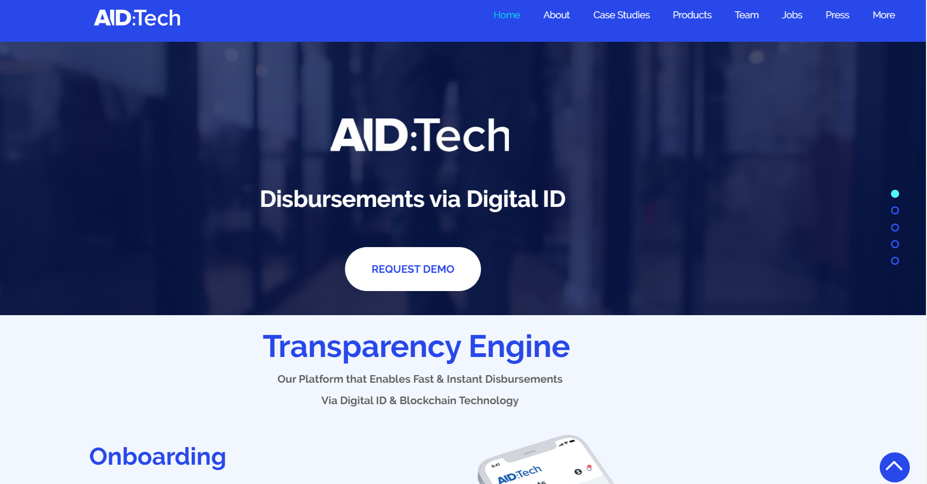
Significant examples of EU Social Startups

Slide 16
TEAMS OF START-UPS
Usually composed of 2-5 people

Slide 17
Factors driving young people to turn into the field of social entrepreneurship
Social entrepreneurship can contribute not only in the creation but also in sustaining vacancies.
Social entrepreneurship can advance young people’s skills, talents and capacities, it can also support their own personal and professional continuous development.
Ultimately, it can also enhance their efforts to be effective representatives of change.

Slide 18
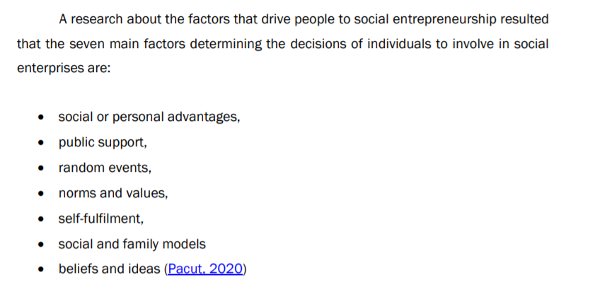
Factors driving young people to turn into the field of social entrepreneurship

Slide 19
OBSTACLES YOUNG PEOPLE MIGHT FACE IN STARTING THEIR ENTERPRISE
Funding support
Legislation system
Lack of experience (especially in management and forming the right team)
Lack of specialised support
Bureaucracy

Slide 20
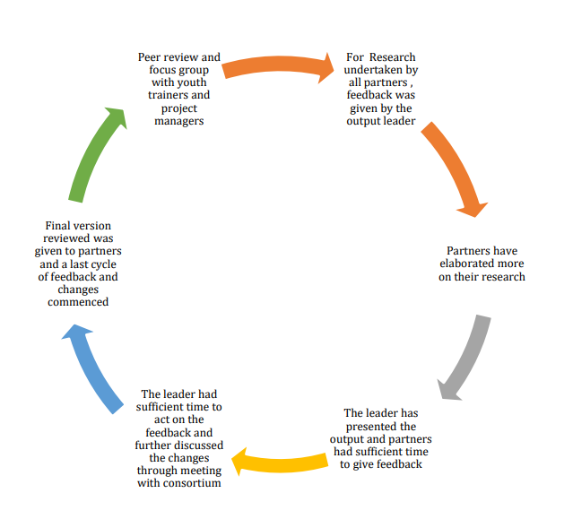
Content of the Methodological Guide Part 2
Methodology undertaken for all a outputs
Output type and expected results –
Output description
Specifications

Slide 21
INSPIRE
2019-3-EL02-KA205-005215
THANK YOU!!
This presentation is related to the Project made by the beneficiaries jointly or individually in any form and using any means shall indicate that it reflects only the authors view and tha the National Agency and the European Commision are not responsible for any use that may be made of the information it contains.

