Slide 1
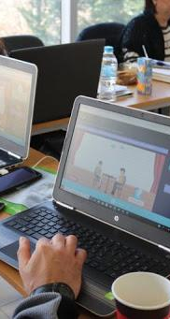

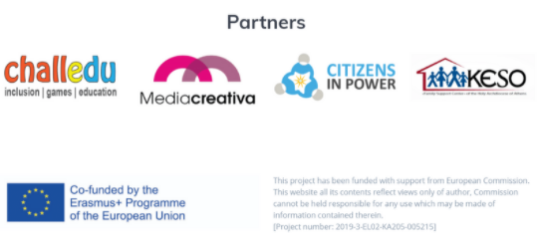
INSPIRE
INnovative Serious Play for Identifying your Role in Social Entrepreneurship

Slide 2

Information about Social Entrepreneurship for individuals from a disadvantaged background
Initiatives, actions and measures taken by the EU to support this group
ISPIRE’S Psychometric Serious Game role
Contents:

Slide 3
So…. can anyone become a Social Entrepreneur?
If you can find a way to turn problems into opportunities and find solutions
If you are dedicated to the cause
If you are aware of your skills, your competencies and abilities
If you can enjoy challenges and like to work for a greater good
THEN THE ANSWER IS YES!

Slide 4
There are no prerequisites to becoming an entrepreneur.
There are ways for everyone to have access to entrepreneurship.
Apart from providing an occupation, social entrepreneurship can help marginalized and disadvantaged groups to gain self-confidence, status and well-being.
But what about people that are vulnerable or/and from disadvantaged backgrounds?

Slide 5
“Social entrepreneurs identify resources where people only see problems...”
– David Bornstein, Author

Slide 6

Groups and people of higher risk of poverty, social exclusion, discrimination and violence than the general population
They can be, but not limited to:
Immigrants
Minorities
People with disabilities
NEETs (Not in Education,
Employment, or Training)
Women
People living in poverty
Who is considered disadvantaged/
vulnerable?
https://pixabay.com/illustrations/group-person-inclusion-wheelchair-418449/

Slide 7

What are some problems that these individuals/groups face?
Unemployment
Low Wages
Inadequate access to education, healthcare and the labour market
Housing instability
Lack of opportunities
Social exclusion
https://unsplash.com/photos/QozzJpFZ2lg

Slide 8
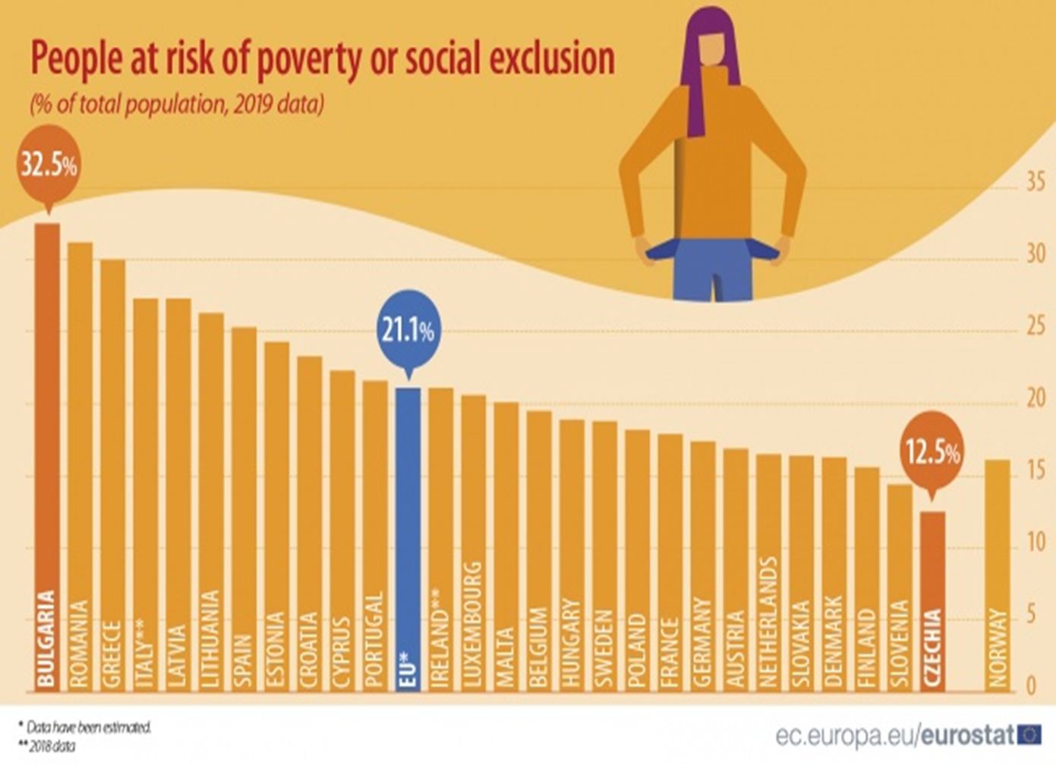

Slide 9
Apart from the obvious, which is being benefitted by actions and initiatives taken by Social Enterprises that address the problems they face, they can start a Social Enterprise of their own or be a part of one.
Therefore, we are talking about entrepreneurship by the disadvantaged and not for them.
The social economy in Europe today employs more than 14.5 million people, or 6.5% of the active population.
There are many opportunities promoting Social Entrepreneurship within Europe for people from disadvantaged backgrounds.
How can these individuals be benefitted from Social Entrepreneurship?

Slide 10
The access to business opportunities and business ownership is unequal
Key resources such as financing and human capital are usually limited for them
There is unfamiliarity with the culture of the host countries, discrimination and language barriers (e.g. immigrants)
There is a lack of network
Skills and applicable work experience might be deficient
For some groups the societal expectations can impact their motivation and engagement in the business sector (e.g. women)
What are the main problems that individuals/groups face when it comes to starting their own Social Enterprise?

Slide 11
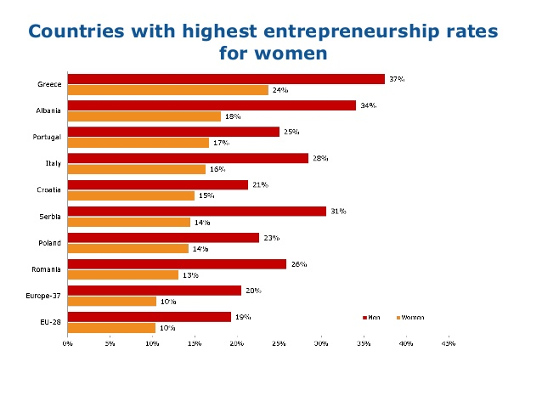
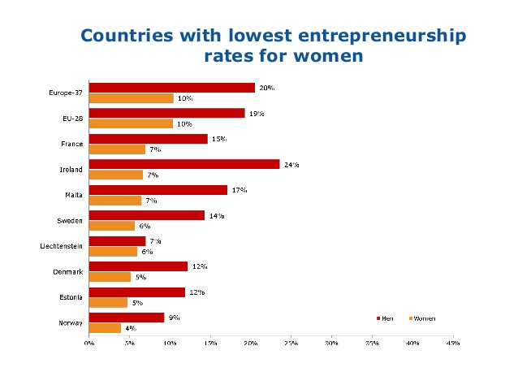

Slide 12
There is a need for a more inclusive entrepreneurship and there are actions taken towards this goal.
Supporting institutions and other entrepreneurial resources are emerging, offering opportunities and support to the less advantaged.
Diversity of entrepreneurship and entrepreneurs is valued and the EU is taking steps to reach this objective by investing in new ideas and being more business-friendly through its structures and plans.
Can people from vulnerable or/and from disadvantaged backgrounds be supported when it comes to starting their own Social Enterprise?

Slide 13
How can disadvantaged people be supported in their entrepreneurial endeavors?
Through local and European policies and tools such as funding to Social Enterprises, benefits (eg. reduced non salary costs), priority in outsourcing activities of Public sector and favorable tax regulations
Through prorammes, funding schemes and networks within the EE (e.g. European Social Fund, Euclid Network, EaSI etc.)
Through associations and foundations on local level for each country (e.g. Social Emprende in Spain, KALO in Greece etc.)

Slide 14
The project INSPIRE is committed to inspire and empower young and disadvantaged people to engage with Social Entrepreneurship and find their own companies
HOW | Through an innovative toolkit, which includes a Methodological Guide, a Learning Training Guide for career development and psychometric methods and a Learning Training Guide for viable Social Enterprises business models addressing challenges based on SDGs (Sustainable Development Goals) and for effective use of Social Medias
 | Through an Innovative Psychometric Serious Game

Slide 15
More specifically, the Psychometric Serious Game aims to help potential entrepreneurs to:
Identify the key role they can play in a team | Assess their skills and competencies
Participate in a social initiative addressing specific SDGs | Reflect upon themselves, their strong points, their personality and their role
Overcome existing challenges that young or/and old entrepreneurs face | Receive feedback and advice for the further development of their skills
Become more self-aware, visionary and INSPIRE(d)

Slide 16
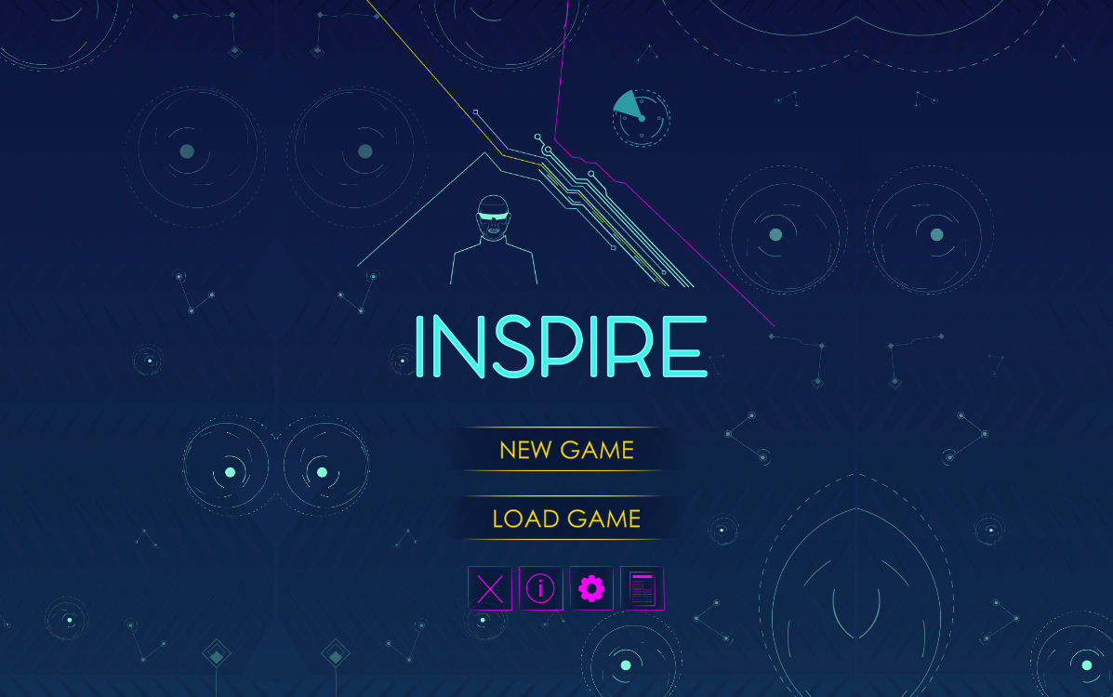

Slide 17
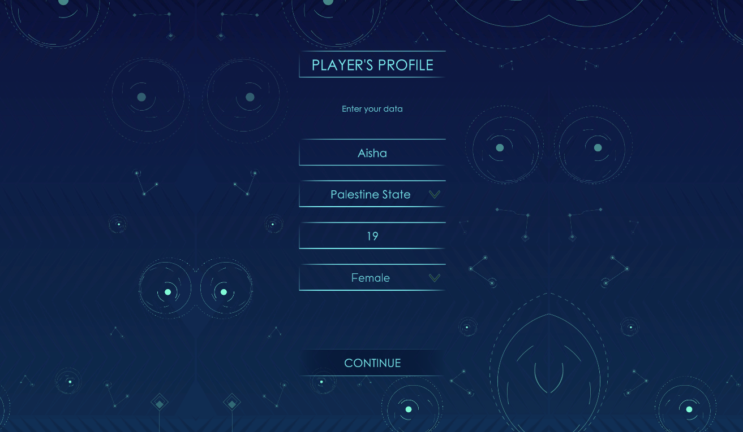

Slide 18
The game begins with an Introduction to the setting, the objective and the mission. So people are put into a fictional reality that simulated real situations.

Slide 19
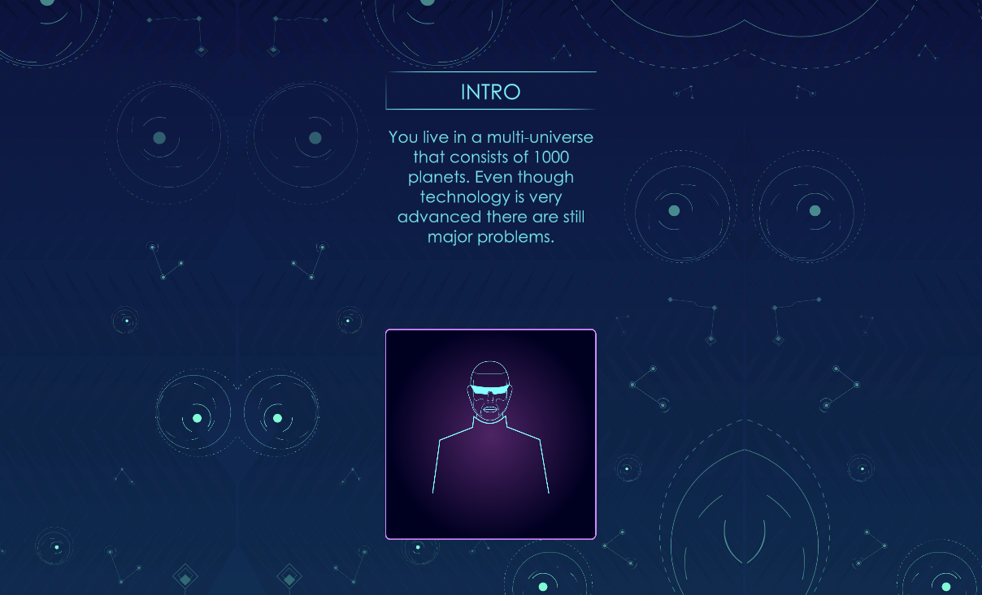

Slide 20
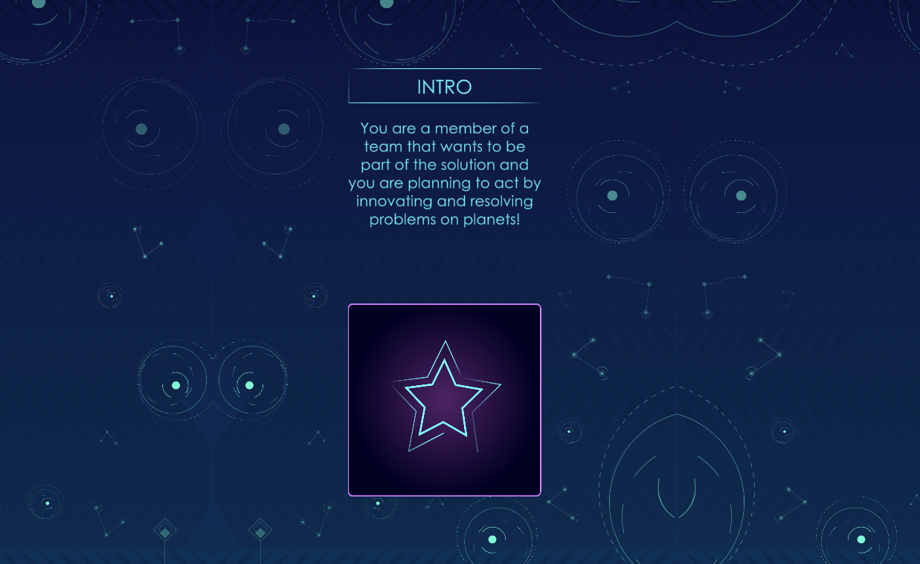

Slide 21
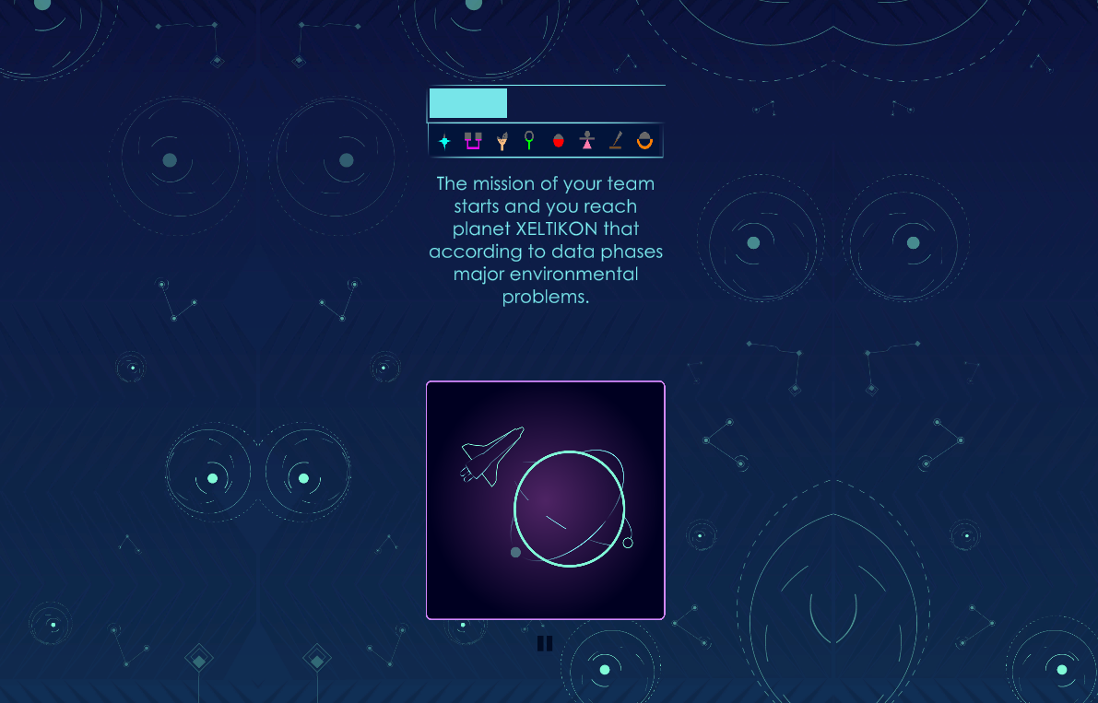

Slide 22
And then the game is ON! The player has to take important decisions regarding their Social Enterprise by swiping Left or Right. Those decisions are basically a self assessment of skills and personality. Thus a good starting point to see if you are SE material and what role you can play in a team!

Slide 23
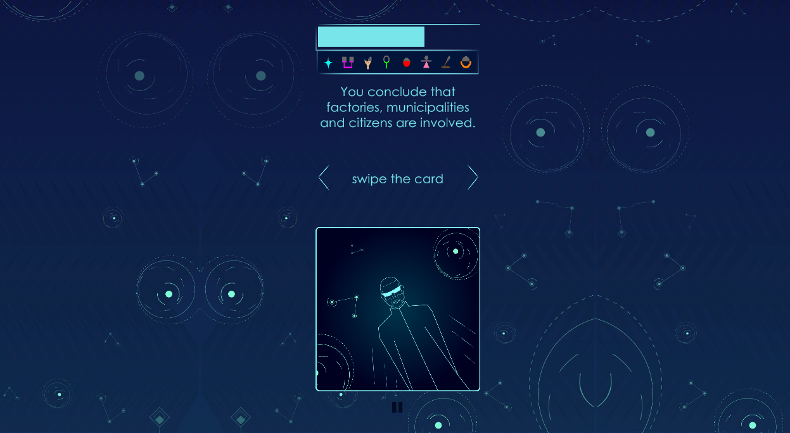

Slide 24
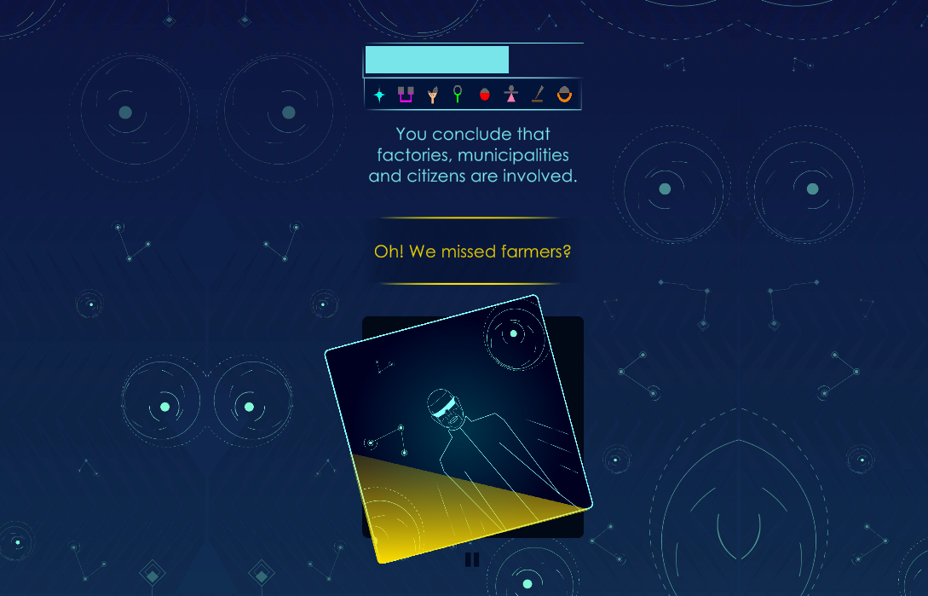

Slide 25
At the end of each level there is a business tool that will help the player advance his/her skills

Slide 26
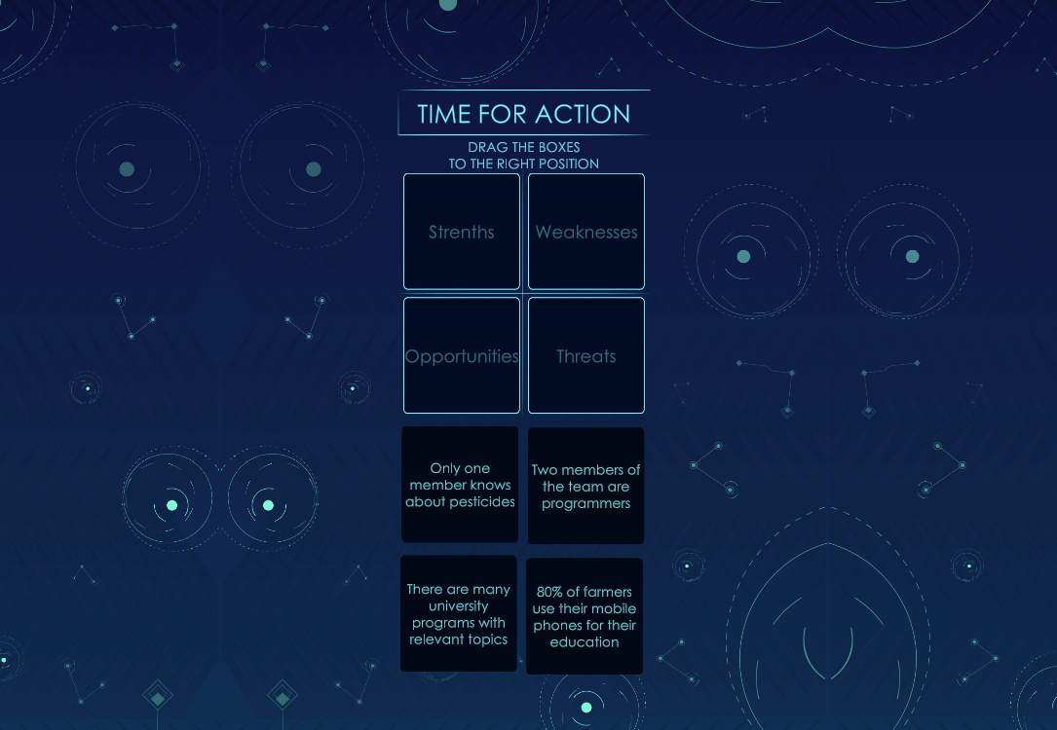

Slide 27
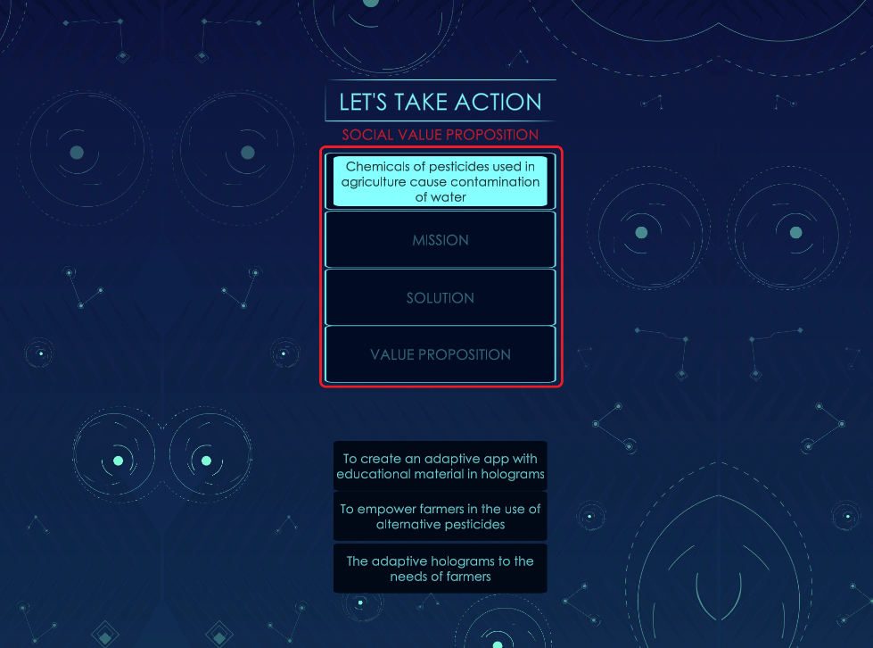

Slide 28
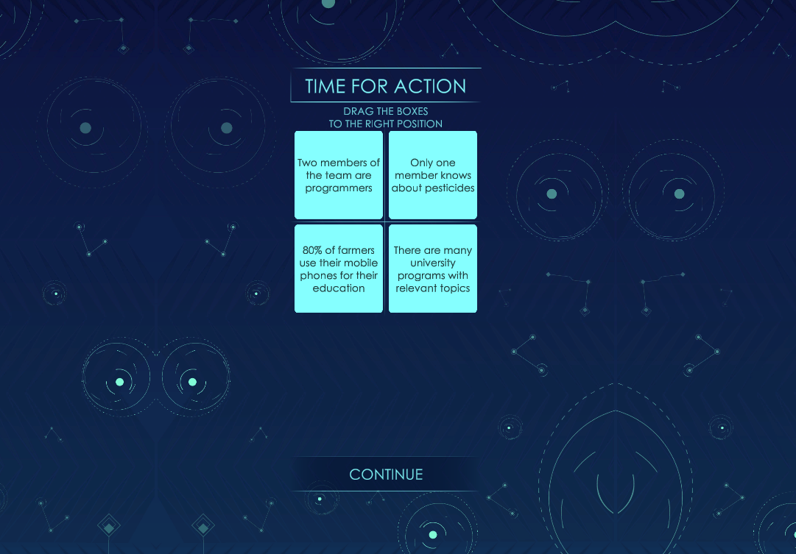

Slide 29
After completing the Time for Action challenges, the player is introduced to some useful tips relevant to the section.

Slide 30
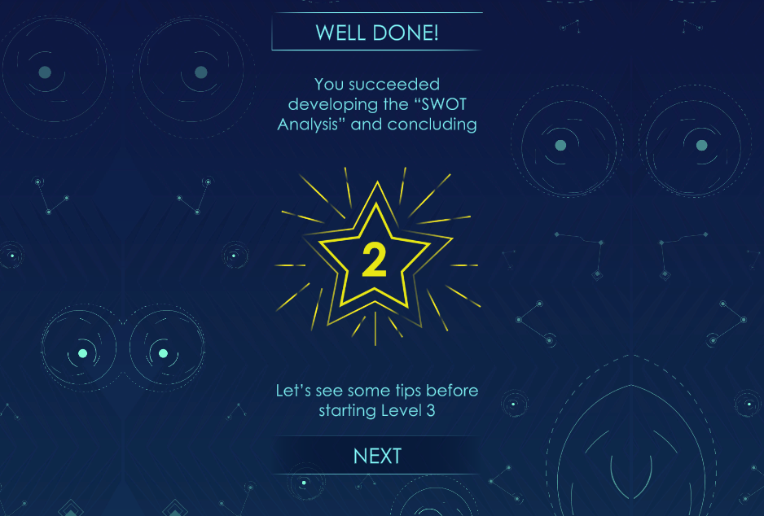

Slide 31
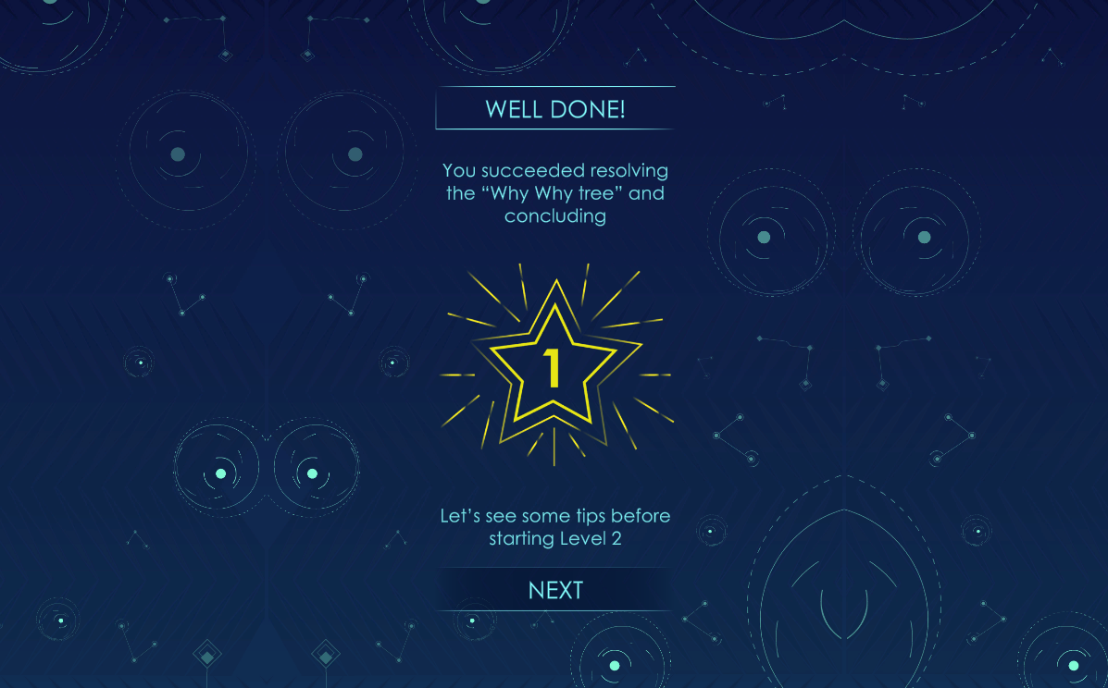

Slide 32
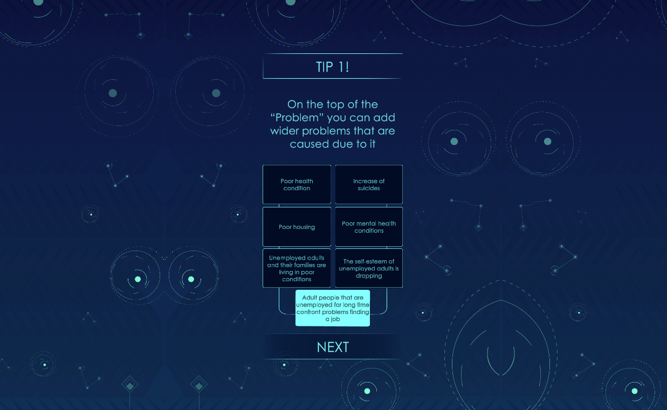

Slide 33
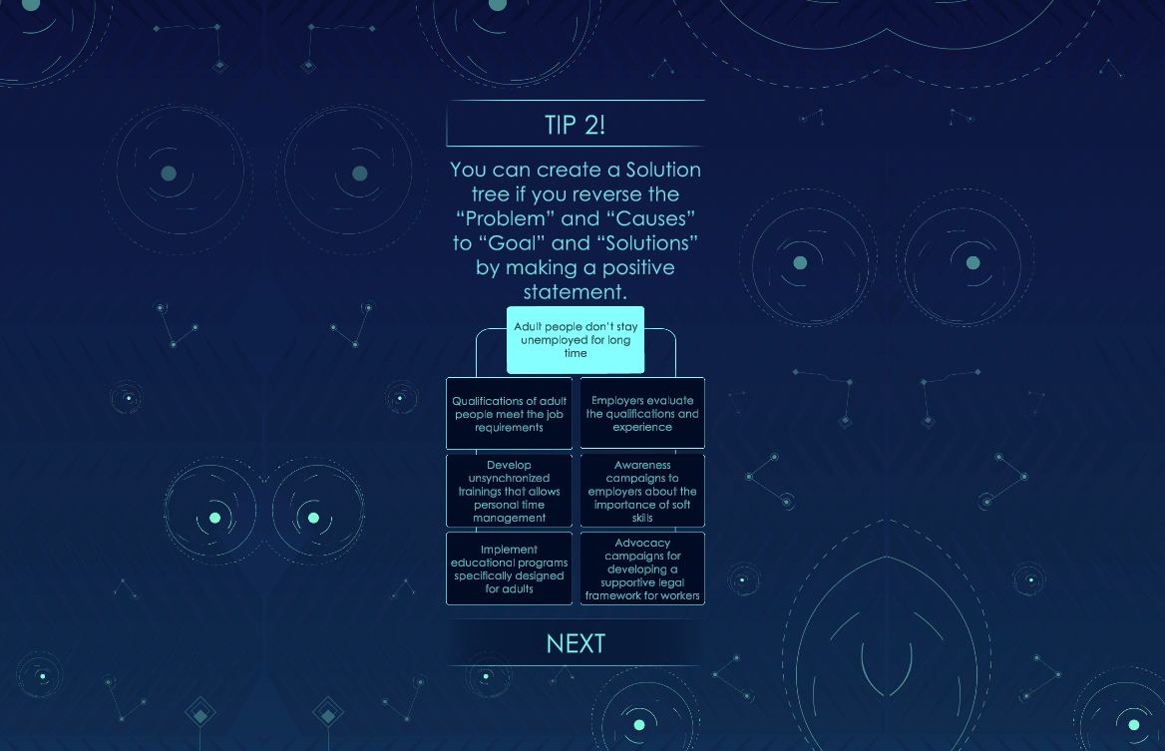

Slide 34
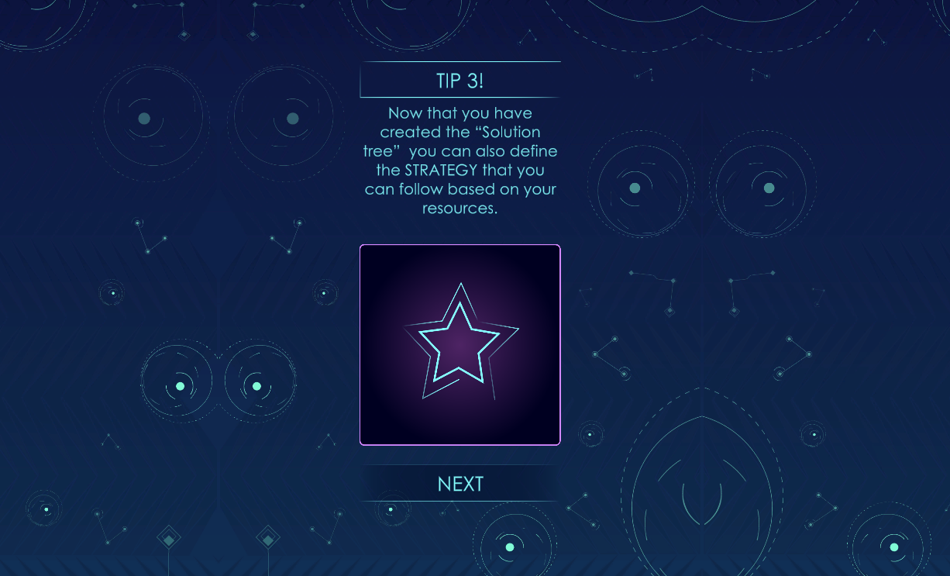

Slide 35
Through this highly engaging, educative and fun game the player will be able to:
Indicate their strengths, skills, abilities and competencies in the sector of Social Entrepreneurship as well as the role they can play in such a TEAM
Learn more about the potential challenges and possible solutions they might face in their endeavours
Explore several useful business tools leading to a more concrete business
Develop a more business-oriented mind and get INSPIRED to start their very own Social Enterprise

Slide 36
THANK YOU!!!
This presentation is related to the Project made by the beneficiaries jointly or individually in any form and using any means shall indicate that it reflects only the authors view and tha the National Agency and the European Commision are not responsible for any use that may be made of the information it contains.

